Slide 1

Finding Similar Items:
Locality Sensitive Hashing
Note to other teachers and users of these slides: We would be delighted if you found this our material useful in giving your own lectures. Feel free to use these slides verbatim, or to modify them to fit your own needs. If you make use of a significant portion of these slides in your own lecture, please include this message, or a link to our web site: http://www.mmds.org
Mining of Massive Datasets
Jure Leskovec, Anand Rajaraman, Jeff Ullman Stanford University
Modified by Yuzhen Ye (Fall 2023)

Slide 2
New thread: High dim. data
High dim. data
Locality sensitive hashing
Clustering
Graph
data
PageRank, SimRank
Network Analysis
Infinite
data
Filtering data streams
Web advertising
Dimensionality reduction
Spam Detection
Queries on streams
Machine learning
SVM
Decision Trees
Perceptron, kNN
Apps
Recommender systems
Association Rules
Duplicate document detection

Slide 3
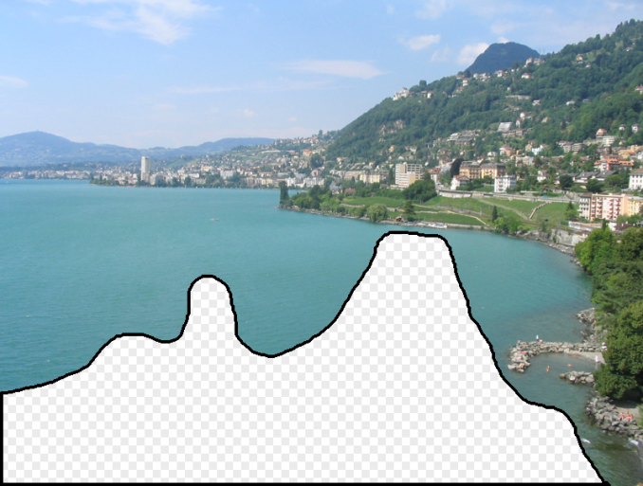

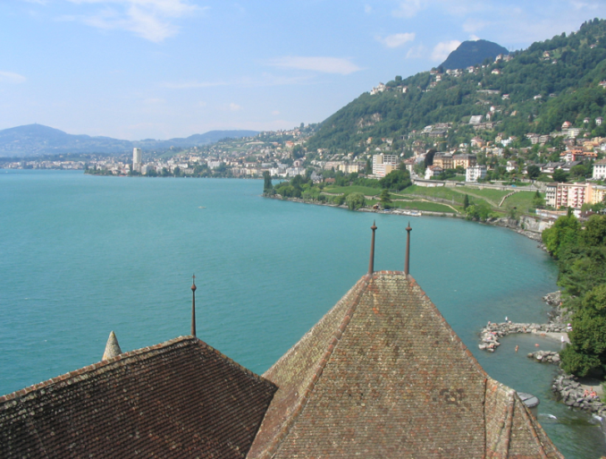
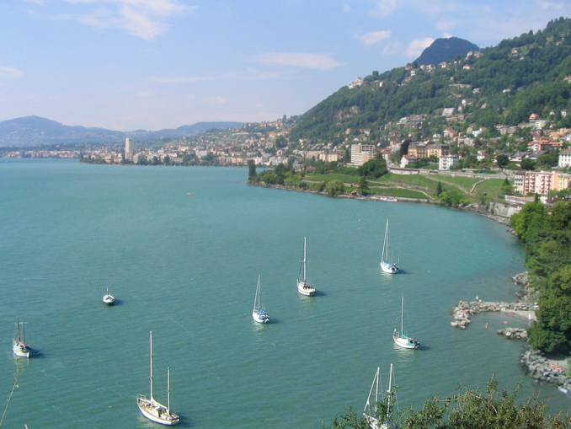
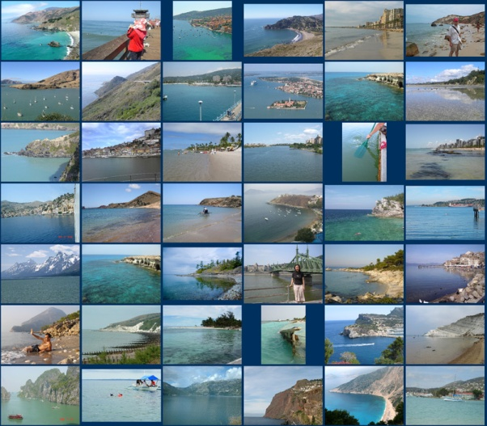
Scene Completion Problem
[Hays and Efros, SIGGRAPH 2007]

Slide 4

Scene Completion Problem
[Hays and Efros, SIGGRAPH 2007]
Notes:
10 nearest neighbors, 20,000 image database

Slide 5
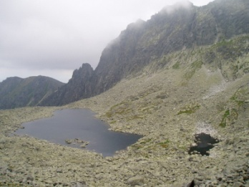
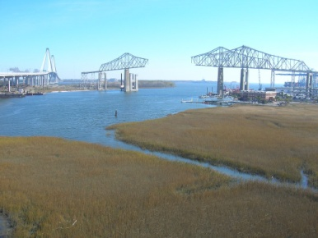
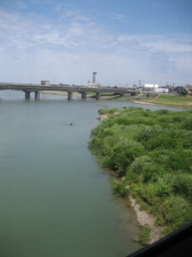
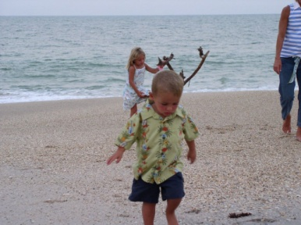
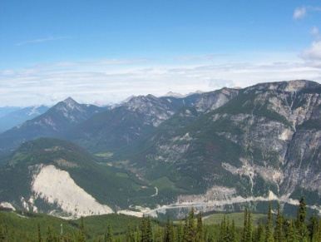
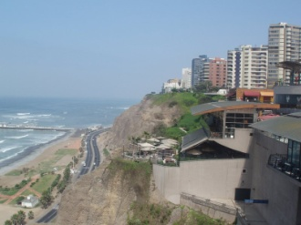
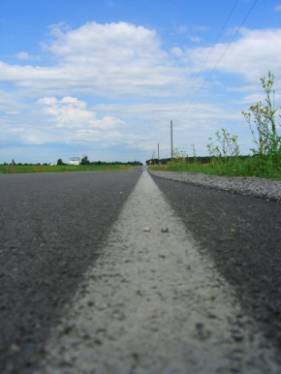
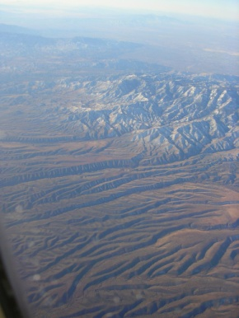
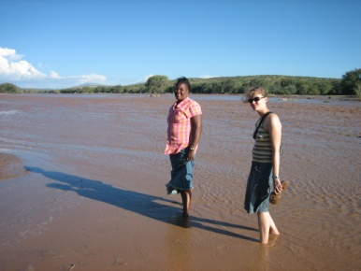

Scene Completion Problem
[Hays and Efros, SIGGRAPH 2007]
10 nearest neighbors from a collection of 20,000 images
Notes:
10 nearest neighbors, 20,000 image database

Slide 6
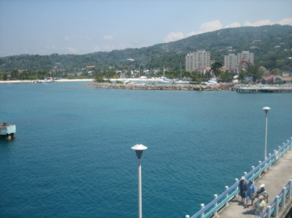
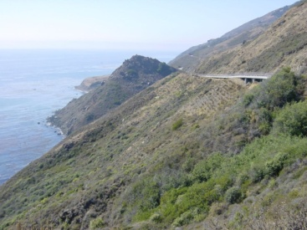
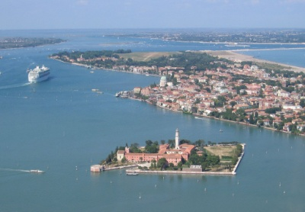
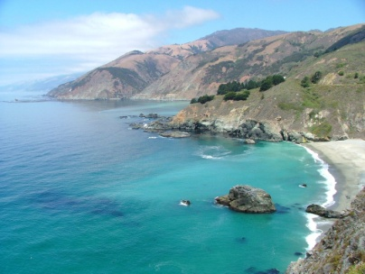

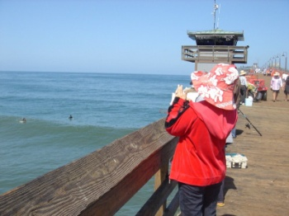
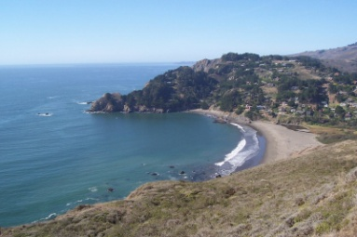
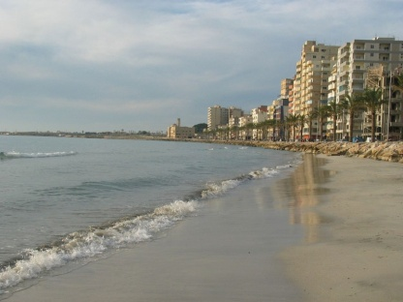

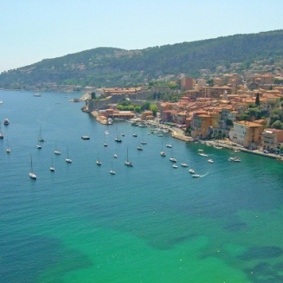
Scene Completion Problem
[Hays and Efros, SIGGRAPH 2007]
10 nearest neighbors from a collection of 2 million images
Notes:
10 nearest neighbors, 2.3 million image database

Slide 7
A Common Metaphor
Many problems can be expressed as
finding “similar” sets:
  Find near-neighbors in high-dimensional space
Examples:
  Pages with similar words
    For duplicate detection, classification by topic
  Customers who purchased similar products
    Products with similar customer sets
  Images with similar features
    Users who visited similar websites

Slide 8
Another Example in Bioinformatics
Here is a DNA sequence CTAGTAGACGA… (query)
And there is a database of m DNA sequences (assume the average length of the DNA sequences is n)
How can we find all sequences in the database that are similar to the query?
A naïve solution
  Assume we know how to quantify “two sequences are similar” (e.g., edit distance)
  Search the query against all the sequences in the database, one at a time
  What’s the time complexity of this naïve approach?

Slide 9
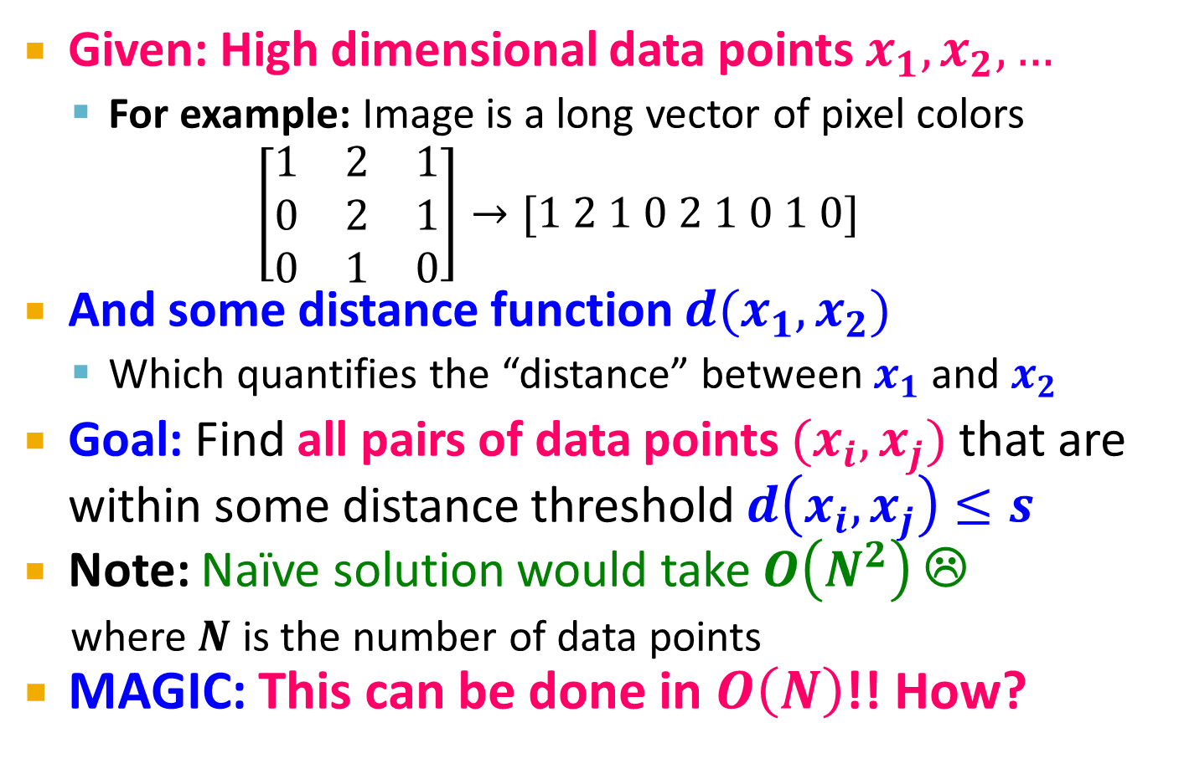
Finding Similar Items
Given: High dimensional data points $x_{1}, x_{2}, …$
  For example: Image is a long vector of pixel colors
  $$\left[\begin{matrix}1 & 2 & 1 \\ 0 & 2 & 1 \\ 0 & 1 & 0\end{matrix}\right]→[1 2 1 0 2 1 0 1 0]$$
And some distance function $d(x_{1},x_{2})$
  Which quantifies the “distance” between $x_{1}$ and $x_{2}$
Goal: Find all pairs of data points $(x_{i},x_{j})$ that are within some distance threshold $d\left(x_{i},x_{j}\right)≤s$
Note: Naïve solution would take $O\left(N^{2}\right)$ ☹
  where $N$ is the number of data points
MAGIC: This can be done in $O\left(N\right)$!! How?

Slide 10
Distance Measures
  Goal: Find near-neighbors in high-dim. space
  We formally define “near neighbors” as
  points that are a “small distance” apart
For each application, we first need to define what “distance” means
Example: Jaccard distance/similarity (for sets)
  The Jaccard similarity of two sets is the size of their intersection divided by the size of their union:
  sim(C₁, C₂) = |C₁∩C₂|/|C₁∪C₂|
  Jaccard distance: d(C₁, C₂) = 1 - |C₁∩C₂|/|C₁∪C₂|
3 in intersection
8 in union
Jaccard similarity= 3/8
Jaccard distance = 5/8

Slide 11
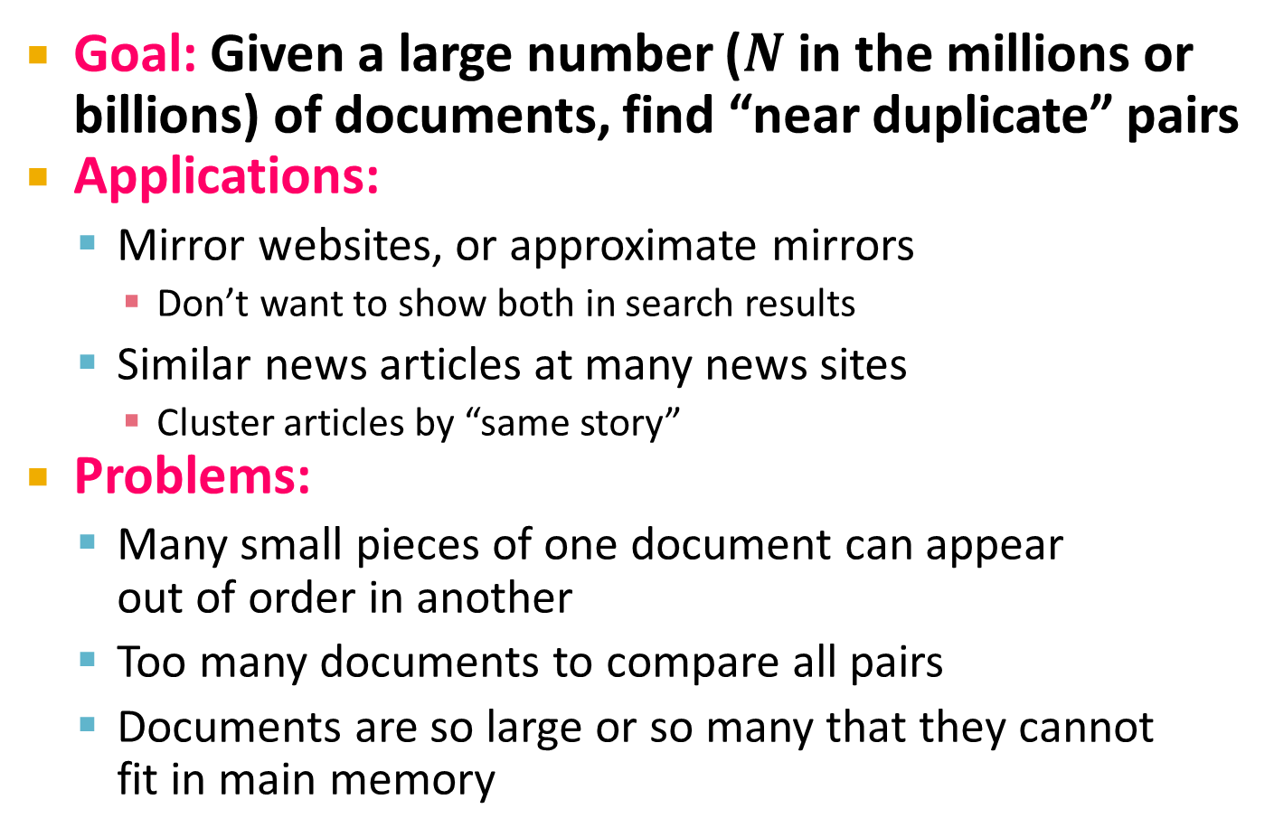
Task: Finding Similar Documents
Goal: Given a large number ($N$ in the millions or billions) of documents, find “near duplicate” pairs
Applications:
  Mirror websites, or approximate mirrors
    Don’t want to show both in search results
  Similar news articles at many news sites
    Cluster articles by “same story”
Problems:
  Many small pieces of one document can appear
  out of order in another
  Too many documents to compare all pairs
  Documents are so large or so many that they cannot
  fit in main memory

Slide 12
Essential Steps for Finding Similar Docs (Fast)
Shingling: Convert documents to sets
MinHashing: Convert large sets to short signatures, while preserving similarity
Locality-Sensitive Hashing (LSH): Focus on
pairs of signatures likely to be from
similar documents
  Candidate pairs!

Slide 13
The Big Picture
Candidate
pairs:
those pairs
of signatures
that we need
to test for
similarity
Shingling
Min
Hashing
Locality-
Sensitive
Hashing
Docu-
ment
The set
of strings
of length k
that appear
in the doc-
ument
Signatures:
short integer
vectors that
represent the
sets, and
reflect their
similarity

Slide 14
Shingling
Shingling
Docu-
ment
The set
of strings
of length k
that appear
in the doc-
ument
Step 1: Shingling: Convert documents to sets

Slide 15
Shingling: Definitions
A k-shingle (or k-gram) for a document is a sequence of k tokens that appears in the doc
  Tokens can be characters, words or something else, depending on the application
  Assume tokens = characters for examples
  (k-mer for DNA sequence)
Example: k=2; document D₁ = abcab
Set of 2-shingles: S(D₁) = {ab, bc, ca}
  Option: Shingles as a bag (multiset), count ab twice: S’(D₁) = {ab, bc, ca, ab}
Working assumptions
  Documents that have lots of shingles in common have similar text, even if the text appears in different order
  Caveat: You must pick k large enough, or most documents will have most shingles: k = 5 is OK for short documents; k = 10 is better for long documents

Slide 16
Shingling: Compressing Shingles
To compress long shingles, we can hash them to (say) 4 bytes
Represent a document by the set of hash values of its k-shingles
  Example: k=2; document D₁= abcab
  Set of 2-shingles: S(D₁) = {ab, bc, ca}
  Hash the singles: h(D₁) = {1, 5, 7}

Slide 17
Shingling: Similarity Metric for Shingles
Document D₁ is a set of its k-shingles C₁=S(D₁)
Equivalently, each document is a
0/1 vector in the space of k-shingles
  Each unique shingle is a dimension
  Vectors are very sparse
A natural similarity measure is the
Jaccard similarity:
sim(D₁, D₂) = |C₁∩C₂|/|C₁∪C₂|

Slide 18
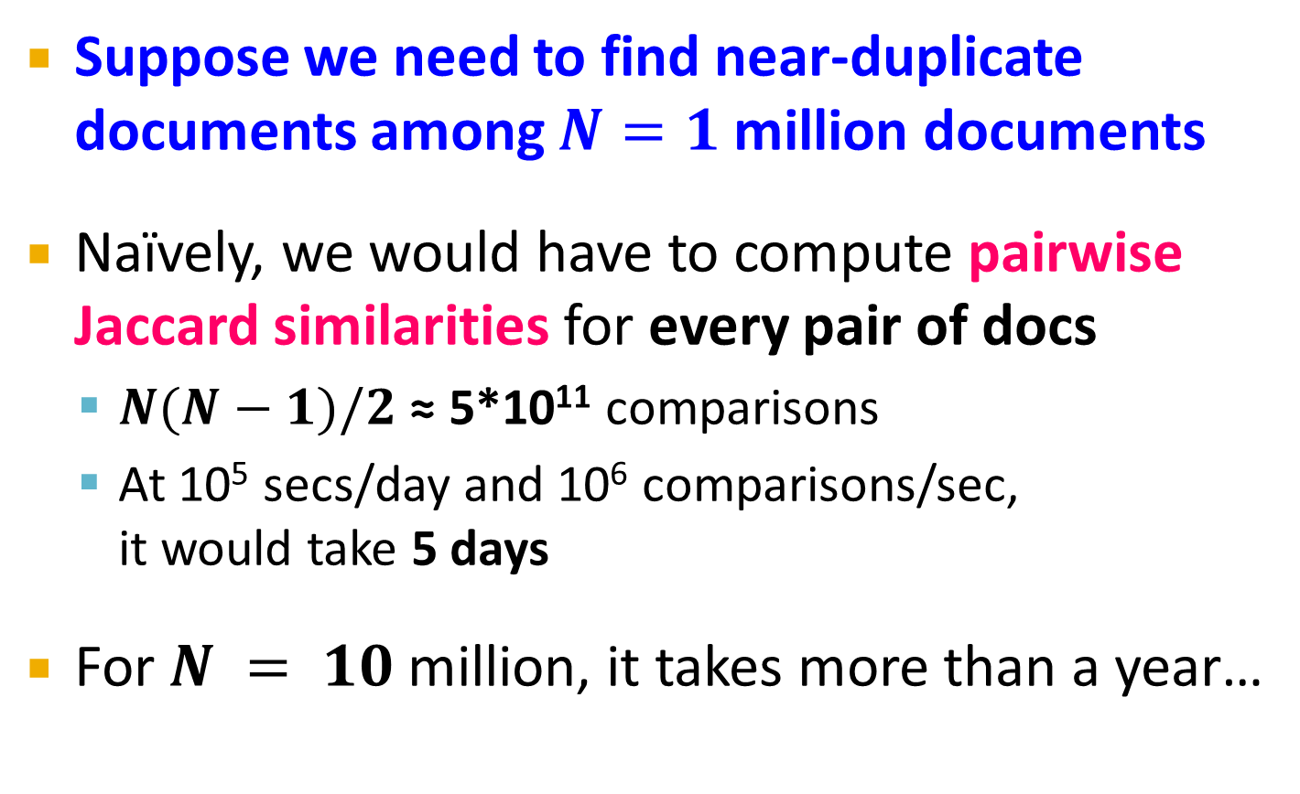
Motivation for MinHash/LSH
Suppose we need to find near-duplicate documents among $N=1$ million documents
Naïvely, we would have to compute pairwise
Jaccard similarities for every pair of docs
  $N(N−1)/2$ ≈ 5*10¹¹ comparisons
  At 10⁵ secs/day and 10⁶ comparisons/sec,
  it would take 5 days
For $N = 10$ million, it takes more than a year…

Slide 19
MinHashing
Shingling
MinHash-
ing
Docu-
ment
The set
of strings
of length k
that appear
in the doc-
ument
Signatures:
short integer
vectors that
represent the
sets, and
reflect their
similarity
Step 2: MinHashing: Convert large sets to short signatures, while preserving similarity

Slide 20
Encoding Sets as Bit Vectors
Many similarity problems can be
formalized as finding subsets that
have significant intersection
Encode sets using 0/1 (bit, boolean) vectors
  One dimension per element in the universal set
Interpret set intersection as bitwise AND, and
set union as bitwise OR
Example: C₁ = 10111; C₂ = 10011
  Size of intersection = 3; size of union = 4,
  Jaccard similarity (not distance) = 3/4
  Distance: d(C₁,C₂) = 1 – (Jaccard similarity) = 1/4

Slide 21
From Sets to Boolean Matrices
Rows = elements (shingles)
Columns = sets (documents)
  1 in row e and column s if and only if e is a member of s
  Column similarity is the Jaccard similarity of the corresponding sets (rows with value 1)
  Typical matrix is sparse!
Each document is a column:
  Example: sim(C₁ ,C₂) = ?
    Size of intersection = 3; size of union = 6,
    Jaccard similarity (not distance) = 3/6
    d(C₁,C₂) = 1 – (Jaccard similarity) = 3/6
Documents
1
1
1
0
1
1
0
1
0
1
0
1
0
0
0
1
Shingles
1
0
0
1
1
1
1
0
1
0
1
0

Slide 22
Compressing Columns
Key idea: “hash” each column C to a small signature h(C), such that:
  (1) h(C) is small enough that the signature fits in RAM
  (2) sim(C₁, C₂) is the same as the “similarity” of signatures h(C₁) and h(C₂)
Goal: Find a hash function h(·) such that:
  If sim(C₁,C₂) is high, then with high prob. h(C₁) = h(C₂)
  If sim(C₁,C₂) is low, then with high prob. h(C₁) ≠ h(C₂)

Slide 23
MinHashing
Goal: Find a hash function h(·) such that:
  if sim(C₁,C₂) is high, then with high prob. h(C₁) = h(C₂)
  if sim(C₁,C₂) is low, then with high prob. h(C₁) ≠ h(C₂)
Clearly, the hash function depends on
the similarity metric:
  Not all similarity metrics have a suitable
  hash function
There is a suitable hash function for
the Jaccard similarity: It is called MinHashing

Slide 24
MinHashing
Imagine the rows of the boolean matrix permuted under random permutation π
Define a “hash” function h_{π}(C) = the index of the first (in the permuted order π) row in which column C has value 1:
  h_{π} (C) = min_{π} π(C)
In practice, random permutation is prohibitive; a hash function is applied to achieve permutation
Use several (e.g., 100) independent hash functions (that is, permutations) to create a signature of a column

Slide 25
MinHashing Example
Input matrix ( 7 x 4)
(Shingles x Documents)
Signature matrix
(3 x 4)
Permutations
 | π1 | π2 | π3
1 | 2 | 4 | 3
2 | 3 | 2 | 4
3 | 7 | 1 | 7
4 | 6 | 3 | 2
5 | 1 | 6 | 6
6 | 5 | 7 | 1
7 | 4 | 5 | 5
 | d1 | d2 | d3 | d4
1 | 1 | 0 | 1 | 0
2 | 1 | 0 | 0 | 1
3 | 0 | 1 | 0 | 1
4 | 0 | 1 | 0 | 1
5 | 0 | 1 | 0 | 1
6 | 1 | 0 | 1 | 0
7 | 1 | 0 | 1 | 0
For d1, the rows (in permutated order π1) having value 1:
2, 3, 5, 4.
So, the first row is 2.
d1 | d2 | d3 | d4
π1
2 | 1 | 2 | 1
2 | 1 | 4 | 1
1 | 2 | 1 | 2
π2
π3
For d3, the rows (in permutated order π2) having value 1:
4, 7, 5.
So, the first row is 4.
For d4, the rows (in permutated order π3) having value 1:
4, 7, 2, 6
So, the first row is 2.
row 7 becomes row 4 in π1
Ye

Slide 26
The MinHash Property
0
0
0
0
1
1
Choose a random permutation π
Claim: Pr[h_{π}(C₁) = h_{π}(C₂)] = sim(C₁, C₂)
Why?
  Let X be a doc (set of shingles), y∈ X is a shingle
  Then: Pr[π(y) = min(π(X))] = 1/|X|
    It is equally likely that any y∈ X is mapped to the min element
  Let y be s.t. π(y) = min(π(C₁∪C₂))
  Then either: π(y) = min(π(C₁)) if y ∈ C₁ , or
  π(y) = min(π(C₂)) if y ∈ C₂
  So, the prob. that both are true is the prob. y ∈ C₁ ∩ C₂
  Pr[min(π(C₁))=min(π(C₂))]=|C₁∩C₂|/|C₁∪C₂|= sim(C₁, C₂)
0
0
0
1
1
0
One of the two
cols had to have
1 at position y
Notes:
Size of the universe of all possible vals of min(π(C₁∪C₂)) is |C₁∪C₂| and in |C₁∩C₂| of cases it can be that min(π(C₁))=min(π(C₂)) which exactly the jaccard between C1 and C2
For two columns A and B, we have h_π(A) = h_π(B) exactly when the minimum hash value of the union A ∪ B lies in the intersection A ∩ B. Thus Pr[h_π(A) = h_π(B)] = |A ∩ B| / |A ∪ B|.

Slide 27
Four Types of Rows
Given cols C₁ and C₂, rows may be classified as:
  C₁ C₂
  A 1 1
  B 1 0
  C 0 1
  D 0 0
  a = # rows of type A, etc.
Note: sim(C₁, C₂) = a/(a +b +c) [Jaccard Similarity]
Then: Pr[h(C₁) = h(C₂)] = Sim(C₁, C₂)
  Look down the cols C₁ and C₂ until we see a 1
  If it’s a type-A row, then h(C₁) = h(C₂)
  If a type-B or type-C row, then not

Slide 28
Similarity for Signatures
We know: Pr[h_{π}(C₁) = h_{π}(C₂)] = sim(C₁, C₂)
Now generalize to multiple hash functions
The similarity of two signatures is the fraction of the hash functions in which they agree
Note: Because of the MinHash property, the similarity of columns is the same as the expected similarity of their signatures
Notes:
Each agress with prob s.
So to estimate s we compute what fraction of hash functions agree

Slide 29
Similarity for Signatures
Original matrix
Signature matrix
 | d1 | d2 | d3 | d4
1 | 1 | 0 | 1 | 0
2 | 1 | 0 | 0 | 1
3 | 0 | 1 | 0 | 1
4 | 0 | 1 | 0 | 1
5 | 0 | 1 | 0 | 1
6 | 1 | 0 | 1 | 0
7 | 1 | 0 | 1 | 0
d1 | d2 | d3 | d4
2 | 1 | 2 | 1
2 | 1 | 4 | 1
1 | 2 | 1 | 2
 | d1-d2 | d2-d3 | d2-d4 | d1-d3
Original (Jaccard) | 0 | 0 | 0.75 | 0.75
Signature | 0 | 0 | 1 | 0.67
7x4 -> 3x4 (compression achieved!)
Ye

Slide 30
Using row hashing instead of permutation
Input matrix ( 7 x 4)
(Shingles x Documents)
Signature matrix
(3 x 4)
Permutations
 | π1 | π2 | π3
1 | 2 | 4 | 3
2 | 3 | 2 | 4
3 | 7 | 1 | 7
4 | 6 | 3 | 2
5 | 1 | 6 | 6
6 | 5 | 7 | 1
7 | 4 | 5 | 5
 | d1 | d2 | d3 | d4
1 | 1 | 0 | 1 | 0
2 | 1 | 0 | 0 | 1
3 | 0 | 1 | 0 | 1
4 | 0 | 1 | 0 | 1
5 | 0 | 1 | 0 | 1
6 | 1 | 0 | 1 | 0
7 | 1 | 0 | 1 | 0
For d1, the rows (in permutated order π1) having value 1:
2, 3, 5, 4.
So the first row is 2.
d1 | d2 | d3 | d4
π1
2 | 1 | 2 | 1
2 | 1 | 4 | 1
1 | 2 | 1 | 2
π2
π3
Hashing rows:
{h₁(1)=2, h₁(2)=3, h₁(3)=7, h₄(4)=6, h₁(5)=1, h₁(6)=5, h₁(7)=4}
d1 | d2 | d3 | d4
h₁
2 | 1 | 2 | 1
2 | 1 | 4 | 1
1 | 2 | 1 | 2
The first signature of d1:
min{h₁(1), h₁(2), h₁(6), h₁(7)}
= min(2,3,5,4) = 2
h₂
h₃
How to pick a random hash function h(x)?
Universal hashing:
h_{a,b}(x)=((a·x+b) mod p) mod N
where:
a,b … random integers
p … prime number (p > N)

Slide 31
Locality Sensitive Hashing
Candidate
pairs:
those pairs
of signatures
that we need
to test for
similarity
Shingling
MinHash-
ing
Locality-
Sensitive
Hashing
Docu-
ment
The set
of strings
of length k
that appear
in the doc-
ument
Signatures:
short integer
vectors that
represent the
sets, and
reflect their
similarity
Step 3: Locality-Sensitive Hashing:
Focus on pairs of signatures likely to be from similar documents

Slide 32
LSH: First Cut
Goal: Find documents with Jaccard similarity at least s (for some similarity threshold, e.g., s=0.8)
LSH – General idea: Use a function f(x,y) that tells whether x and y is a candidate pair: a pair of elements whose similarity must be evaluated
For MinHash matrices:
  Hash columns of signature matrix M to many buckets
  Each pair of documents that hashes into the
  same bucket is a candidate pair

Slide 33
Candidates from Min-Hash
Pick a similarity threshold s (0 < s < 1)
Columns x and y of M are a candidate pair if their signatures agree on at least fraction s of their rows:
M (i, x) = M (i, y) for at least frac. s values of i
  We expect documents x and y to have the same (Jaccard) similarity as their signatures

Slide 34
LSH for MinHash
Big idea: Hash columns of
signature matrix M several times
Arrange that (only) similar columns are likely to hash to the same bucket, with high probability
Candidate pairs are those that hash to the same bucket

Slide 35
Partition M into b Bands
r rows
per band
b bands
One
signature
Signature matrix M

Slide 36
Partition M into Bands
Divide matrix M into b bands of r rows
For each band, hash its portion of each column to a hash table with k buckets
  Make k as large as possible
Candidate column pairs are those that hash to the same bucket for ≥ 1 band
Tune b and r to catch most similar pairs,
but few non-similar pairs

Slide 37
Hashing Bands
Buckets
Columns 2 and 6
are probably identical
(candidate pair)
Columns 6 and 7 are
surely different.
Matrix M
r rows
b bands

Slide 38
Simplifying Assumption
There are enough buckets that columns are unlikely to hash to the same bucket unless they are identical in a particular band
Hereafter, we assume that “same bucket” means “identical in that band”
Assumption needed only to simplify analysis, not for correctness of algorithm

Slide 39
Example of Bands
Assume the following case:
Suppose 100,000 columns of M (100k docs)
Signatures of 100 integers (rows)
Therefore, signatures take 40Mb
Choose b = 20 bands of r = 5 integers/band
Goal: Find pairs of documents that
are at least s = 0.8 similar

Slide 40
C₁, C₂ are 80% Similar
Find pairs of ≥ s=0.8 similarity, set b=20, r=5
Assume: sim(C₁, C₂) = 0.8
  Since sim(C₁, C₂) ≥ s, we want C₁, C₂ to be a candidate pair: We want them to hash to at least 1 common bucket (at least one band is identical)
Probability C₁, C₂ identical in one particular
band: (0.8)⁵ = 0.328
Probability C₁, C₂ are not similar in all of the 20 bands: (1-0.328)²⁰ = 0.00035
  i.e., about 1/3000th of the 80%-similar column pairs
  are false negatives (we miss them)
  We would find 99.965% pairs of truly similar documents

Slide 41
C₁, C₂ are 30% Similar
Find pairs of ≥ s=0.8 similarity, set b=20, r=5
Assume: sim(C₁, C₂) = 0.3
  Since sim(C₁, C₂) < s we want C₁, C₂ to hash to NO
  common buckets (all bands should be different)
Probability C₁, C₂ identical in one particular band: (0.3)⁵ = 0.00243
Probability C₁, C₂ identical in at least 1 of 20 bands: 1 - (1 - 0.00243)²⁰ = 0.0474
  In other words, approximately 4.74% pairs of docs with similarity 0.3% end up becoming candidate pairs
    They are false positives since we will have to examine them (they are candidate pairs) but then it will turn out their similarity is below threshold s

Slide 42
LSH Involves a Tradeoff
Pick:
  The number of MinHashes (rows of M)
  The number of bands b, and
  The number of rows r per band
to balance false positives/negatives
Example: If we had only 15 bands of 5 rows, the number of false positives would go down, but the number of false negatives would go up

Slide 43
Analysis of LSH – What We Want
Probability = 1 if t > s
Probability
of sharing
a bucket
No chance
if t < s
Similarity threshold s
Similarity t =sim(C₁, C₂) of two sets

Slide 44
What 1 Band of 1 Row Gives You
Probability
of sharing
a bucket
Remember:
Probability of
equal hash-values
= similarity
Similarity t =sim(C₁, C₂) of two sets

Slide 45
b bands, r rows/band
Columns C₁ and C₂ have similarity t
Pick any band (r rows)
  Prob. that all rows in band equal = t^{r}
  Prob. that some row in band unequal = 1 - t^{r}
Prob. that no band identical = (1 - t^{r})^{b}
Prob. that at least 1 band identical = 1 - (1 - t^{r})^{b}

Slide 46
What b Bands of r Rows Gives You
No bands
identical
At least
one band
identical
(
)^{b}
Probability
of sharing
a bucket
s ~ (1/b)^{1/r}
1 -
1 -
t ^{r}
All rows
of a band
are equal
Some row
of a band
unequal
Similarity t=sim(C₁, C₂) of two sets

Slide 47
Example: b = 20; r = 5
Similarity threshold s
Prob. that at least 1 band is identical:
s | 1-(1-s^{r})^{b}
.2 | .006
.3 | .047
.4 | .186
.5 | .470
.6 | .802
.7 | .975
.8 | .9996

Slide 48
Picking r and b: The S-curve
Picking r and b to get the best S-curve
  50 hash-functions (r=5, b=10)
Prob. sharing a bucket
Blue area: False Negative rate
Green area: False Positive rate
Similarity

Slide 49
LSH Summary
Tune M, b, r to get almost all pairs with similar signatures, but eliminate most pairs that do not have similar signatures
Check in main memory that candidate pairs really do have similar signatures
Optional: In another pass through data, check that the remaining candidate pairs really represent similar documents

Slide 50
Summary: 3 Steps
Shingling: Convert documents to sets
  We used hashing to assign each shingle an ID
MinHashing: Convert large sets to short signatures, while preserving similarity
  We used similarity preserving hashing to generate signatures with property Pr[h_{π}(C₁) = h_{π}(C₂)] = sim(C₁, C₂)
  We used hashing to get around generating random permutations
Locality-Sensitive Hashing: Focus on pairs of signatures likely to be from similar documents
  We used hashing to find candidate pairs of similarity ≥ s

Slide 51
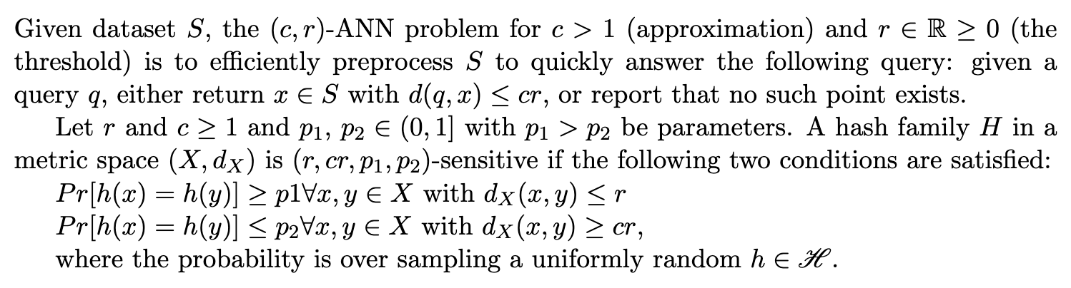
Approximation near neighbor search
ANNS: approximation near neighbor search

Slide 52

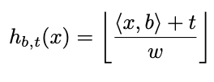

LSH for ANNS
Jaccard Similarity – MinHash
Cosine similarity – SimHash (Charikar, 2002)
  For unit vectors, their cosine similarity is a special case of Euclidean distance
  Hash vectors using hyperplanes (k – bucket size)
Euclidean distance – similar to SimHash
(best known LSH, Andoni and Indyk, 2006)

Slide 53
Google web crawler uses simhash
Ref: Detecting Near-Duplicates for Web Crawling (WWW 2007)
  a near-duplicate detection system for a multi-billion page repository
  Charikar’s simhash fingerprinting technique is appropriate
  simhash fingerprints of near-duplicates differ in a small number of bit positions
  for a repository of 8B webpages, 64-bit simhash fingerprints and k = 3 are reasonable; k is number of bits that differ, i.e., Hamming distance (if two fingerprints have at most 3 bits that differ, they are near duplicates).

Slide 54
More details about the simhash fingerprint
”Given a set of features extracted from a document and their corresponding weights, we use simhash to generate an f-bit fingerprint as follows. We maintain an f-dimensional vector V , each of whose dimensions is initialized to zero. A feature is hashed into an f-bit hash value. These f bits (unique to the feature) increment/decrement the f components of the vector by the weight of that feature as follows: if the i-th bit of the hash value is 1, the i-th component of V is incremented by the weight of that feature; if the i-th bit of the hash value is 0, the i-th component of V is decremented by the weight of that feature. When all features have been processed, some components of V are positive while others are negative. The signs of components determine the corresponding bits of the final fingerprint.”

