Slide 1
Data Mining: Similarity and Distance
Lecture Notes for Chapter 2
Introduction to Data Mining , 2nd Edition
by
Tan, Steinbach, Karpatne, Kumar
Modified by Yuzhen Ye (Fall 2023)

Slide 2
Similarity and Dissimilarity Measures
Similarity measure
  Numerical measure of how alike two data objects are.
  Is higher when objects are more alike.
  Often falls in the range [0,1]
Dissimilarity measure
  Numerical measure of how different two data objects are
  Lower when objects are more alike
  Minimum dissimilarity is often 0
  Upper limit varies
Proximity refers to a similarity or dissimilarity

Slide 3
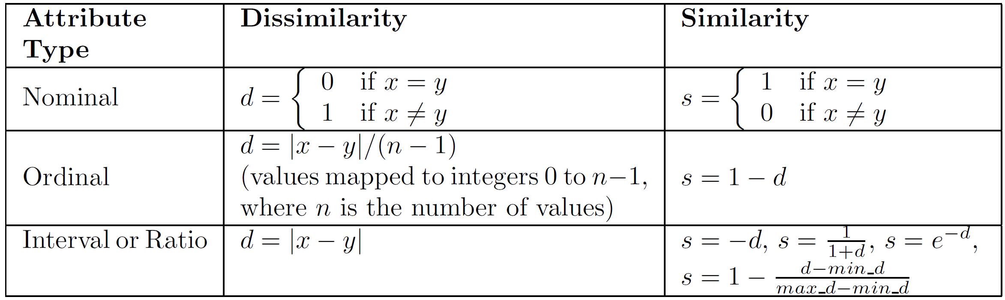
Similarity/Dissimilarity for Simple Attributes
The following table shows the similarity and dissimilarity between two objects, x and y, with respect to a single, simple attribute.

Slide 4
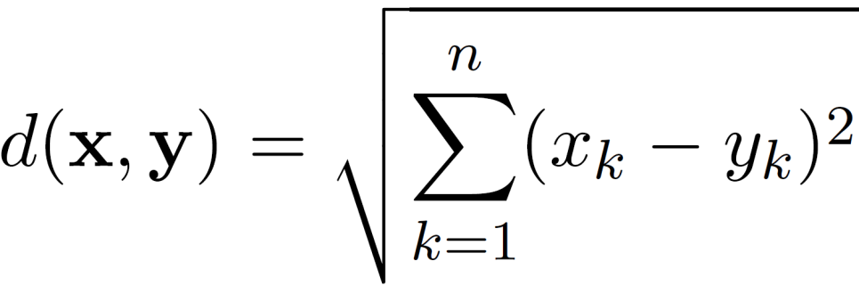
Euclidean Distance
Euclidean Distance
  where n is the number of dimensions (attributes) and x_{k} and y_{k} are, respectively, the k^{th} attributes (components) or data objects x and y.
Standardization is necessary, if scales differ.

Slide 5
Euclidean Distance
Distance Matrix

Slide 6
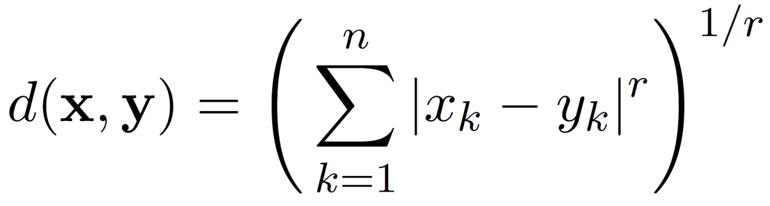
Minkowski Distance
Minkowski Distance is a generalization of Euclidean Distance
  Where r is a parameter, n is the number of dimensions (attributes) and x_{k} and y_{k} are, respectively, the k^{th} attributes (components) or data objects x and y.

Slide 7
Minkowski Distance: Examples
r = 1. City block (Manhattan, taxicab, L₁ norm) distance.
  A common example of this for binary vectors is the Hamming distance, which is just the number of bits that are different between two binary vectors
r = 2. Euclidean distance
r → ∞. “supremum” (L_{max} norm, L∞ norm) distance.
  This is the maximum difference between any component of the vectors
Do not confuse r with n, i.e., all these distances are defined for all numbers of dimensions.

Slide 8
Minkowski Distance
Distance Matrix

Slide 9
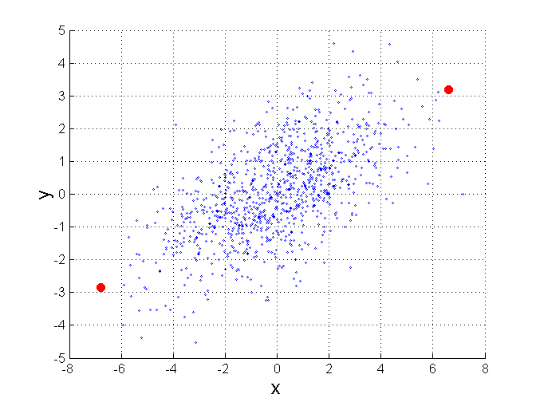
Mahalanobis Distance
$mahalanobis\left(x,y\right)={ ((x−y)}^{T}Ʃ^{−1}(x−y))$^{-0.5}
Σ is the covariance matrix
For red points, the Euclidean distance is 14.7, Mahalanobis distance is 6.

Slide 10
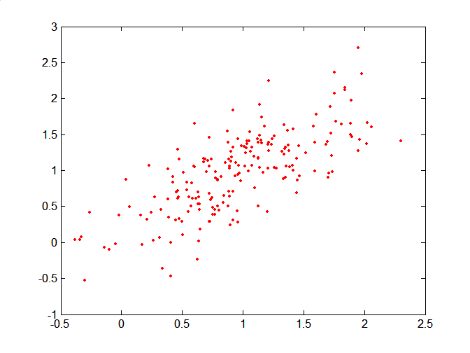
Mahalanobis Distance
Covariance Matrix:
C
B
A: (0.5, 0.5)
B: (0, 1)
C: (1.5, 1.5)
Mahal(A,B) = 5
Mahal(A,C) = 4
A

Slide 11
Common Properties of a Distance
Distances, such as the Euclidean distance, have some well known properties.
  d(x, y) ≥ 0 for all x and y and d(x, y) = 0 if and only if x = y.
  d(x, y) = d(y, x) for all x and y. (Symmetry)
  d(x, z) ≤ d(x, y) + d(y, z) for all points x, y, and z.
  (Triangle Inequality)
where d(x, y) is the distance (dissimilarity) between points (data objects), x and y.
A distance that satisfies these properties is a metric

Slide 12
Common Properties of a Similarity
Similarities, also have some well known properties.
  s(x, y) = 1 (or maximum similarity) only if x = y.
  (does not always hold, e.g., cosine)
  s(x, y) = s(y, x) for all x and y. (Symmetry)
where s(x, y) is the similarity between points (data objects), x and y.

Slide 13
Similarity Between Binary Vectors
Common situation is that objects, x and y, have only binary attributes
Compute similarities using the following quantities
f₀₁ = the number of attributes where x was 0 and y was 1
f₁₀ = the number of attributes where x was 1 and y was 0
f₀₀ = the number of attributes where x was 0 and y was 0
f₁₁ = the number of attributes where x was 1 and y was 1
Simple Matching and Jaccard Coefficients
SMC = number of matches / number of attributes
= (f₁₁ + f₀₀) / (f₀₁ + f₁₀ + f₁₁ + f₀₀)
J = number of 11 matches / number of non-zero attributes
= (f₁₁) / (f₀₁ + f₁₀ + f₁₁)

Slide 14
SMC versus Jaccard: Example
x = 1 0 0 0 0 0 0 0 0 0
y = 0 0 0 0 0 0 1 0 0 1
f₀₁ = 2 (the number of attributes where x was 0 and y was 1)
f₁₀ = 1 (the number of attributes where x was 1 and y was 0)
f₀₀ = 7 (the number of attributes where x was 0 and y was 0)
f₁₁ = 0 (the number of attributes where x was 1 and y was 1)
SMC = (f₁₁ + f₀₀) / (f₀₁ + f₁₀ + f₁₁ + f₀₀)
= (0+7) / (2+1+0+7) = 0.7
J = (f₁₁) / (f₀₁ + f₁₀ + f₁₁) = 0 / (2 + 1 + 0) = 0

Slide 15
Cosine Similarity
If d₁ and d₂ are two document vectors, then
cos( d₁, d₂ ) = <d₁,d₂> / ||d₁|| ||d₂|| ,
where <d₁,d₂> indicates inner product or vector dot product of vectors, d₁ and d_{2,} and || d || is the length of vector d.
Example:
d₁ = 3 2 0 5 0 0 0 2 0 0
d₂ = 1 0 0 0 0 0 0 1 0 2
<d₁, d2> = 3*1 + 2*0 + 0*0 + 5*0 + 0*0 + 0*0 + 0*0 + 2*1 + 0*0 + 0*2 = 5
| d₁ || = (3*3+2*2+0*0+5*5+0*0+0*0+0*0+2*2+0*0+0*0)^{0.5} = (42) ^{0.5} = 6.481
|| d₂ || = (1*1+0*0+0*0+0*0+0*0+0*0+0*0+1*1+0*0+2*2) ^{0.5} = (6) ^{0.5} = 2.449
cos(d₁, d₂ ) = 0.3150

Slide 16
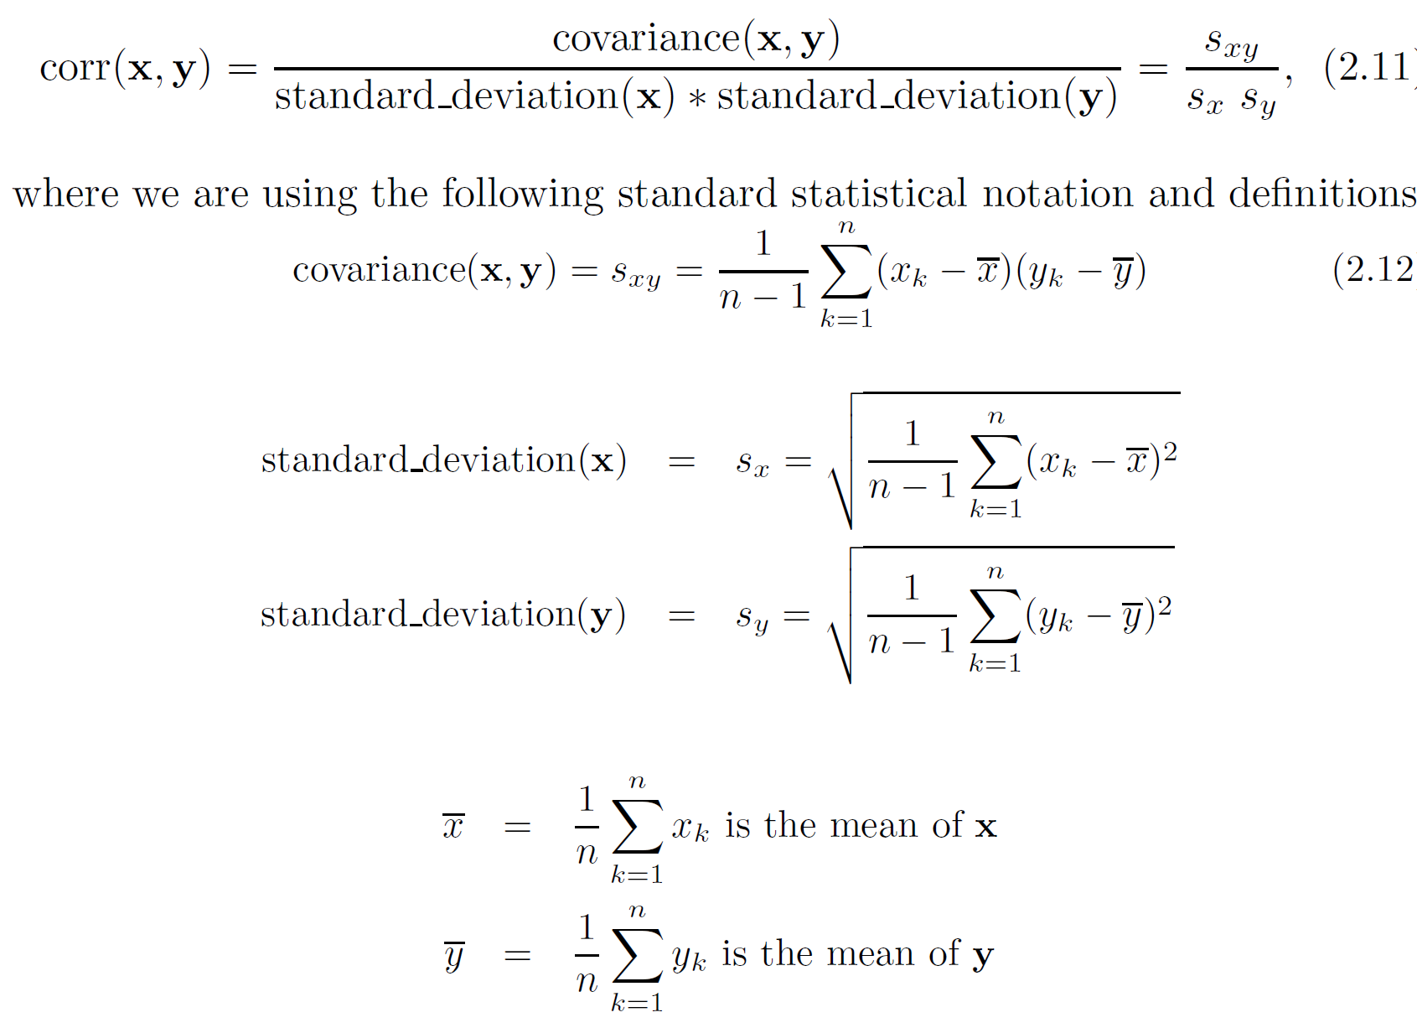
Correlation measures the linear relationship between objects

Slide 17
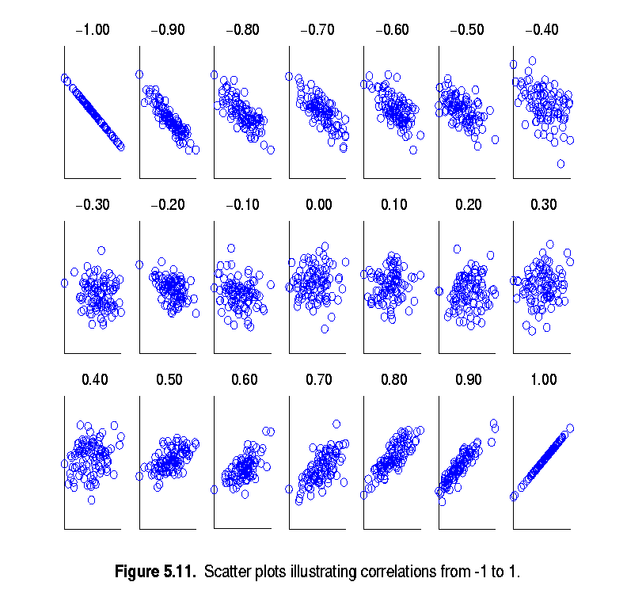
Visually Evaluating Correlation
Scatter plots showing the similarity from –1 to 1.

Slide 18
Drawback of Correlation
x = (-3, -2, -1, 0, 1, 2, 3)
y = (9, 4, 1, 0, 1, 4, 9)
y_{i} = x_{i}²
mean(x) = 0, mean(y) = 4
std(x) = 2.16, std(y) = 3.74
corr = (-3)(5)+(-2)(0)+(-1)(-3)+(0)(-4)+(1)(-3)+(2)(0)+3(5) / ( 6 * 2.16 * 3.74 )
= 0

Slide 19
Correlation vs Cosine vs Euclidean Distance
Compare the three proximity measures according to their behavior under variable transformation
  scaling: multiplication by a value
  translation: adding a constant
Consider the example
  x = (1, 2, 4, 3, 0, 0, 0), y = (1, 2, 3, 4, 0, 0, 0)
  y_{s} = y * 2 (scaled version of y), y_{t} = y + 5 (translated version)
Property | Cosine | Correlation | Euclidean Distance
Invariant to scaling (multiplication) | Yes | Yes | No
Invariant to translation (addition) | No | Yes | No
Measure | (x , y) | (x , y_{s}) | (x , y_{t})
Cosine | 0.9667 | 0.9667 | 0.7940
Correlation | 0.9429 | 0.9429 | 0.9429
Euclidean Distance | 1.4142 | 5.8310 | 14.2127

Slide 20
Correlation vs cosine vs Euclidean distance
Choice of the right proximity measure depends on the domain
What is the correct choice of proximity measure for the following situations?
  Comparing documents using the frequencies of words
    Documents are considered similar if the word frequencies are similar
  Comparing the temperature in Celsius of two locations
    Two locations are considered similar if the temperatures are similar in magnitude
  Comparing two time series of temperature measured in Celsius
    Two time series are considered similar if their “shape” is similar, i.e., they vary in the same way over time, achieving minimums and maximums at similar times, etc.

Slide 21
Comparison of Proximity Measures
Domain of application
  Similarity measures tend to be specific to the type of attribute and data
  Record data, images, graphs, sequences, 3D-protein structure, etc. tend to have different measures
However, one can talk about various properties that you would like a proximity measure to have
  Symmetry is a common one
  Tolerance to noise and outliers is another
  Ability to find more types of patterns?
  Many others possible
The measure must be applicable to the data and produce results that agree with domain knowledge

Slide 22
Information Based Measures
Information theory is a well-developed and fundamental disciple with broad applications
Some similarity measures are based on information theory
  Mutual information in various versions
  Maximal Information Coefficient (MIC) and related measures
  General and can handle non-linear relationships
  Can be complicated and time intensive to compute

Slide 23
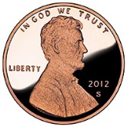

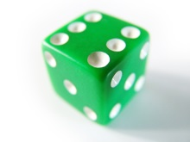
Information and Probability
Information relates to possible outcomes of an event
  transmission of a message, flip of a coin, or measurement of a piece of data
The more certain an outcome, the less information that it contains and vice-versa
  For example, if a coin has two heads, then an outcome of heads provides no information
  More quantitatively, the information is related the probability of an outcome
    The smaller the probability of an outcome, the more information it provides and vice-versa
  Entropy is the commonly used measure

Slide 24
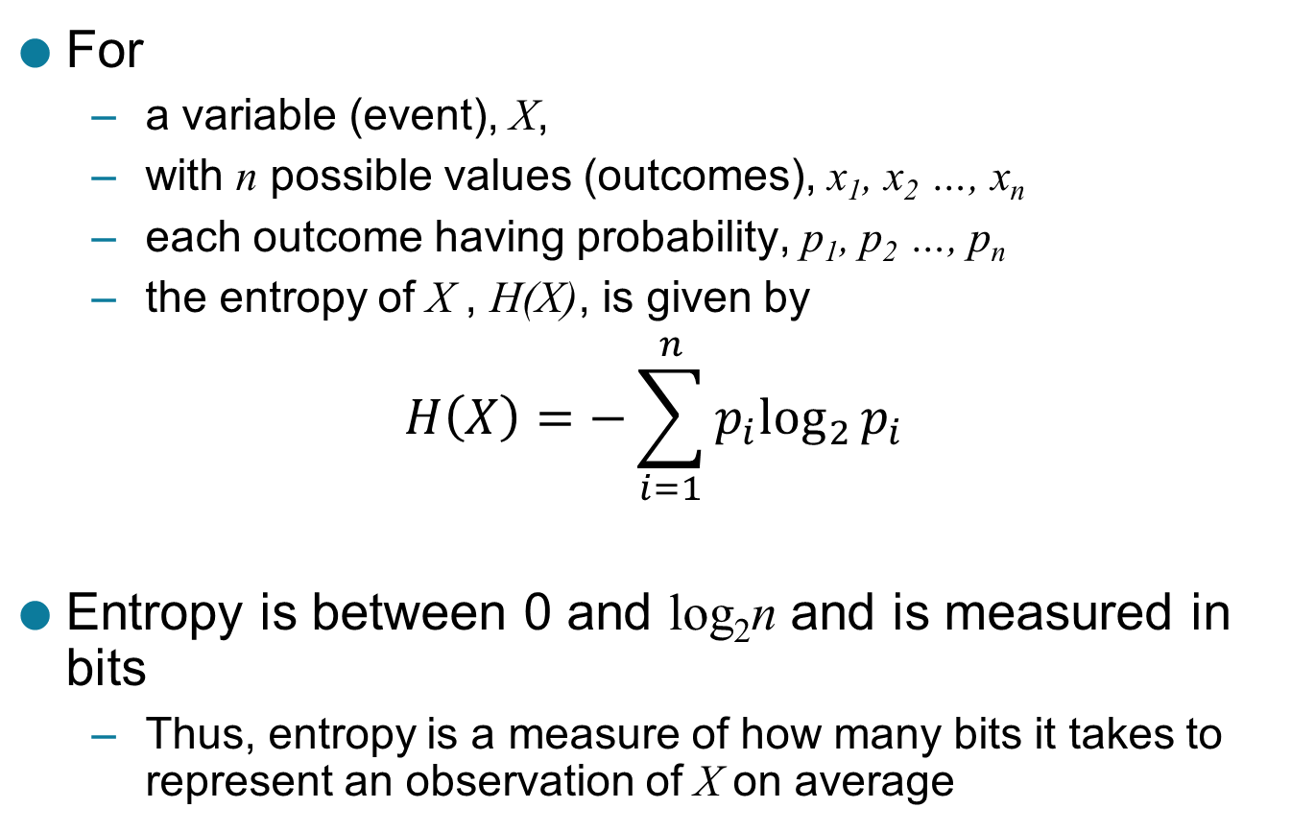
Entropy
For
  a variable (event), X,
  with n possible values (outcomes), x₁, x₂ …, x_{n}
  each outcome having probability, p₁, p₂ …, p_{n}
  the entropy of X , H(X), is given by
$$H\left(X\right)=−\sum_{i=1}^{n}{{p_{i}log}_{2}{p_{i}}}$$
Entropy is between 0 and log₂n and is measured in bits
  Thus, entropy is a measure of how many bits it takes to represent an observation of X on average

Slide 25
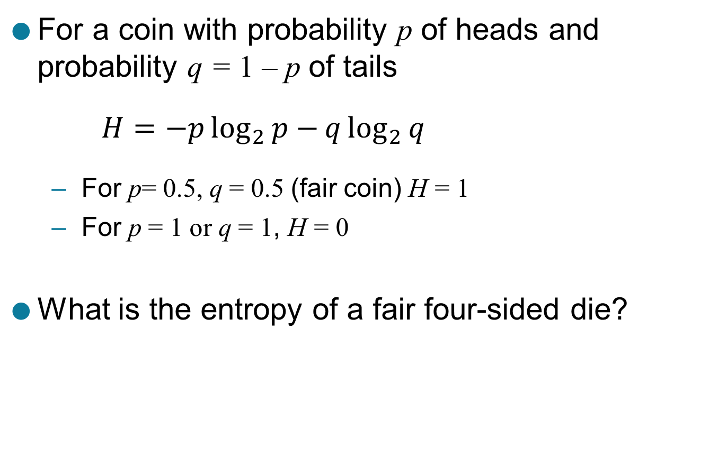
Entropy Examples
For a coin with probability p of heads and probability q = 1 – p of tails
$$H=−p\log_{2}{p−}q\log_{2}{q}$$
  For p= 0.5, q = 0.5 (fair coin) H = 1
  For p = 1 or q = 1, H = 0
What is the entropy of a fair four-sided die?

Slide 26
Entropy for Sample Data: Example
Maximum entropy is log₂5 = 2.3219
Hair Color | Count | p | -plog₂p
Black | 75 | 0.75 | 0.3113
Brown | 15 | 0.15 | 0.4105
Blond | 5 | 0.05 | 0.2161
Red | 0 | 0.00 | 0
Other | 5 | 0.05 | 0.2161
Total | 100 | 1.0 | 1.1540

Slide 27
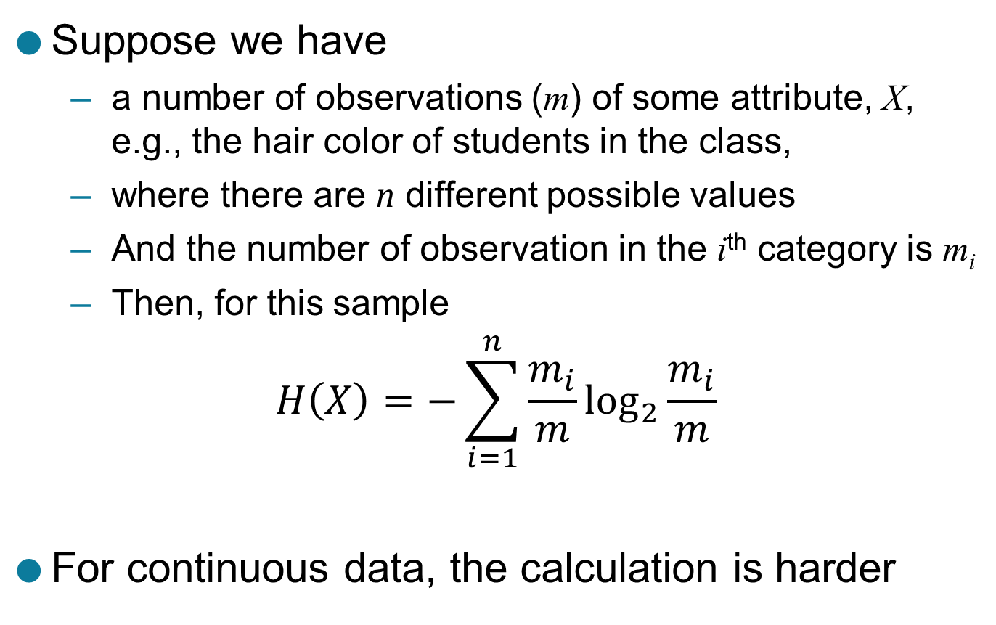
Entropy for Sample Data
Suppose we have
  a number of observations (m) of some attribute, X, e.g., the hair color of students in the class,
  where there are n different possible values
  And the number of observation in the i^{th} category is m_{i}
  Then, for this sample
$$H\left(X\right)=−\sum_{i=1}^{n}{{\frac{m_{i}}{m}log}_{2}{\frac{m_{i}}{m}}}$$
For continuous data, the calculation is harder

Slide 28
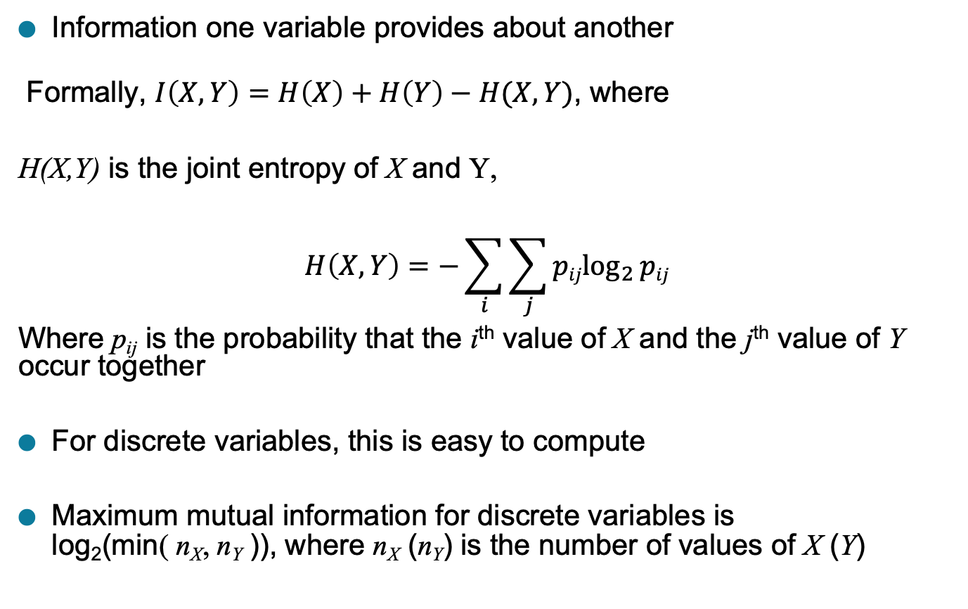
Mutual Information
Information one variable provides about another
Formally, $I\left(X,Y\right)=H\left(X\right)+H\left(Y\right)−H(X,Y)$, where
H(X,Y) is the joint entropy of X and Y,
$$H\left(X,Y\right)=−\sum_{i}{\sum_{j}{{pijlog}_{2}{pij}}}$$
Where p_{ij} is the probability that the i^{th} value of X and the j^{th} value of Y occur together
For discrete variables, this is easy to compute
Maximum mutual information for discrete variables is
log₂(min( n_{X}, n_{Y} )), where n_{X} (n_{Y}) is the number of values of X (Y)

Slide 29
Mutual Information Example
Student Status | Count | p | -plog₂p
Undergrad | 45 | 0.45 | 0.5184
Grad | 55 | 0.55 | 0.4744
Total | 100 | 1.00 | 0.9928
Student Status | Grade | Count | p | -plog₂p
Undergrad | A | 5 | 0.05 | 0.2161
Undergrad | B | 30 | 0.30 | 0.5211
Undergrad | C | 10 | 0.10 | 0.3322
Grad | A | 30 | 0.30 | 0.5211
Grad | B | 20 | 0.20 | 0.4644
Grad | C | 5 | 0.05 | 0.2161
Total |  | 100 | 1.00 | 2.2710
Grade | Count | p | -plog₂p
A | 35 | 0.35 | 0.5301
B | 50 | 0.50 | 0.5000
C | 15 | 0.15 | 0.4105
Total | 100 | 1.00 | 1.4406
Mutual information of Student Status and Grade = 0.9928 + 1.4406 - 2.2710 = 0.1624

Slide 30
Maximal Information Coefficient
Reshef, David N., Yakir A. Reshef, Hilary K. Finucane, Sharon R. Grossman, Gilean McVean, Peter J. Turnbaugh, Eric S. Lander, Michael Mitzenmacher, and Pardis C. Sabeti. "Detecting novel associations in large data sets." science 334, no. 6062 (2011): 1518-1524.
Applies mutual information to two continuous variables
Consider the possible binnings of the variables into discrete categories
  n_{X} × n_{Y} ≤ N^{0.6} where
    n_{X} is the number of values of X
    n_{Y} is the number of values of Y
    N is the number of samples (observations, data objects)
Compute the mutual information
  Normalized by log₂(min( n_{X}, n_{Y} ))
Take the highest value

Slide 31
General Approach for Combining Similarities
Sometimes attributes are of many different types, but an overall similarity is needed.
1: For the k^{th} attribute, compute a similarity, s_{k}(x, y), in the range [0, 1].
2: Define an indicator variable, δ_{k}, for the k^{th} attribute as follows:
  δ_{k} = 0 if the k^{th} attribute is an asymmetric attribute and
  both objects have a value of 0, or if one of the objects has a missing value for the kth attribute
  δ_{k} = 1 otherwise
3. Compute

Slide 32
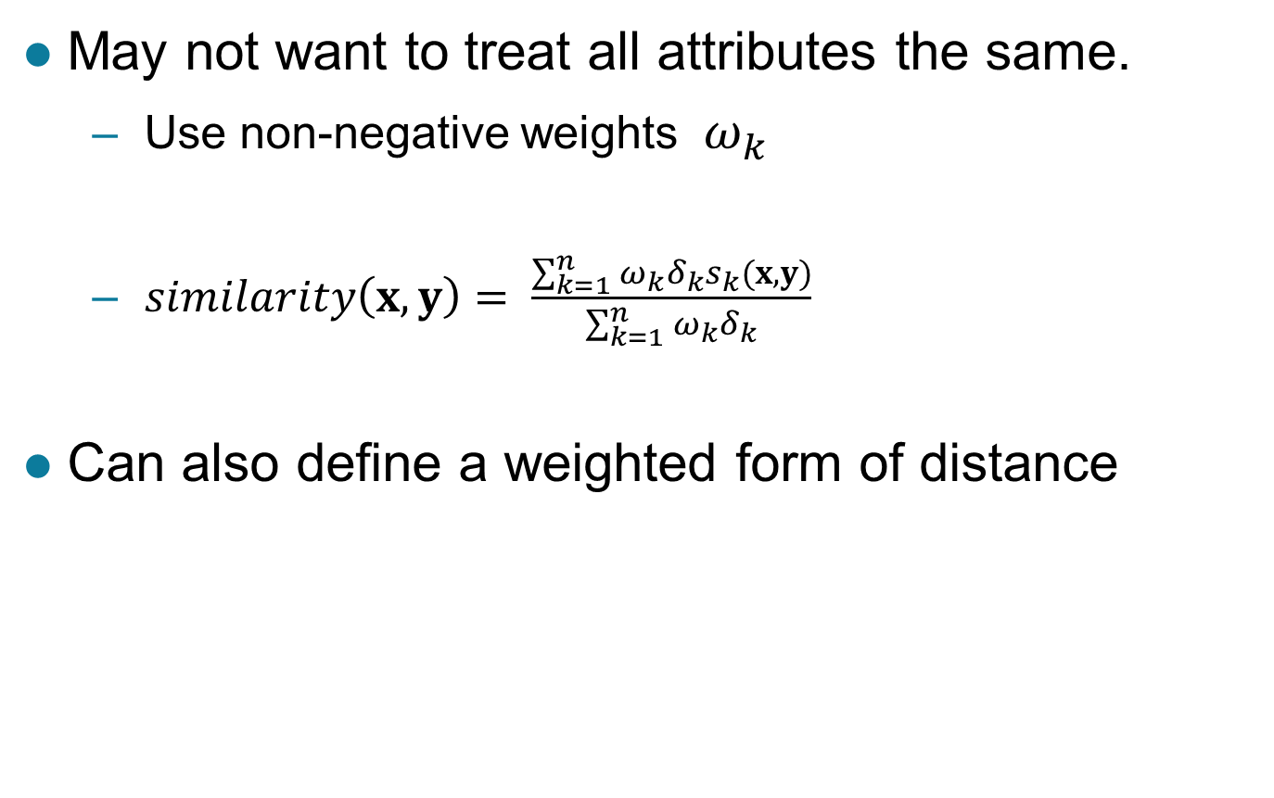
Using Weights to Combine Similarities
May not want to treat all attributes the same.
  Use non-negative weights $ω_{k}$
  $similarity\left(x,y\right)= \frac{\sum_{k=1}^{n}{ω_{k}δ_{k}s_{k}(x,y)}}{\sum_{k=1}^{n}{ω_{k}δ_{k}}}$
Can also define a weighted form of distance

Slide 33
One problem, many approaches
(from bacterial co-occurrence to interactions)
Presence/Absence
  Fisher's t-test
  Jaccard Index
  Pearson’s for binary (Phi-coefficient)
  C-score
Abundance/Count
  Pearson
  Spearman
  Kendall’s Tau
  Bray-Curtis similarity
  Morisita-Horn Similarity
  Ensemble approach
  Maximal Information Coefficient (MIC)
  SparCC
  CoNet
Preprocessing
  Sum to constant
  Proportion
  Centered log ratio transformation
  Relative abundances
  Rarefaction
Statistical/mathematical considerations
  Zero-inflated data
  Resilience to outliers
  Parametric vs non-parametric
  Zero handling for logging
  Spurious co-occurrence
  Sparsity
  Constant sum constraint
2022, Ye

