Slide 1
Analysis of Large Graphs: Link Analysis, PageRank
Note to other teachers and users of these slides: We would be delighted if you found this our material useful in giving your own lectures. Feel free to use these slides verbatim, or to modify them to fit your own needs. If you make use of a significant portion of these slides in your own lecture, please include this message, or a link to our web site: http://www.mmds.org
Some slides are modified by Yuzhen Ye, IUB
Mining of Massive Datasets
Jure Leskovec, Anand Rajaraman, Jeff Ullman Stanford University
http://www.mmds.org

Slide 2
New Topic: Graph Data!
High dim. data
Locality sensitive hashing
Clustering
Graph data
PageRank, SimRank
Community Detection
Infinite data
Filtering data streams
Web advertising
Dimensionality reduction
Spam Detection
Queries on streams
Machine learning
SVM
Decision Trees
Perceptron, kNN
Apps
Recommender systems
Association Rules
Duplicate document detection

Slide 3
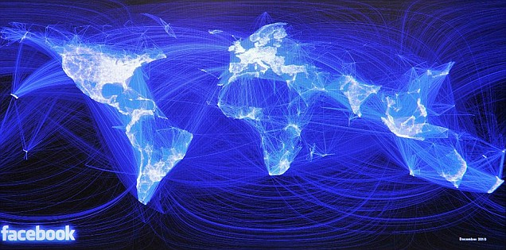
Graph Data: Social Networks
Facebook social graph
4-degrees of separation [Backstrom-Boldi-Rosa-Ugander-Vigna, 2011]

Slide 4
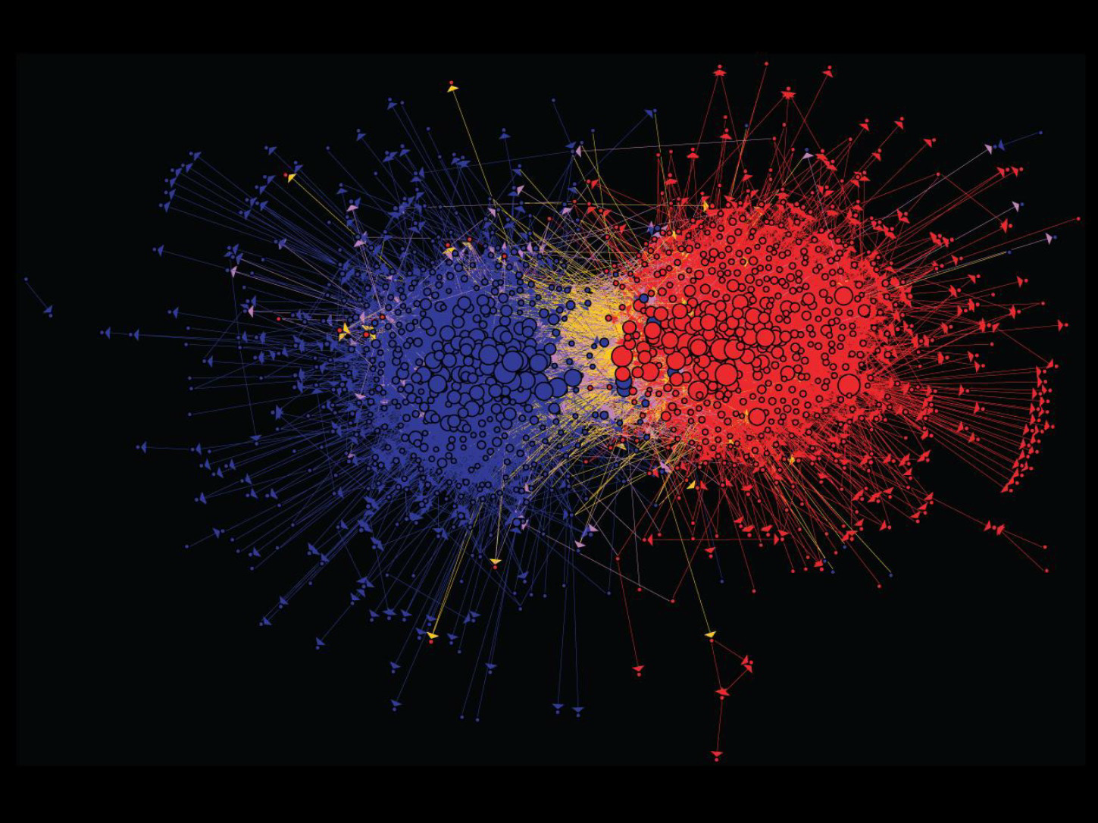
Graph Data: Media Networks
Connections between political blogs
Polarization of the network [Adamic-Glance, 2005]

Slide 5
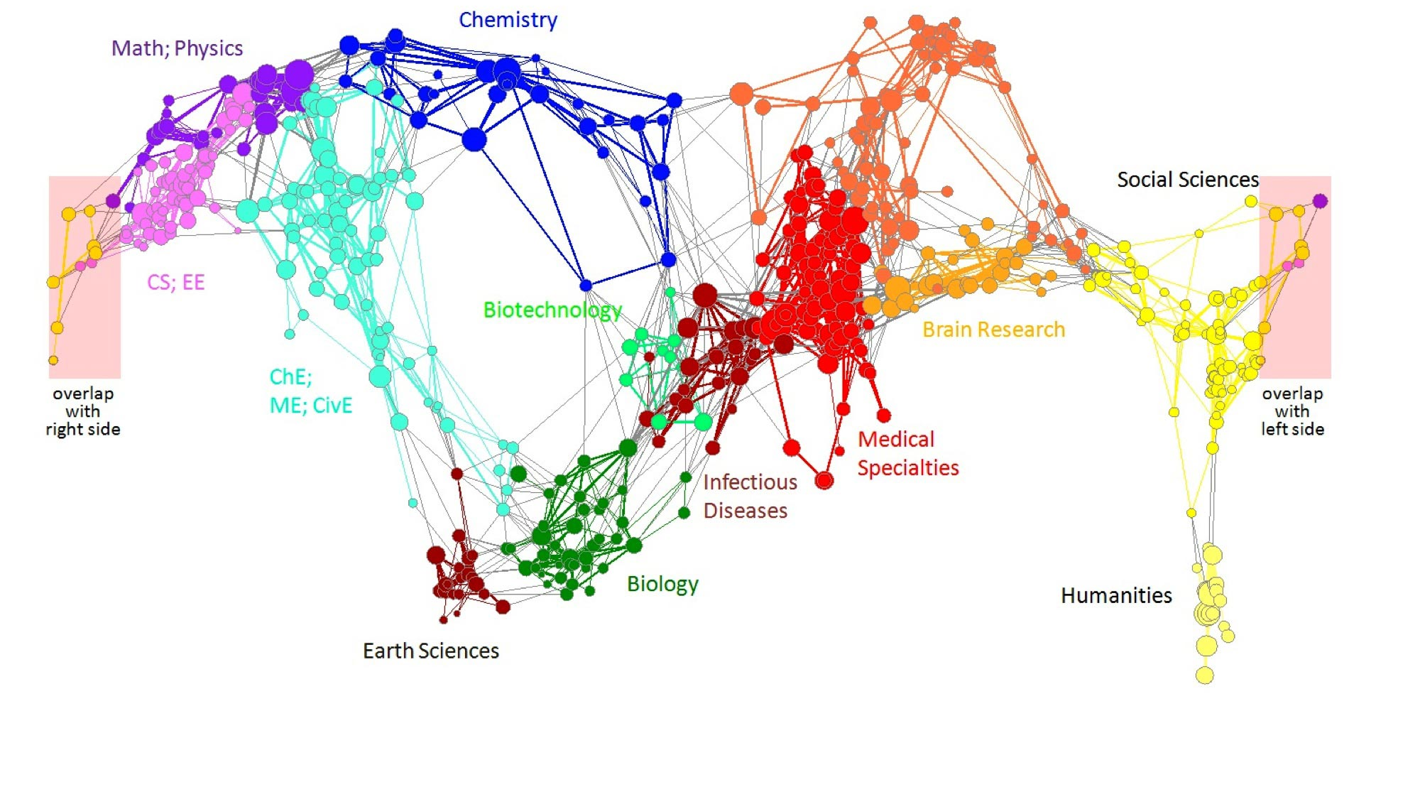
Graph Data: Information Nets
Citation networks and Maps of science
[Börner et al., 2012]

Slide 6
Graph Data: Communication Nets
domain2
domain1
router
domain3
Internet

Slide 7
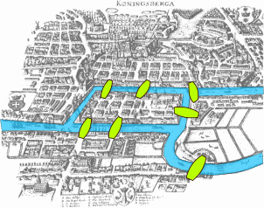
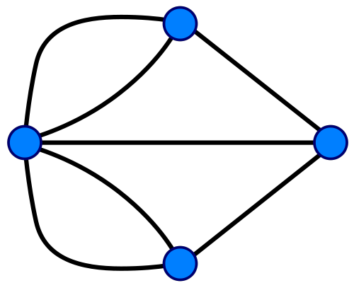
Graph Data: Technological Networks
Seven Bridges of Königsberg [Euler, 1735]
Return to the starting point by traveling each link of the graph once and only once.

Slide 8
Web as a Graph
Web as a directed graph:
Nodes: Webpages
Edges: Hyperlinks
I teach a class on Networks.
CS224W: Classes are in the Gates building
Computer Science Department at Stanford
Stanford University

Slide 9
Web as a Graph
Web as a directed graph:
Nodes: Webpages
Edges: Hyperlinks
I teach a class on Networks.
CS224W: Classes are in the Gates building
Computer Science Department at Stanford
Stanford University

Slide 10
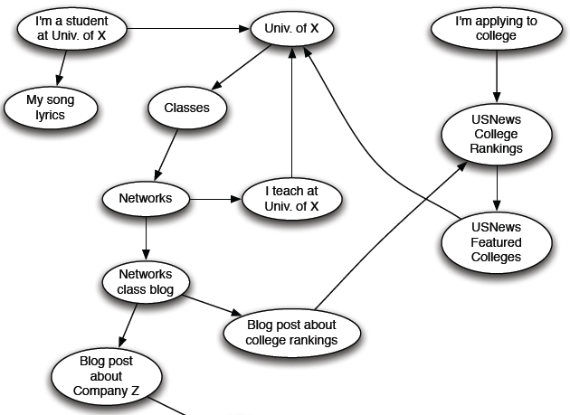
Web as a Directed Graph

Slide 11
Broad Question
How to organize the Web?
First try: Human curated Web directories
Yahoo, DMOZ, LookSmart
Second try: Web Search
Information Retrieval investigates: Find relevant docs in a small and trusted set
Newspaper articles, Patents, etc.
But: Web is huge, full of untrusted documents, random things, web spam, etc.

Slide 12
Web Search: 2 Challenges
2 challenges of web search:
(1) Web contains many sources of information Who to “trust”?
Trick: Trustworthy pages may point to each other!
(2) What is the “best” answer to query “newspaper”?
No single right answer
Trick: Pages that actually know about newspapers might all be pointing to many newspapers

Slide 13
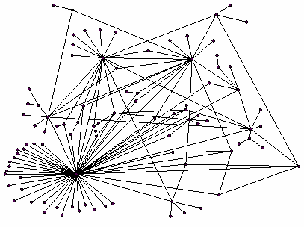
Ranking Nodes on the Graph
All web pages are not equally “important”
www.joe-schmoe.com vs. www.stanford.edu
There is large diversity in the web-graph node connectivity. Let’s rank the pages by the link structure!

Slide 14
Webpages and Visits
There are about 1.13 billion websites on the internet in 2023
Yuzhen Ye

Slide 15
Link Analysis Algorithms
We will cover the following Link Analysis approaches for computing importances of nodes in a graph:
PageRank
Topic-Specific (Personalized) PageRank
Web Spam Detection Algorithms

Slide 16
PageRank: The “Flow” Formulation

Slide 17
Links as Votes
Idea: Links as votes
Page is more important if it has more links
In-coming links? Out-going links?
Think of in-links as votes:
www.stanford.edu has 23,400 in-links
www.joe-schmoe.com has 1 in-link
Are all in-links equal?
Links from important pages count more
Recursive question!

Slide 18
Example: PageRank Scores
B
38.4
C
34.3
A
3.3
D
3.9
E
8.1
F
3.9
1.6
1.6
1.6
1.6
1.6

Slide 19
Simple Recursive Formulation
Each link’s vote is proportional to the importance of its source page
If page j with importance r_{j} has n out-links, each link gets r_{j} / n votes
Page j’s own importance is the sum of the votes on its in-links
i
k
r_{i}/3
r_{k}/4
j
r_{j}/3
r_{j} = r_{i}/3+r_{k}/4
r_{j}/3
r_{j}/3

Slide 20
PageRank: The “Flow” Model
A “vote” from an important page is worth more
A page is important if it is pointed to by other important pages
Define a “rank” r_{j} for page j
The web in 1839
y/2
y
a/2
y/2
m
a
m
a/2
“Flow” equations:
r_{y} = r_{y} /2 + r_{a} /2
r_{a} = r_{y} /2 + r_{m}
r_{m} = r_{a} /2
$d_{i}$ … out-degree of node $i$

Slide 21
Solving the Flow Equations
Flow equations:
3 equations, 3 unknowns, no constants
No unique solution
All solutions equivalent modulo the scale factor
Additional constraint forces uniqueness:
$r_{y} +r_{a}+ r_{m} = 1$
Solution: $r_{y} =\frac{2}{5}, r_{a} =\frac{2}{5}, r_{m} =\frac{1}{5}$
Gaussian elimination method works for small examples, but we need a better method for large web-size graphs
We need a new formulation!
r_{y} = r_{y} /2 + r_{a} /2
r_{a} = r_{y} /2 + r_{m}
r_{m} = r_{a} /2

Slide 22
PageRank: Matrix Formulation
Stochastic adjacency matrix $M$
Let page $i$ has $di$ out-links
If $i →j$, then $Mji =\frac{1}{di}$ else $Mji = 0$
$M$ is a column stochastic matrix
Columns sum to 1
Rank vector $r$: vector with an entry per page
$ri$ is the importance score of page $i$
$\sum_{i}{r_{i}^{}=1}$
The flow equations can be written $r = M⋅ r$

Slide 23
Example
Remember the flow equation:
Flow equation in the matrix form
$$M⋅ r=r$$
Suppose page i links to 3 pages, including j
i
j
r_{j}
.
=
r_{i}
1/3
M
.
r
=
r

Slide 24
Eigenvector Formulation
The flow equations can be written $r = M ∙ r$
So the rank vector r is an eigenvector of the stochastic web matrix M
In fact, it is the first or principal eigenvector, with corresponding eigenvalue of 1
Largest eigenvalue of M is 1 since M is column stochastic (with non-negative entries)
We know r is unit length and each column of M sums to one, so $Mr≤1$
We can now efficiently solve for r! The method is called Power iteration
NOTE: x is an eigenvector with the corresponding eigenvalue λ if: $$Ax=λx$$

Slide 25
Example: Flow Equations & M
 | y | a | m
y | ½ | ½ | 0
a | ½ | 0 | 1
m | 0 | ½ | 0
y
a
m
r = M∙r
r_{y} = r_{y} /2 + r_{a} /2
r_{a} = r_{y} /2 + r_{m}
r_{m} = r_{a} /2
y ½ ½ 0 y
a = ½ 0 1 a
m 0 ½ 0 m

Slide 26
Power Iteration Method
Given a web graph with n nodes, where the nodes are pages and edges are hyperlinks
Power iteration: a simple iterative scheme
Suppose there are N web pages
Initialize: r⁽⁰⁾ = [1/N,….,1/N]^{T}
Iterate: r^{(t+1)} = M ∙ r^{(t)}
Stop when |r^{(t+1)} – r^{(t)}|₁ < ε
d_{i} …. out-degree of node i
|x|₁ = ∑_{1≤i≤N}|x_{i}| is the L1 norm
Can use any other vector norm, e.g., Euclidean

Slide 27
PageRank: How to solve?
Power Iteration:
Set $r_{j}=1$/N
1: ${r′}_{j}=\sum_{i→j}{\frac{r_{i}}{d_{i}}}$
2:$r=r′$
Go to 1
Example:
r_{y} 1/3 1/3 5/12 9/24 6/15
r_{a} = 1/3 3/6 1/3 11/24 … 6/15
r_{m} 1/3 1/6 3/12 1/6 3/15
y
 | y | a | m
y | ½ | ½ | 0
a | ½ | 0 | 1
m | 0 | ½ | 0
a
m
r_{y} = r_{y} /2 + r_{a} /2
r_{a} = r_{y} /2 + r_{m}
r_{m} = r_{a} /2
Iteration 0, 1, 2, …

Slide 28
PageRank: How to solve?
Power Iteration:
Set $r_{j}=1$/N
1: ${r′}_{j}=\sum_{i→j}{\frac{r_{i}}{d_{i}}}$
2:$r=r′$
Goto 1
Example:
r_{y} 1/3 1/3 5/12 9/24 6/15
r_{a} = 1/3 3/6 1/3 11/24 … 6/15
r_{m} 1/3 1/6 3/12 1/6 3/15
y
 | y | a | m
y | ½ | ½ | 0
a | ½ | 0 | 1
m | 0 | ½ | 0
a
m
Surfer at y has ½ probability of going to y and a (but 0 probability of going to m)
r_{y} = r_{y} /2 + r_{a} /2
r_{a} = r_{y} /2 + r_{m}
r_{m} = r_{a} /2
Iteration 0, 1, 2, …
Surfer has equal probability of starting at any of the pages.

Slide 29
Another example
A B C D
A B C D
r
r (after one iteration)
M r
P(A)
P(A to A)
P(B )
P(B to A)

Slide 30
Why Power Iteration works? (1)
Details!
Power iteration: A method for finding dominant eigenvector (the vector corresponding to the largest eigenvalue)
$r^{(1)}=M⋅r^{(0)}$
$r^{(2)}=M⋅r^{\left(1\right)}=M\left(Mr^{\left(1\right)}\right)=M^{2}⋅r^{\left(0\right)}$
$r^{(3)}=M⋅r^{\left(2\right)}=M\left(M^{2}r^{\left(0\right)}\right)=M^{3}⋅r^{\left(0\right)}$
Claim: Sequence $M⋅r^{\left(0\right)},M^{2}⋅r^{\left(0\right)},…M^{k}⋅r^{\left(0\right)},…$ approaches the dominant eigenvector of $M$

Slide 31
Why Power Iteration works? (2)
Details!
Claim: Sequence $M⋅r^{\left(0\right)},M^{2}⋅r^{\left(0\right)},…M^{k}⋅r^{\left(0\right)},…$ approaches the dominant eigenvector of $M$
Proof:
Assume M has n linearly independent eigenvectors, $x_{1}, x_{2}, …, x_{n}$ with corresponding eigenvalues $λ_{1},λ_{2}, …,λ_{n}$, where $λ_{1}>λ_{2}>…>λ_{n}$
Vectors $x_{1}, x_{2}, …, x_{n}$ form a basis and thus we can write: ${r^{(0)}=c_{1} x}_{1}+c_{2} x_{2}+…+c_{n} x_{n}$
$Mr^{(0)}=M\left(c_{1} x_{1}+c_{2} x_{2}+…+c_{n} x_{n}\right)$
$=c_{1}(Mx_{1})+c_{2}(Mx_{2})+…+c_{n}(Mx_{n})$
$=c_{1}(λ_{1}x_{1})+c_{2}(λ_{2}x_{2})+…+c_{n}(λ_{n}x_{n})$
Repeated multiplication on both sides produces
$M^{k}r^{(0)}=c_{1}(λ_{1}^{k}x_{1})+c_{2}(λ_{2}^{k}x_{2})+…+c_{n}(λ_{n}^{k}x_{n})$

Slide 32
Why Power Iteration works? (3)
Details!
Claim: Sequence $M⋅r^{\left(0\right)},M^{2}⋅r^{\left(0\right)},…M^{k}⋅r^{\left(0\right)},…$ approaches the dominant eigenvector of $M$
Proof (continued):
Repeated multiplication on both sides produces
$M^{k}r^{(0)}=c_{1}(λ_{1}^{k}x_{1})+c_{2}(λ_{2}^{k}x_{2})+…+c_{n}(λ_{n}^{k}x_{n})$
$M^{k}r^{(0)}=λ_{1}^{k}\left[c_{1}x_{1}+c_{2}{\left(\frac{λ_{2}^{}}{λ_{1}^{}}\right)}^{k}x_{2}+…+c_{n}{\left(\frac{λ_{2}^{}}{λ_{1}^{}}\right)}^{k}x_{n}\right]$
Since $λ_{1}^{}>λ_{2}^{}$ then fractions $\frac{λ_{2}^{}}{λ_{1}^{}},\frac{λ_{3}^{}}{λ_{1}^{}}…<1$ and so ${\left(\frac{λ_{i}^{}}{λ_{1}^{}}\right)}^{k}=0$ as $k→∞$ (for all $i=2…n$).
Thus: $M^{k}r^{(0)}≈c_{1}\left(λ_{1}^{k}x_{1}\right)$
Note if $c_{1}=0$ then the method won’t converge

Slide 33
Random Walk Interpretation
Imagine a random web surfer:
At any time $t$, surfer is on some page $i$
At time $t+1$, the surfer follows an out-link from $i$ uniformly at random
Ends up on some page $j$ linked from $i$
Process repeats indefinitely
Let:
$p(t)$ … vector whose $i$^{th} coordinate is the prob. that the surfer is at page $i$ at time $t$
So, $p(t)$ is a probability distribution over pages
i₁
i₂
i₃
j

Slide 34
The Stationary Distribution
i₁
i₂
i₃
Where is the surfer at time t+1?
Follows a link uniformly at random
$p\left(t+1\right)= M⋅p(t)$
Suppose the random walk reaches a state $p\left(t+1\right)= M⋅p(t) = p(t)$
then $p(t)$ is stationary distribution of a random walk
Our original rank vector $r$ satisfies $r = M⋅r$
So, $r$ is a stationary distribution for the random walk
j

Slide 35
Existence and Uniqueness
A central result from the theory of random walks (a.k.a. Markov processes):
For graphs that satisfy certain conditions, the stationary distribution is unique and eventually will be reached no matter what the initial probability distribution at time t = 0

Slide 36
PageRank: The Google Formulation

Slide 37
PageRank: Three Questions
Does this converge?
Does it converge to what we want?
Are results reasonable?
or
equivalently

Slide 38
Does this converge?
Example:
r_{a} 1 0 1 0
r_{b} 0 1 0 1
a
b
=
Iteration 0, 1, 2, …

Slide 39
Does it converge to what we want?
Example:
r_{a} 1 0 0 0
r_{b} 0 1 0 0
a
b
=
Iteration 0, 1, 2, …

Slide 40
PageRank: Problems
Dead end
2 problems:
(1) Some pages are dead ends (have no out-links)
Random walk has “nowhere” to go to
Such pages cause importance to “leak out”
(2) Spider traps: (all out-links are within the group)
Random walk gets “stuck” in a trap
And eventually spider traps absorb all importance
Spider trap

Slide 41
Problem: Spider Traps
Power Iteration:
Set $r_{j}=1$
$r_{j}=\sum_{i→j}{\frac{r_{i}}{d_{i}}}$
And iterate
Example:
r_{y} 1/3 2/6 3/12 5/24 0
r_{a} = 1/3 1/6 2/12 3/24 … 0
r_{m} 1/3 3/6 7/12 16/24 1
y
 | y | a | m
y | ½ | ½ | 0
a | ½ | 0 | 0
m | 0 | ½ | 1
a
m
m is a spider trap
r_{y} = r_{y} /2 + r_{a} /2
r_{a} = r_{y} /2
r_{m} = r_{a} /2 + r_{m}
Iteration 0, 1, 2, …
All the PageRank score gets “trapped” in node m.

Slide 42
Solution: Teleports!
The Google solution for spider traps: At each time step, the random surfer has two options
With prob. β, follow a link at random
With prob. 1-β, jump to some random page
Common values for β are in the range 0.8 to 0.9
Surfer will teleport out of spider trap within a few time steps
y
y
a
m
a
m

Slide 43
Problem: Dead Ends
Power Iteration:
Set $r_{j}=1$
$r_{j}=\sum_{i→j}{\frac{r_{i}}{d_{i}}}$
And iterate
Example:
r_{y} 1/3 2/6 3/12 5/24 0
r_{a} = 1/3 1/6 2/12 3/24 … 0
r_{m} 1/3 1/6 1/12 2/24 0
y
 | y | a | m
y | ½ | ½ | 0
a | ½ | 0 | 0
m | 0 | ½ | 0
a
m
r_{y} = r_{y} /2 + r_{a} /2
r_{a} = r_{y} /2
r_{m} = r_{a} /2
Iteration 0, 1, 2, …
Here the PageRank “leaks” out since the matrix is not stochastic.

Slide 44
Solution: Always Teleport!
Teleports: Follow random teleport links with probability 1.0 from dead-ends
Adjust matrix accordingly
y
y
a
m
a
m
 | y | a | m
y | ½ | ½ | 0
a | ½ | 0 | 0
m | 0 | ½ | 0
 | y | a | m
y | ½ | ½ | ⅓
a | ½ | 0 | ⅓
m | 0 | ½ | ⅓

Slide 45
Why Teleports Solve the Problem?
Why are dead-ends and spider traps a problem and why do teleports solve the problem?
Spider-traps are not a problem, but with traps PageRank scores are not what we want
Solution: Never get stuck in a spider trap by teleporting out of it in a finite number of steps
Dead-ends are a problem
The matrix is not column stochastic so our initial assumptions are not met
Solution: Make matrix column stochastic by always teleporting when there is nowhere else to go

Slide 46
Solution: Random Teleports
Google’s solution that does it all: At each step, random surfer has two options:
With probability β, follow a link at random
With probability 1-β, jump to some random page
PageRank equation [Brin-Page, 98] $r_{j}=\sum_{i→j}{β \frac{r_{i}}{d_{i}}}+(1−β)\frac{1}{N}$
d_{i} … out-degree of node i
This formulation assumes that $M$ has no dead ends. We can either preprocess matrix $M$ to remove all dead ends or explicitly follow random teleport links with probability 1.0 from dead-ends.

Slide 47
The Google Matrix
PageRank equation [Brin-Page, ‘98] $r_{j}=\sum_{i→j}{β\frac{r_{i}}{d_{i}}}+(1−β)\frac{1}{N}$
The Google Matrix A:
$$A=β M+\left(1−β\right){\left[\frac{1}{N}\right]}_{N×N}$$
We have a recursive problem: $r=A⋅r$ And the Power method still works!
What is β ?
In practice β =0.8,0.9 (make 5 steps on avg., jump)
[1/N]_{NxN}…N by N matrix where all entries are 1/N

Slide 48
Random Teleports (β = 0.8)
M
[1/N]_{NxN}
7/15
y
1/2 1/2 0
1/2 0 0
0 1/2 1
1/3 1/3 1/3
1/3 1/3 1/3
1/3 1/3 1/3
0.8
+ 0.2
7/15
1/15
7/15
1/15
y 7/15 7/15 1/15
a 7/15 1/15 1/15
m 1/15 7/15 13/15
13/15
a
7/15
m
1/15
1/15
A
y
a =
m
1/3
1/3
1/3
0.33
0.20
0.46
0.24
0.20
0.52
0.26
0.18
0.56
7/33
5/33
21/33
. . .

Slide 49
PageRank: The Complete Algorithm
Input: Graph $G$ and parameter $β$
Directed graph $G$ with spider traps and dead ends
Parameter $β$
Output: PageRank vector $r$
Set: $r_{j}^{\left(0\right)} =\frac{1}{N}, t=1$
do:
$∀j: {r′}_{j}^{(t)}=\sum_{i→j}{β \frac{r_{i}^{(t−1)}}{d_{i}}}$
${r′}_{j}^{(t)}=0$ if in-degree of $j$ is 0
Now re-insert the leaked PageRank:
$∀j: r_{j}^{\left(t\right)}={r^{′}}_{j}^{\left(t\right)}+\frac{1−S}{N}$
$t=t+1$
while $\sum_{j}{\left|r_{j}^{(t)}−r_{j}^{(t−1)}\right|>ε}$
If the graph has no dead-ends then the amount of leaked PageRank is 1-β. But since we have dead-ends the amount of leaked PageRank may be larger. We have to explicitly account for it by computing S.
where: $S=\sum_{j}{{r′}_{j}^{(t)}}$

Slide 50
How do we actually compute the PageRank?
Need compact representation of the Web structure (matrix -> list)
Efficient PageRank iteration (e.g., using MapReduce)

Slide 51
Some Problems with PageRank
Measures generic popularity of a page
Will ignore/miss topic-specific authorities
Solution: Topic-Specific PageRank (next)
Uses a single measure of importance
Other models of importance
Solution: Hubs-and-Authorities
Susceptible to Link spam
Artificial link topographies created in order to boost page rank
Solution: TrustRank

Slide 52
Topic-Specific PageRank

Slide 53
Topic-Specific PageRank
Instead of generic popularity, can we measure popularity within a topic?
Goal: Evaluate Web pages not just according to their popularity, but by how close they are to a particular topic, e.g. “sports” or “history”
Allows search queries to be answered based on interests of the user
Example: Query “Trojan” wants different pages depending on whether you are interested in sports, history and computer security

Slide 54
Topic-Specific PageRank
Random walker has a small probability of teleporting at any step
Teleport can go to:
Standard PageRank: Any page with equal probability
To avoid dead-end and spider-trap problems
Topic Specific PageRank: A topic-specific set of “relevant” pages (teleport set)
Idea: Bias the random walk
When walker teleports, she pick a page from a set S
S contains only pages that are relevant to the topic
E.g., Open Directory (DMOZ) pages for a given topic/query
For each teleport set S, we get a different vector r_{S}

Slide 55
Matrix Formulation
To make this work all we need is to update the teleportation part of the PageRank formulation:
$Aij = β M_{ij}+(1−β)/|S|$ if $i∈ S$
$β M_{ij}+0$ otherwise
A is stochastic!
We weighted all pages in the teleport set S equally
Could also assign different weights to pages!
Compute as for regular PageRank:
Multiply by M, then add a vector
Maintains sparseness

Slide 56
Example: Topic-Specific PageRank
Suppose S = {1}, β = 0.8
0.2
0.5
1
Node Iteration
0 1 2 … stable
1 0.25 0.4 0.28 0.294
2 0.25 0.1 0.16 0.118
3 0.25 0.3 0.32 0.327
4 0.25 0.2 0.24 0.261
0.4
0.5
0.4
1
2
3
0.8
1
1
0.8
0.8
4
S={1,2,3,4}, β=0.8:
r=[0.13, 0.10, 0.39, 0.36]
S={1,2,3} , β=0.8:
r=[0.17, 0.13, 0.38, 0.30]
S={1,2} , β=0.8:
r=[0.26, 0.20, 0.29, 0.23]
S={1} , β=0.8:
r=[0.29, 0.11, 0.32, 0.26]
S={1}, β=0.90:
r=[0.17, 0.07, 0.40, 0.36]
S={1} , β=0.8:
r=[0.29, 0.11, 0.32, 0.26]
S={1}, β=0.70:
r=[0.39, 0.14, 0.27, 0.19]

Slide 57
Discovering the Topic Vector S
Create different PageRanks for different topics
The 16 DMOZ top-level categories:
arts, business, sports,…
Which topic ranking to use?
User can pick from a menu
Classify query into a topic
Can use the context of the query
E.g., query is launched from a web page talking about a known topic
History of queries e.g., “basketball” followed by “Jordan”
User context, e.g., user’s bookmarks, …

Slide 58
TrustRank: Combating the Web Spam

Slide 59
What is Web Spam?
Spamming:
Any deliberate action to boost a web page’s position in search engine results, incommensurate with page’s real value
Spam:
Web pages that are the result of spamming
This is a very broad definition
SEO industry might disagree!
SEO = search engine optimization
Approximately 10-15% of web pages are spam

Slide 60
First Spammers: Term Spam
How do you make your page appear to be about movies?
(1) Add the word movie 1,000 times to your page
Set text color to the background color, so only search engines would see it
(2) Or, run the query “movie” on your target search engine
See what page came first in the listings
Copy it into your page, make it “invisible”
These and similar techniques are term spam
Notes:
Do not forget to tell the joke "I used to do this when I was young" when talking about point (1) :D

Slide 61
Google’s Solution to Term Spam
Believe what people say about you, rather than what you say about yourself
Use words in the anchor text (words that appear underlined to represent the link) and its surrounding text
PageRank as a tool to measure the “importance” of Web pages

Slide 62
Google vs. Spammers: Round 2!
Once Google became the dominant search engine, spammers began to work out ways to fool Google
Spam farms were developed to concentrate PageRank on a single page
Link spam:
Creating link structures that boost PageRank of a particular page

Slide 63
Link Farms
Accessible
Owned
Inaccessible
1
t
2
M
Millions of farm pages
One of the most common and effective organizations for a link farm

Slide 64
Summary
PageRank: transition matrix & power iteration (eigenvector -> stationary distribution)
PageRank with teleport to alleviate problems caused by dead ends and spider traps (surfer has a small probability of teleporting at any step to any page with equal probability)
Topic-specific PageRank (weight pages as well; bias the random walk – teleport to relevant pages with higher probabilities)
Be aware of spams (term spam & link spam); TrustRank

