Slide 1
Data Mining
Cluster Analysis: Advanced Concepts and Algorithms
Lecture Notes for Chapter 8
Introduction to Data Mining, 2nd Edition
by
Tan, Steinbach, Karpatne, Kumar
Modified by Yuzhen Ye (Spring 2020)

Slide 2
Outline
Probabilistic approach
  Model/Prototype-based; Mixture Model Clustering (EM algorithm)
  LSH-based
Hierarchical-based/Graph-based (scalable algorithms)
  CURE

Slide 3
Hard (Crisp) vs Soft (Probabilistic) Clustering
Idea is to model the set of data points as arising from a mixture of distributions
  Typically, normal (Gaussian) distribution is used
  But other distributions have been very profitably used
Clusters are found by estimating the parameters of the statistical distributions
  Can use a k-means like algorithm, called the Expectation-Maximization (EM) algorithm, to estimate these parameters
    Actually, k-means is a special case of this approach
  Provides a compact representation of clusters
  The probabilities with which point belongs to each cluster provide a functionality similar to fuzzy clustering.

Slide 4
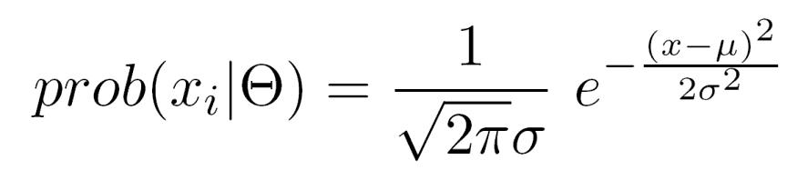
Probabilistic Clustering: Example
Informal example: consider
modeling the points that
generate the following
histogram.
Looks like a combination of two
normal (Gaussian) distributions
Suppose we can estimate the
mean and standard deviation of each normal distribution.
  This completely describes the two clusters
  We can compute the probabilities with which each point belongs to each cluster
  Can assign each point to the
  cluster (distribution) for which it
  is most probable.

Slide 5
Problem: Unknown Parameters
Solution: EM algorithm
Guess the initial distribution (Initialize the parameters)
Repeat
  For each point, compute its probability under each distribution
  Using these probabilities, update the parameters of each distribution
Until there is no change
Very similar to K-means
Consists of assignment (to compute probabilities) and update steps
Can use random initialization
  Problem of local minima
For normal distributions, typically use K-means to initialize
If using normal distributions, can find elliptical as well as spherical shapes.

Slide 6
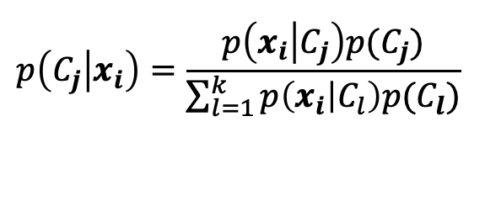

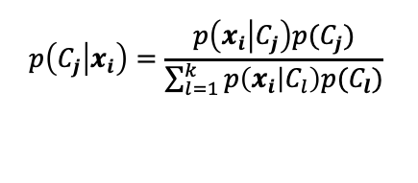
Probabilistic Clustering: Updating Centroids
Update formula for weights assuming an estimate for statistical parameters
Every data point contributes to every cluster
  In a weighted way; and weights are probabilities
  Probabilities calculated using Bayes rule:
Need to assign weights to each cluster
  Weights may not be equal
  Similar to prior probabilities
  Can be estimated:
$$x_{i} is a data point$$
$$C_{j} is a cluster$$
$$c_{j} is a centroid$$
m: # of data points
k: # of clusters
$$p\left(C_{j} | x_{i}\right)=\frac{p\left(x_{i} | C_{j}\right)p(C_{j})}{\sum_{l=1}^{k}{p\left(x_{i} | C_{l}\right)p(C_{l})}}$$
$$p\left(C_{j} | x_{i}\right)=\frac{p\left(x_{i} | C_{j}\right)p(C_{j})}{\sum_{l=1}^{k}{p\left(x_{i} | C_{l}\right)p(C_{l})}}$$

Slide 7
In General, EM Algorithm can be Used
When the data indeed has missing values, due to problems with or limitations of the observation process
When optimizing the likelihood function is analytically intractable but it can be simplified by assuming the existence of and values for additional but missing (or hidden) parameters.

Slide 8
The EM algorithm handles hidden data
Consider a model where, for observed data x and model parameters θ:
p(x|θ)=∑_{z} p(x,z|θ).
z is the “hidden” variable that is marginalized out
Finding θ* which maximizes ∑_{z} p(x,z|θ) is hard!
The EM algorithm reduces the difficult task of optimizing log P(x; θ) into a sequence of simpler optimization subproblems.
In each iteration, The EM algorithm receives parameters θ^{(t)}, and returns new parameters θ^{(t+1)}, s.t. p(x|θ^{(t+1)}) > p(x|θ^{(t)}).

Slide 9
The EM algorithm
In each iteration the EM algorithm does the following.
E step: Calculate
M step: Find which maximizes the Q function
(Next iteration sets θ^{(t)} ← and repeats).
The EM update rule:

Slide 10
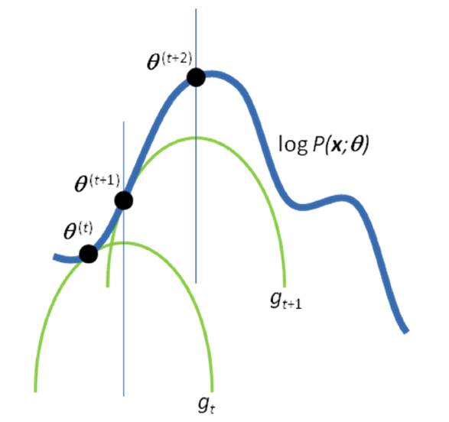
Convergence of the EM algorithm
Compare the Q function and the g function
Fig. 1
Ref: Nature Biotechnology 26, 897 - 899 (2008)

Slide 11
The EM update rule
The EM update rule maximizes the log likelihood of a dataset expanded to contain all possible completions of the unobserved variables, where each completion is weighted by the posterior probability!

Slide 12
Probabilistic Clustering Applied to Sample Data

Slide 13
Probabilistic Clustering: Dense and Sparse Clusters
?

Slide 14
Problems with EM
Convergence can be slow
Only guarantees finding local maxima
Makes some significant statistical assumptions
Number of parameters for Gaussian distribution grows as O(d²), d the number of dimensions
  Parameters associated with covariance matrix
  K-means only estimates cluster means, which grow as O(d)

Slide 15
LSH-based Clustering
The basic idea of the LSH technique is using multiple hash functions to hash the data points and guarantee that there is a high probability of collision for points which are close to each other and low collision probability for dissimilar points.
LSH schemes exist for many distance measures, such as Hamming norm, L _{p} norms, cosine distance, earth movers distance (EMD), and Jaccard coefficient.
Although LSH was originally proposed for approximate nearest neighbor search in high dimensions, it can be used for clustering as well. The buckets could be used as the bases for clustering.
Ref1 https://link.springer.com/referenceworkentry/10.1007%2F978-0-387-30164-8_486
Ref 2: Google News Paper
Yuzhen Ye (Spring 2020)

Slide 16
Graph-Based Clustering: General Concepts
Graph-Based clustering uses the proximity graph
  Start with the proximity matrix
  Consider each point as a node in a graph
  Each edge between two nodes has a weight which is the proximity between the two points
  Initially the proximity graph is fully connected
  MIN (single-link) and MAX (complete-link) can be viewed in graph terms
In the simplest case, clusters are connected components in the graph.

Slide 17
Sparsification in the Clustering Process

Slide 18
CURE Algorithm: Graph-Based Clustering
Agglomerative hierarchical clustering algorithms vary in terms of how the proximity of two clusters are computed
    MIN (single link)
      susceptible to noise/outliers
    MAX (complete link)/GROUP AVERAGE/Centroid/Ward’s:
      may not work well with non-globular clusters
CURE algorithm tries to handle both problems

Slide 19
CURE Algorithm
Represents a cluster using multiple representative points
  Representative points are found by selecting a constant number of points from a cluster
    First representative point is chosen to be the point furthest from the center of the cluster
    Remaining representative points are chosen so that they are farthest from all previously chosen points

Slide 20
CURE Algorithm
“Shrink” representative points toward the center of the cluster by a factor, α
Shrinking representative points toward the center helps avoid problems with noise and outliers
Cluster similarity is the similarity of the closest pair of representative points from different clusters
×
×

Slide 21
CURE Algorithm
Uses agglomerative hierarchical scheme to perform clustering;
  α = 0: similar to centroid-based
  α = 1: somewhat similar to single-link
CURE is better able to handle clusters of arbitrary shapes and sizes

Slide 22
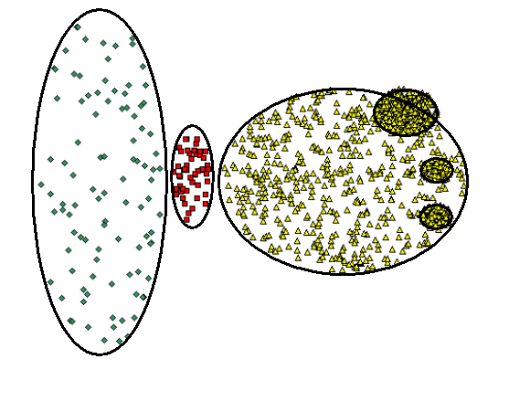
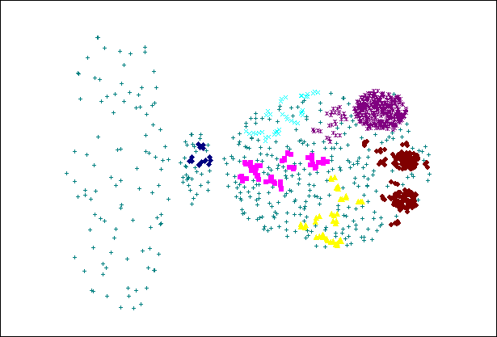
CURE Cannot Handle Differing Densities
Original Points
CURE

Slide 23
A comparison of the clustering algorithms in scikit-learn
https://scikit-learn.org/stable/modules/clustering.html

