Slide 1
Data Mining
Chapter 5
Association Analysis: Basic Concepts
Introduction to Data Mining, 2nd Edition
by
Tan, Steinbach, Karpatne, Kumar
Modified by Yuzhen Ye (Fall 2023)

Slide 2
Topics
Motivation
Frequent item generation
  Generate all itemsets whose support ≥ minsup; Apriori algorithm (F_{k-1} x F_{k,} F_{k-1} x F_{k-1})
  Support counting using Hash tree
Rule generation
Compact representation of frequent itemsets
  Maximal frequent itemsets
  Closed itemsets
Evaluation of association patterns
  Measures (properties: inversion, null addition and scaling)
  Simpson’s Paradox (contingency table)
  Skewed support distribution
Yuzhen Ye

Slide 3
Yuzhen Ye, 2020
Source: http://download.1105media.com/tdwi/Remote-assets/Events/2017/Boston/MarkMadsen_Beer-and-Diapers.pdf

Slide 4
The beer and diapers story continues
Yuzhen Ye, 2020
Source: http://download.1105media.com/tdwi/Remote-assets/Events/2017/Boston/MarkMadsen_Beer-and-Diapers.pdf

Slide 5
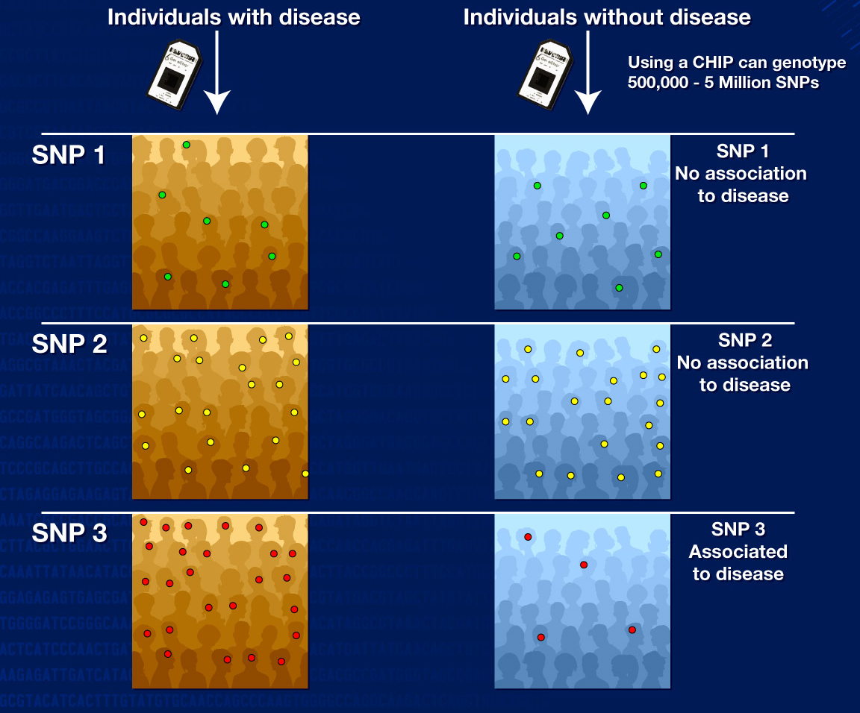
Genome-wise Association Studies
Genome-wide association studies involve scanning markers across the genomes of many people to find genetic variations associated with a particular disease.
Once new genetic associations are identified, researchers can use the information to develop better strategies to detect, treat and prevent the disease.
Such studies are particularly useful in finding genetic variations that contribute to common, complex diseases, such as asthma, cancer, diabetes, heart disease and mental illnesses.
An example: in 2005, three independent studies found that a common form of blindness is associated with variation in the gene for complement factor H, which produces a protein involved in regulating inflammation.
Yuzhen Ye, 2022
Ref: https://www.genome.gov/about-genomics/fact-sheets/Genome-Wide-Association-Studies-Fact-Sheet

Slide 6
Correlation(association)!=causality
Yuzhen Ye, 2020
Source: http://download.1105media.com/tdwi/Remote-assets/Events/2017/Boston/MarkMadsen_Beer-and-Diapers.pdf

Slide 7
Association Rule Mining
Given a set of transactions, find rules that will predict the occurrence of an item based on the occurrences of other items in the transaction
Market-Basket transactions
Example of Association Rules
{Diaper} → {Beer},
{Milk, Bread} → {Eggs,Coke},
{Beer, Bread} → {Milk},
Implication means co-occurrence, not causality!

Slide 8
Definition: Frequent Itemset
Itemset
  A collection of one or more items
    Example: {Milk, Bread, Diaper}
  k-itemset
    An itemset that contains k items
Support count (σ)
  Frequency of occurrence of an itemset
  E.g. σ({Milk, Bread,Diaper}) = 2
Support
  Fraction of transactions that contain an itemset
  E.g. s({Milk, Bread, Diaper}) = 2/5
Frequent Itemset
  An itemset whose support is greater than or equal to a minsup threshold

Slide 9
Definition: Association Rule
Association Rule
  An implication expression of the form X → Y, where X and Y are itemsets
  Example:
  {Milk, Diaper} → {Beer}
Rule Evaluation Metrics
  Support (s)
    Fraction of transactions that contain both X and Y
  Confidence (c)
    Measures how often items in Y
    appear in transactions that
    contain X
Example:

Slide 10
Association Rule Mining Task
Given a set of transactions T, the goal of association rule mining is to find all rules having
  support ≥ minsup threshold
  confidence ≥ minconf threshold
Brute-force approach:
  List all possible association rules
  Compute the support and confidence for each rule
  Prune rules that fail the minsup and minconf thresholds
  ⇒ Computationally prohibitive!

Slide 11
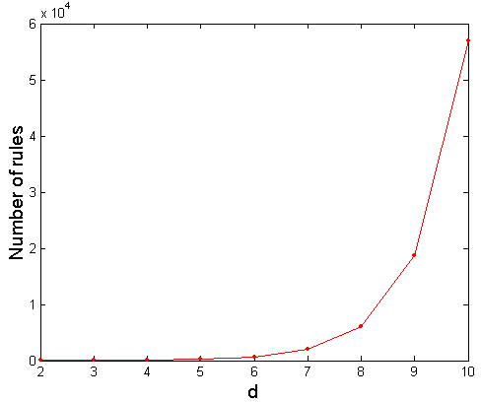
Computational Complexity
Given d unique items:
  Total number of itemsets = 2^{d}
  Total number of possible association rules:
If d=6, R = 602 rules

Slide 12
Mining Association Rules
Example of Rules:
{Milk,Diaper} → {Beer} (s=0.4, c=0.67)
{Milk,Beer} → {Diaper} (s=0.4, c=1.0)
{Diaper,Beer} → {Milk} (s=0.4, c=0.67)
{Beer} → {Milk,Diaper} (s=0.4, c=0.67)
{Diaper} → {Milk,Beer} (s=0.4, c=0.5)
{Milk} → {Diaper,Beer} (s=0.4, c=0.5)
Observations:
All the above rules are binary partitions of the same itemset:
{Milk, Diaper, Beer}
Rules originating from the same itemset have identical support but
can have different confidence
Thus, we may decouple the support and confidence requirements

Slide 13
Mining Association Rules
Two-step approach:
  Frequent Itemset Generation
    Generate all itemsets whose support ≥ minsup
  Rule Generation
    Generate high confidence rules from each frequent itemset, where each rule is a binary partitioning of a frequent itemset
Frequent itemset generation is still computationally expensive

Slide 14
Frequent Itemset Generation
Given d items, there are 2^{d} possible candidate itemsets

Slide 15
Frequent Itemset Generation
Brute-force approach:
  Each itemset in the lattice is a candidate frequent itemset
  Count the support of each candidate by scanning the database
  Match each transaction against every candidate
  Complexity ~ O(NMw) => Expensive since M = 2^{d} !!!

Slide 16
Frequent Itemset Generation Strategies
Reduce the number of candidates (M)
  Complete search: M=2^{d}
  Use pruning techniques to reduce M
Reduce the number of transactions (N)
  Reduce size of N as the size of itemset increases
  Used by DHP and vertical-based mining algorithms
Reduce the number of comparisons (NM)
  Use efficient data structures to store the candidates or transactions
  No need to match every candidate against every transaction

Slide 17
Reducing Number of Candidates
Apriori principle:
  If an itemset is frequent, then all of its subsets must also be frequent
Apriori principle holds due to the following property of the support measure:
  Support of an itemset never exceeds the support of its subsets
  This is known as the anti-monotone property of support

Slide 18
Illustrating Apriori Principle
Found to be Infrequent
Pruned supersets

Slide 19
Illustrating Apriori Principle
Items (1-itemsets)
Minimum Support = 3
If every subset is considered,
⁶C₁ + ⁶C₂ + ⁶C₃
6 + 15 + 20 = 41
With support-based pruning,
6 + 6 + 4 = 16

Slide 20
Illustrating Apriori Principle
Items (1-itemsets)
Minimum Support = 3
If every subset is considered,
⁶C₁ + ⁶C₂ + ⁶C₃
6 + 15 + 20 = 41
With support-based pruning,
6 + 6 + 4 = 16

Slide 21
Illustrating Apriori Principle
Items (1-itemsets)
Pairs (2-itemsets)
(No need to generate
candidates involving Coke
or Eggs)
Minimum Support = 3
If every subset is considered,
⁶C₁ + ⁶C₂ + ⁶C₃
6 + 15 + 20 = 41
With support-based pruning,
6 + 6 + 4 = 16

Slide 22
Illustrating Apriori Principle
Items (1-itemsets)
Pairs (2-itemsets)
(No need to generate
candidates involving Coke
or Eggs)
Minimum Support = 3
If every subset is considered,
⁶C₁ + ⁶C₂ + ⁶C₃
6 + 15 + 20 = 41
With support-based pruning,
6 + 6 + 4 = 16

Slide 23
Illustrating Apriori Principle
Items (1-itemsets)
Pairs (2-itemsets)
(No need to generate
candidates involving Coke
or Eggs)
Minimum Support = 3
Triplets (3-itemsets)
If every subset is considered,
⁶C₁ + ⁶C₂ + ⁶C₃
6 + 15 + 20 = 41
With support-based pruning,
6 + 6 + 4 = 16
If every subset is considered,
⁶C₁ + ⁶C₂ + ⁶C₃
6 + 15 + 20 = 41
With support-based pruning,
6 + 6 + 4 = 16

Slide 24
Illustrating Apriori Principle
Items (1-itemsets)
Pairs (2-itemsets)
(No need to generate
candidates involving Coke
or Eggs)
Minimum Support = 3
Triplets (3-itemsets)
If every subset is considered,
⁶C₁ + ⁶C₂ + ⁶C₃
6 + 15 + 20 = 41
With support-based pruning,
6 + 6 + 4 = 16

Slide 25
Illustrating Apriori Principle
Items (1-itemsets)
Pairs (2-itemsets)
(No need to generate
candidates involving Coke
or Eggs)
Minimum Support = 3
Triplets (3-itemsets)
If every subset is considered,
⁶C₁ + ⁶C₂ + ⁶C₃
6 + 15 + 20 = 41
With support-based pruning,
6 + 6 + 4 = 16
6 + 6 + 1 = 13

Slide 26
Apriori Algorithm
  F_{k}: frequent k-itemsets
  L_{k}: candidate k-itemsets
Algorithm
  Let k=1
  Generate F₁ = {frequent 1-itemsets}
  Repeat until F_{k} is empty
    Candidate Generation: Generate L_{k+1} from F_{k}
    Candidate Pruning: Prune candidate itemsets in L_{k+1} containing subsets of length k that are infrequent
    Support Counting: Count the support of each candidate in L_{k+1} by scanning the DB
    Candidate Elimination: Eliminate candidates in L_{k+1} that are infrequent, leaving only those that are frequent => F_{k+1}

Slide 27
Candidate Generation: Brute-force method

Slide 28
Candidate Generation: Merge Fk-1 and F1 itemsets

Slide 29
Candidate Generation: F_{k-1} x F_{k-1} Method
Merge two frequent (k-1)-itemsets if their first (k-2) items are identical
F₃ = {ABC,ABD,ABE,ACD,BCD,BDE,CDE}
  Merge(ABC, ABD) = ABCD
  Merge(ABC, ABE) = ABCE
  Merge(ABD, ABE) = ABDE
  Do not merge(ABD,ACD) because they share only prefix of length 1 instead of length 2

Slide 30
Candidate Pruning
Let F₃ = {ABC,ABD,ABE,ACD,BCD,BDE,CDE} be the set of frequent 3-itemsets
L₄ = {ABCD,ABCE,ABDE} is the set of candidate 4-itemsets generated (from previous slide)
Candidate pruning
  Prune ABCE because ACE and BCE are infrequent
  Prune ABDE because ADE is infrequent
After candidate pruning: L₄ = {ABCD}

Slide 31
Candidate Generation: Fk-1 x Fk-1 Method

Slide 32
Illustrating Apriori Principle
Items (1-itemsets)
Pairs (2-itemsets)
(No need to generate
candidates involving Coke
or Eggs)
Minimum Support = 3
Triplets (3-itemsets)
If every subset is considered,
⁶C₁ + ⁶C₂ + ⁶C₃
6 + 15 + 20 = 41
With support-based pruning,
6 + 6 + 1 = 13
Use of F_{k-1}xF_{k-1} method for candidate generation results in
only one 3-itemset. This is eliminated after the support counting step.

Slide 33
Alternate F_{k-1} x F_{k-1} Method
Merge two frequent (k-1)-itemsets if the last (k-2) items of the first one is identical to the first (k-2) items of the second.
F₃ = {ABC,ABD,ABE,ACD,BCD,BDE,CDE}
  Merge(ABC, BCD) = ABCD
  Merge(ABD, BDE) = ABDE
  Merge(ACD, CDE) = ACDE
  Merge(BCD, CDE) = BCDE

Slide 34
Candidate Pruning for Alternate F_{k-1} x F_{k-1} Method
Let F₃ = {ABC,ABD,ABE,ACD,BCD,BDE,CDE} be the set of frequent 3-itemsets
L₄ = {ABCD,ABDE,ACDE,BCDE} is the set of candidate 4-itemsets generated (from previous slide)
Candidate pruning
  Prune ABDE because ADE is infrequent
  Prune ACDE because ACE and ADE are infrequent
  Prune BCDE because BCE
After candidate pruning: L₄ = {ABCD}

Slide 35
Support Counting of Candidate Itemsets
Scan the database of transactions to determine the support of each candidate itemset
  Must match every candidate itemset against every transaction, which is an expensive operation

Slide 36
Support Counting of Candidate Itemsets
To reduce number of comparisons, store the candidate itemsets in a hash structure
  Instead of matching each transaction against every candidate, match it against candidates contained in the hashed buckets

Slide 37
Support Counting: An Example
Suppose you have 15 candidate itemsets of length 3:
{1 4 5}, {1 2 4}, {4 5 7}, {1 2 5}, {4 5 8}, {1 5 9}, {1 3 6}, {2 3 4}, {5 6 7}, {3 4 5}, {3 5 6}, {3 5 7}, {6 8 9}, {3 6 7}, {3 6 8}
How many of these itemsets are supported by transaction (1,2,3,5,6)?

Slide 38
DHP Algorithm
DHP (Direct Hashing and Pruning) algorithm. DHP employs hash functions to generate candidate itemsets efficiently; and it also employs effective pruning techniques to reduce the size of database.
Ref: Chiou & Tseng, 2007
Ye

Slide 39
Support Counting Using a Hash Tree
Suppose you have 15 candidate itemsets of length 3:
{1 4 5}, {1 2 4}, {4 5 7}, {1 2 5}, {4 5 8}, {1 5 9}, {1 3 6}, {2 3 4}, {5 6 7}, {3 4 5}, {3 5 6}, {3 5 7}, {6 8 9}, {3 6 7}, {3 6 8}
You need:
Hash function
Max leaf size: max number of itemsets stored in a leaf node (if number of candidate itemsets exceeds max leaf size, split the node)
Hash function
2 3 4
5 6 7
3,6,9
1,4,7
1 4 5
3 4 5
3 5 6
3 5 7
6 8 9
3 6 7
3 6 8
1 3 6
2,5,8
1 2 4
4 5 7
1 2 5
4 5 8
1 5 9

Slide 40
Support Counting Using a Hash Tree
Hash Function
Candidate Hash Tree
1,4,7
3,6,9
2,5,8
2 3 4
5 6 7
1 4 5
1 3 6
3 4 5
3 5 6
3 6 7
Hash on 1, 4 or 7
3 5 7
3 6 8
1 2 4
1 5 9
6 8 9
1 2 5
4 5 7
4 5 8

Slide 41
Support Counting Using a Hash Tree
Hash Function
Candidate Hash Tree
1,4,7
3,6,9
2,5,8
2 3 4
5 6 7
1 4 5
1 3 6
3 4 5
3 5 6
3 6 7
Hash on 2, 5 or 8
3 5 7
3 6 8
1 2 4
1 5 9
6 8 9
1 2 5
4 5 7
4 5 8

Slide 42
Support Counting Using a Hash Tree
Hash Function
Candidate Hash Tree
1,4,7
3,6,9
2,5,8
2 3 4
5 6 7
1 4 5
1 3 6
3 4 5
3 5 6
3 6 7
Hash on 3, 6 or 9
3 5 7
3 6 8
1 2 4
1 5 9
6 8 9
1 2 5
4 5 7
4 5 8

Slide 43
Support Counting Using a Hash Tree
1 2 3 5 6
transaction
Hash Function
1 +
2 3 5 6
2 +
3 5 6
1,4,7
3,6,9
3 +
5 6
2,5,8
2 3 4
5 6 7
1 4 5
1 3 6
3 4 5
3 5 6
3 6 7
3 5 7
3 6 8
1 2 4
1 2 5
1 5 9
6 8 9
4 5 7
4 5 8

Slide 44
Support Counting Using a Hash Tree
1 2 3 5 6
transaction
Hash Function
1 +
2 3 5 6
2 +
3 5 6
1,4,7
3,6,9
1 2 +
3 5 6
3 +
5 6
2,5,8
1 3 +
5 6
2 3 4
1 5 +
6
5 6 7
1 4 5
1 3 6
3 4 5
3 5 6
3 6 7
3 5 7
3 6 8
1 2 4
1 2 5
1 5 9
6 8 9
4 5 7
4 5 8

Slide 45
Support Counting Using a Hash Tree
1 2 3 5 6
transaction
Hash Function
1 +
2 3 5 6
2 +
3 5 6
1,4,7
3,6,9
1 2 +
3 5 6
3 +
5 6
2,5,8
1 3 +
5 6
2 3 4
1 5 +
6
5 6 7
1 4 5
1 3 6
3 4 5
3 5 6
3 6 7
3 5 7
3 6 8
1 2 4
1 2 5
1 5 9
6 8 9
4 5 7
4 5 8
Match transaction against 11 out of 15 candidates

Slide 46
Rule Generation
Given a frequent itemset L, find all non-empty subsets f ⊂ L such that f → L – f satisfies the minimum confidence requirement
  If {A,B,C,D} is a frequent itemset, candidate rules:
    ABC →D, ABD →C, ACD →B, BCD →A,
    A →BCD, B →ACD, C →ABD, D →ABC
    AB →CD, AC → BD, AD → BC, BC →AD,
    BD →AC, CD →AB,
If |L| = k, then there are 2^{k} – 2 candidate association rules (ignoring L → ∅ and ∅ → L)

Slide 47
Rule Generation
In general, confidence does not have an anti-monotone property
  c(ABC →D) can be larger or smaller than c(AB →D)
But confidence of rules generated from the same itemset has an anti-monotone property
  E.g., Suppose {A,B,C,D} is a frequent 4-itemset:
  c(ABC → D) ≥ c(AB → CD) ≥ c(A → BCD)
  Confidence is anti-monotone w.r.t. number of items on the RHS of the rule

Slide 48
Rule Generation for Apriori Algorithm
Lattice of rules
Low Confidence Rule
Pruned Rules

Slide 49
Factors Affecting Complexity of Apriori
Choice of minimum support threshold
  lowering support threshold results in more frequent itemsets
  this may increase number of candidates and max length of frequent itemsets
Dimensionality (number of items) of the data set
  More space is needed to store support count of itemsets
  if number of frequent itemsets also increases, both computation and I/O costs may also increase
Size of database
  run time of algorithm increases with number of transactions
Average transaction width
  transaction width increases the max length of frequent itemsets
  number of subsets in a transaction increases with its width, increasing computation time for support counting

Slide 50
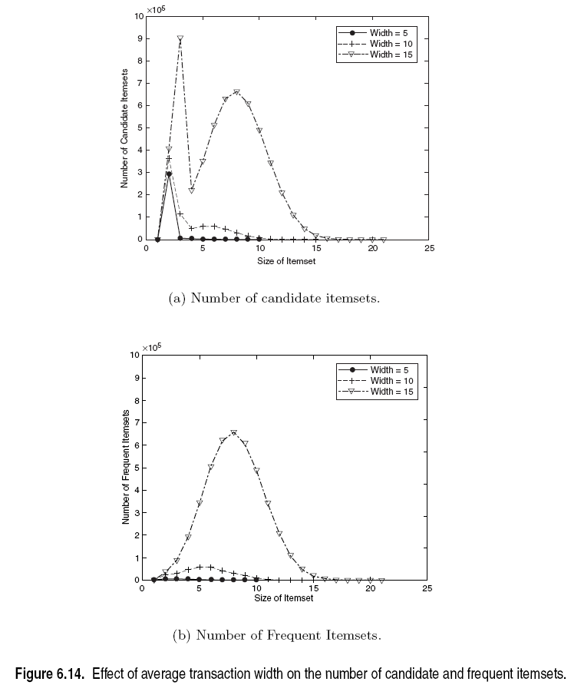
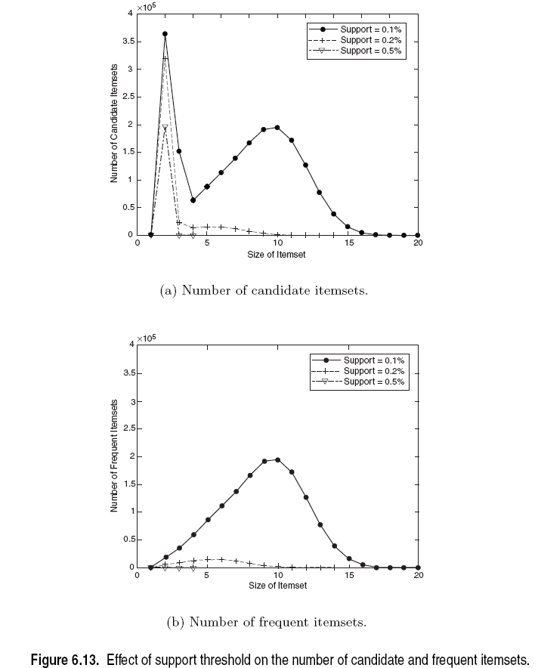
Factors Affecting Complexity of Apriori

Slide 51
Compact Representation of Frequent Itemsets
Some frequent itemsets are redundant because their supersets are also frequent
    Consider the following data set. Assume support threshold =5
  Number of frequent itemsets
Need a compact representation

Slide 52
Maximal Frequent Itemset
An itemset is maximal frequent if it is frequent and none of its immediate supersets is frequent
Maximal Itemsets
Infrequent Itemsets
Border

Slide 53
What are the Maximal Frequent Itemsets in this Data?
Minimum support threshold = 5
(A1-A10)
(B1-B10)
(C1-C10)

Slide 54
An illustrative example
Items
 | A | B | C | D | E | F | G | H | I | J
1
2
3
4
5
6
7
8
9
10
Support threshold (by count) : 5
Frequent itemsets: ?
Maximal itemsets: ?
Transactions

Slide 55
An illustrative example
Items
 | A | B | C | D | E | F | G | H | I | J
1
2
3
4
5
6
7
8
9
10
Support threshold (by count) : 5
Frequent itemsets: {F}
Maximal itemsets: {F}
Support threshold (by count): 4
Frequent itemsets: ?
Maximal itemsets: ?
Transactions

Slide 56
An illustrative example
Items
 | A | B | C | D | E | F | G | H | I | J
1
2
3
4
5
6
7
8
9
10
Support threshold (by count) : 5
Frequent itemsets: {F}
Maximal itemsets: {F}
Support threshold (by count): 4
Frequent itemsets: {E}, {F}, {E,F}, {J}
Maximal itemsets: {E,F}, {J}
Support threshold (by count): 3
Frequent itemsets: ?
Maximal itemsets: ?
Transactions

Slide 57
An illustrative example
Items
 | A | B | C | D | E | F | G | H | I | J
1
2
3
4
5
6
7
8
9
10
Support threshold (by count) : 5
Frequent itemsets: {F}
Maximal itemsets: {F}
Support threshold (by count): 4
Frequent itemsets: {E}, {F}, {E,F}, {J}
Maximal itemsets: {E,F}, {J}
Support threshold (by count): 3
Frequent itemsets:
All subsets of {C,D,E,F} + {J}
Maximal itemsets:
{C,D,E,F}, {J}
Transactions

Slide 58
Another illustrative example
Items
 | A | B | C | D | E | F | G | H | I | J
1
2
3
4
5
6
7
8
9
10
Support threshold (by count) : 5
Maximal itemsets: {A}, {B}, {C}
Support threshold (by count): 4
Maximal itemsets: {A,B}, {A,C},{B,C}
Support threshold (by count): 3
Maximal itemsets: {A,B,C}
Transactions

Slide 59
Closed Itemset
An itemset X is closed if none of its immediate supersets has the same support as the itemset X.
X is not closed if at least one of its immediate supersets has support count as X.

Slide 60
Closed Itemset
An itemset X is closed if none of its immediate supersets has the same support as the itemset X.
X is not closed if at least one of its immediate supersets has support count as X.

Slide 61
Maximal vs Closed Itemsets
Transaction Ids
Not supported by any transactions

Slide 62
Maximal Frequent vs Closed Frequent Itemsets
Minimum support = 2
Closed but not maximal
Closed and maximal
# Closed frequent = 9
# Maximal freaquent = 4

Slide 63
What are the Closed Itemsets in this Data?
(A1-A10)
(B1-B10)
(C1-C10)

Slide 64
Example 1
Items
 | A | B | C | D | E | F | G | H | I | J
1
2
3
4
5
6
7
8
9
10
Itemsets | Support (counts) | Closed itemsets
{C} | 3
{D} | 2
{C,D} | 2
Transactions

Slide 65
Example 1
Items
 | A | B | C | D | E | F | G | H | I | J
1
2
3
4
5
6
7
8
9
10
Itemsets | Support (counts) | Closed itemsets
{C} | 3 | ✓
{D} | 2
{C,D} | 2 | ✓
Transactions

Slide 66
Example 2
Items
 | A | B | C | D | E | F | G | H | I | J
1
2
3
4
5
6
7
8
9
10
Itemsets | Support (counts) | Closed itemsets
{C} | 3
{D} | 2
{E} | 2
{C,D} | 2
{C,E} | 2
{D,E} | 2
{C,D,E} | 2
Transactions

Slide 67
Example 2
Items
 | A | B | C | D | E | F | G | H | I | J
1
2
3
4
5
6
7
8
9
10
Itemsets | Support (counts) | Closed itemsets
{C} | 3 | ✓
{D} | 2
{E} | 2
{C,D} | 2
{C,E} | 2
{D,E} | 2
{C,D,E} | 2 | ✓
Transactions

Slide 68
Example 3
Items
 | A | B | C | D | E | F | G | H | I | J
1
2
3
4
5
6
7
8
9
10
Closed itemsets: {C,D,E,F}, {C,F}
Transactions

Slide 69
Example 4
Items
 | A | B | C | D | E | F | G | H | I | J
1
2
3
4
5
6
7
8
9
10
Closed itemsets: {C,D,E,F}, {C}, {F}
Transactions

Slide 70
Maximal vs Closed Itemsets

Slide 71
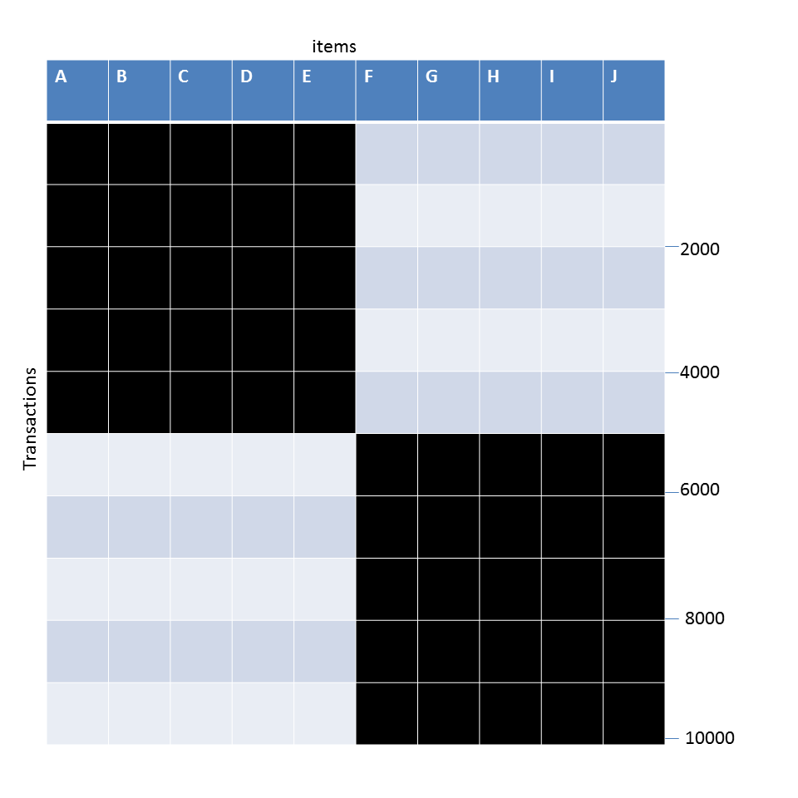
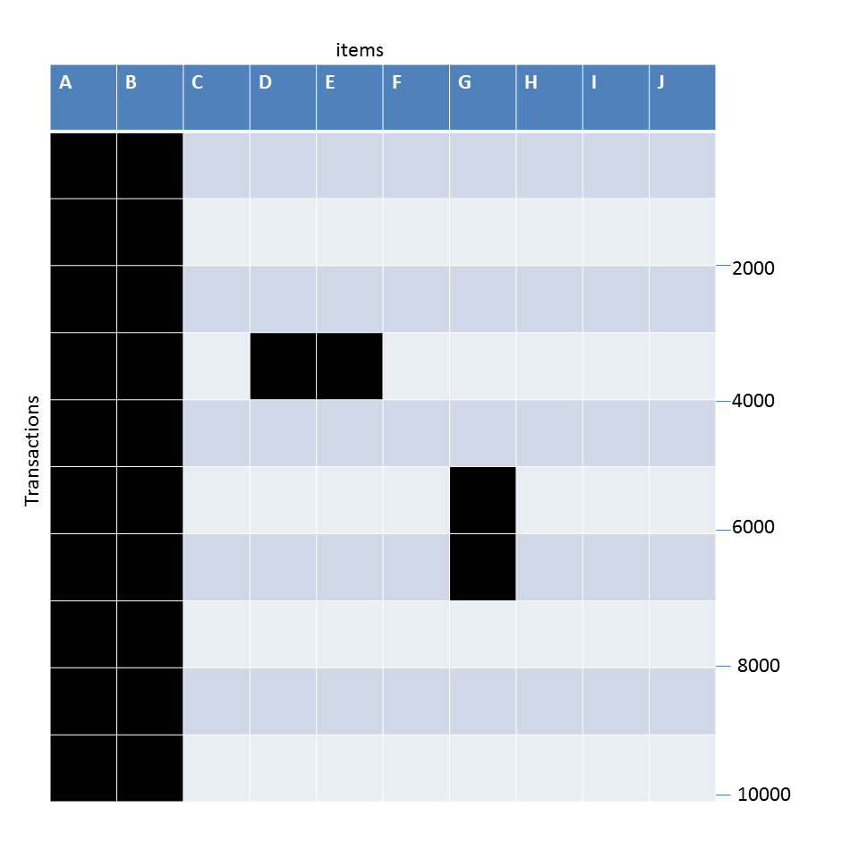
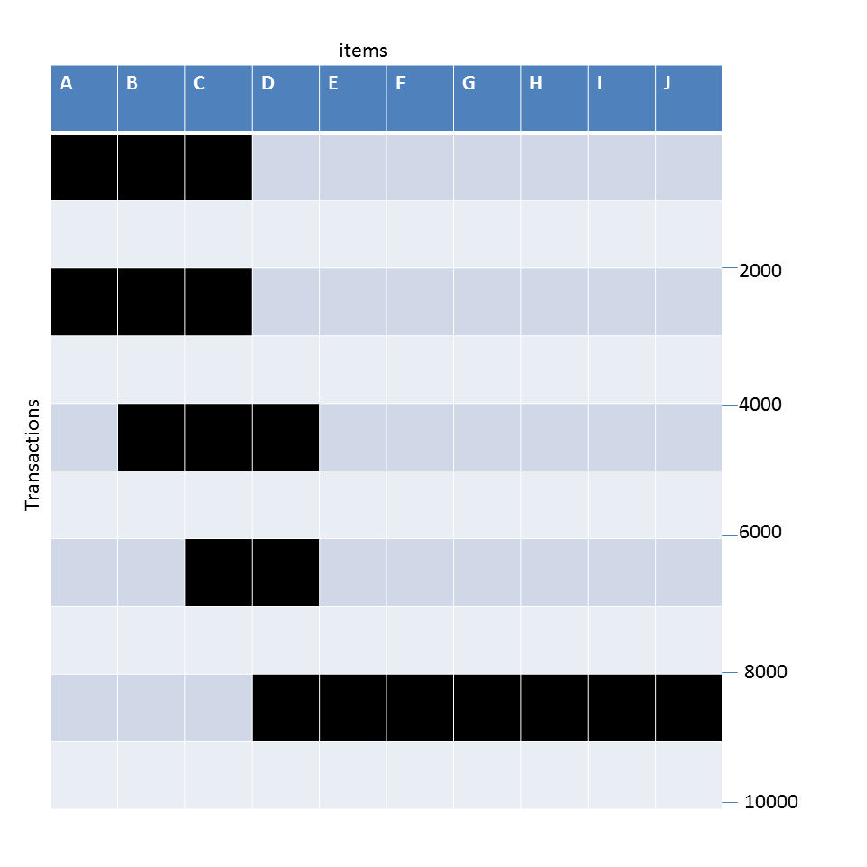
Example question
Given the following transaction data sets (dark cells indicate presence of an item in a transaction) and a support threshold of 20%, answer the following questions
DataSet: A
Data Set: B
Data Set: C
What is the number of frequent itemsets for each dataset? Which dataset will produce the most number of frequent itemsets?
Which dataset will produce the longest frequent itemset?
Which dataset will produce frequent itemsets with highest maximum support?
Which dataset will produce frequent itemsets containing items with widely varying support levels (i.e., itemsets containing items with mixed support, ranging from 20% to more than 70%)?
What is the number of maximal frequent itemsets for each dataset? Which dataset will produce the most number of maximal frequent itemsets?
What is the number of closed frequent itemsets for each dataset? Which dataset will produce the most number of closed frequent itemsets?

Slide 72
Pattern Evaluation
Association rule algorithms can produce large number of rules
Interestingness measures can be used to prune/rank the patterns
  In the original formulation, support & confidence are the only measures used

Slide 73
Computing Interestingness Measure
Given X → Y or {X,Y}, information needed to compute interestingness can be obtained from a contingency table
Contingency table
 | Y | Y
X | f₁₁ | f₁₀ | f₁₊
X | f₀₁ | f₀₀ | f_{o+}
 | f₊₁ | f₊₀ | N
f₁₁: support of X and Y
f₁₀: support of X and Y
f₀₁: support of X and Y
f₀₀: support of X and Y
Used to define various measures
support, confidence, Gini,
entropy, etc.

Slide 74
Drawback of Confidence
Customers | Tea | Coffee | …
C1 | 0 | 1 | …
C2 | 1 | 0 | …
C3 | 1 | 1 | …
C4 | 1 | 0 | …
…
Association Rule: Tea → Coffee
Confidence ≅ P(Coffee|Tea) = 150/200 = 0.75
Confidence > 50%, meaning people who drink tea are more likely to drink coffee than not drink coffee
So rule seems reasonable

Slide 75
Drawback of Confidence
 | Coffee | Coffee
Tea | 150 | 50 | 200
Tea | 650 | 150 | 800
 | 800 | 200 | 1000
Association Rule: Tea → Coffee
Confidence= P(Coffee|Tea) = 150/200 = 0.75
but P(Coffee) = 0.8, which means knowing that a person drinks tea reduces the probability that the person drinks coffee!
Note that P(Coffee|Tea) = 650/800 = 0.8125

Slide 76
Drawback of Confidence
Customers | Tea | Honey | …
C1 | 0 | 1 | …
C2 | 1 | 0 | …
C3 | 1 | 1 | …
C4 | 1 | 0 | …
…
Association Rule: Tea → Honey
Confidence ≅ P(Honey|Tea) = 100/200 = 0.50
Confidence = 50%, which may mean that drinking tea has little influence whether honey is used or not
So rule seems uninteresting
But P(Honey) = 120/1000 = .12 (hence tea drinkers are far more likely to have honey

Slide 77
Measure for Association Rules
So, what kind of rules do we really want?
  Confidence(X → Y) should be sufficiently high
    To ensure that people who buy X will more likely buy Y than not buy Y
  Confidence(X → Y) > support(Y)
    Otherwise, rule will be misleading because having item X actually reduces the chance of having item Y in the same transaction
    Is there any measure that capture this constraint?
      Answer: Yes. There are many of them.

Slide 78
Statistical Relationship between X and Y
The criterion
confidence(X → Y) = support(Y)
is equivalent to:
  P(Y|X) = P(Y)
  P(X,Y) = P(X) × P(Y) (X and Y are independent)
  If P(X,Y) > P(X) × P(Y) : X & Y are positively correlated
  If P(X,Y) < P(X) × P(Y) : X & Y are negatively correlated

Slide 79
Measures that take into account statistical dependence
lift is used for rules while interest is used for itemsets

Slide 80
Example: Lift/Interest
 | Coffee | Coffee
Tea | 150 | 50 | 200
Tea | 650 | 150 | 800
 | 800 | 200 | 1000
Association Rule: Tea → Coffee
Confidence= P(Coffee|Tea) = 0.75
but P(Coffee) = 0.8
Interest = 0.15 / (0.2×0.8) = 0.9375 (< 1, therefore is negatively associated)
So, is it enough to use confidence/Interest for pruning?

Slide 81
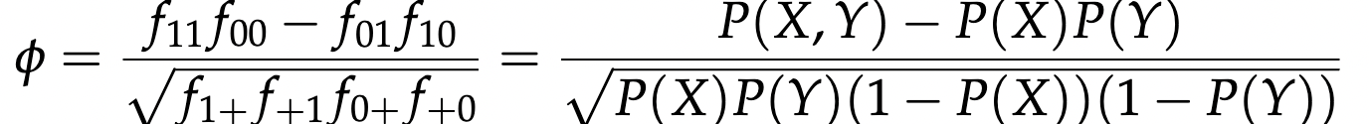
Example: φ-Coefficient
φ-Coefficient is analogous to Pearson’s correlation coefficient for continuous variables
 | Y | Y
X | 60 | 10 | 70
X | 10 | 20 | 30
 | 70 | 30 | 100
 | Y | Y
X | 20 | 10 | 30
X | 10 | 60 | 70
 | 30 | 70 | 100
φ-Coefficient is the same for both tables
Ye

Slide 82
There are lots of measures proposed in the literature

Slide 83
Comparing Different Measures
10 examples of contingency tables:
Rankings of contingency tables using various measures:

Slide 84
Property under Inversion Operation
Transaction 1
.
.
.
.
.
Transaction N

Slide 85
Property under Inversion Operation
Transaction 1
.
.
.
.
.
Transaction N
Correlation: -0.1667 -0.1667
IS/cosine 0.0 0.825

Slide 86
Property under Null Addition
100
Invariant measures:
  cosine, Jaccard, All-confidence, confidence
Non-invariant measures:
  correlation, Interest/Lift, odds ratio, etc

Slide 87
Property under Row/Column Scaling
Grade-Gender Example (Mosteller, 1968):
 | Male | Female
High | 30 | 20 | 50
Low | 40 | 10 | 50
 | 70 | 30 | 100
 | Male | Female
High | 60 | 60 | 120
Low | 80 | 30 | 110
 | 140 | 90 | 230
2x
3x
Mosteller:
Underlying association should be independent of
the relative number of male and female students
in the samples
Odds-Ratio ((f₁₁₊f₀₀ )/(f₁₀₊f₁₀)) has this property
has this property

Slide 88
Property under Row/Column Scaling
Relationship between Mask use and susceptibility to Covid:
 | Covid-Positive | Covid-Free
Mask | 20 | 30 | 50
No-Mask | 40 | 10 | 50
 | 60 | 40 | 100
 | Covid-Positive | Covid-Free
Mask | 40 | 300 | 340
No-Mask | 80 | 100 | 180
 | 120 | 400 | 520
2x
10x
Mosteller:
Underlying association should be independent of
the relative number of Covid-positive and Covid-free subjects
Odds-Ratio ((f₁₁₊f₀₀ )/(f₁₀₊f₁₀)) has this property

Slide 89
Different Measures have Different Properties

Slide 90
Simpson’s Paradox
Observed relationship in data may be influenced by the presence of other confounding factors (hidden variables)
  Hidden variables may cause the observed relationship between a pair of variables to disappear or reverse its direction!
Proper stratification is needed to avoid generating spurious patterns

Slide 91
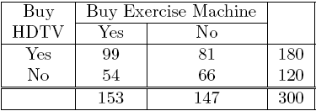
Simpson’s Paradox
=> Customers who buy HDTV are more likely to buy exercise machines
Simpson's paradox is a phenomenon in probability and statistics, in which a trend (e.g., association) appears in several different groups of data but disappears or reverses when these groups are combined.

Slide 92
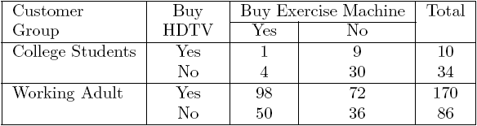
Simpson’s Paradox
Remember: Customers (all) who buy HDTV are more likely to buy exercise machines
College students:
College students who buy HDTV are less likely to buy exercise machines
Working adults:
Working adults who buy HDTV are less likely to buy exercise machines

Slide 93
Contingency table and chi-squared test
a contingency table displays the (multivariate) frequency distribution of variables
O: observed frequency
E: expected frequency
chi-squared statistic = 0.0239, p-value is .877162, not significant (at p < .05)
chi-squared statistic = 0.0057, p-value is .939929, not significant (at p < .05)
The chi-squared statistic is 2.8812. The p-value is .089622. Also not significant at p < .05.
Yuzhen Ye

Slide 94
Simpson’s Paradox
Recovery rate from Covid
  Hospital A: 80%
  Hospital B: 90%
Which hospital is better?

Slide 95
Simpson’s Paradox
Recovery rate from Covid
  Hospital A: 80%
  Hospital B: 90%
Which hospital is better?
Covid recovery rate on older population
  Hospital A: 50%
  Hospital B: 30%
Covid recovery rate on younger population
  Hospital A: 99%
  Hospital B: 98%
Why: Hospital A had more old patients than hospital B, and old patients had lower recovery rate.
Hospital A: old% = 37%
Hospital B: old% = 12%

Slide 96
Simpson’s Paradox
Covid-19 death: (per 100,000 of population)
  County A: 15
  County B: 10
Which state is managing the pandemic better?

Slide 97
Simpson’s Paradox
Covid-19 death: (per 100,000 of population)
  County A: 15
  County B: 10
Which state is managing the pandemic better?
Covid death rate on older population
  County A: 20
  County B: 40
Covid death rate on younger population
  County A: 2
  County B: 5

Slide 98
Simpson’s paradox
HPV vaccination & pregnancy?

Slide 99
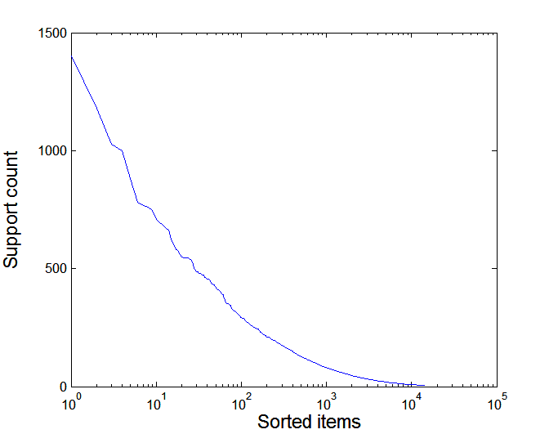
Effect of Support Distribution on Association Mining
Few items with high support
Many items with low support
Support distribution of a retail data set
Rank of item (in log scale)
Many real data sets have skewed support distribution

Slide 100
Effect of Support Distribution
Difficult to set the appropriate minsup threshold
  If minsup is too high, we could miss itemsets involving interesting rare items (e.g., {caviar, vodka})
  If minsup is too low, it is computationally expensive and the number of itemsets is very large

Slide 101
Cross-Support Patterns
A cross-support pattern involves items with varying degree of support
Example: {caviar,milk}
How to avoid such patterns?
caviar
milk

Slide 102
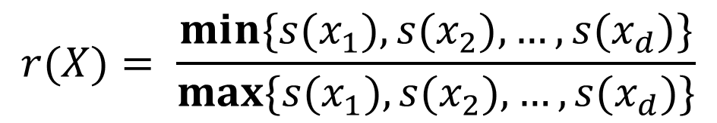
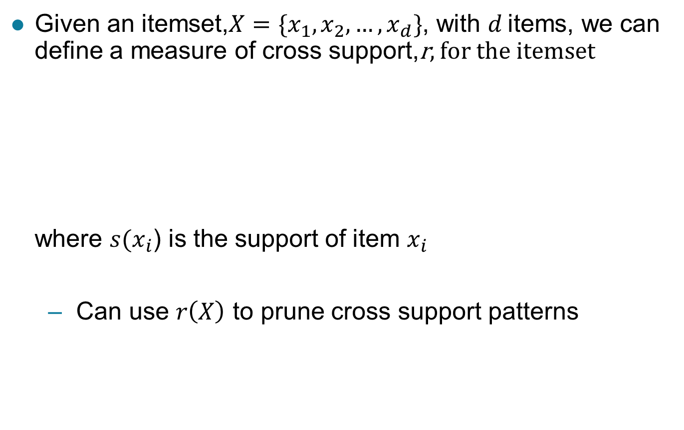
A Measure of Cross Support
$$r(X)= \frac{min\{s(x_{1}),s(x_{2}), …,s(x_{d})\}}{max\{s(x_{1}),s(x_{2}), …,s(x_{d})\}}$$
  Given an itemset,$X=\{x_{1},x_{2},…,x_{d}\}$, with $d$ items, we can define a measure of cross support,r, for the itemset
  where $s(x_{i}$) is the support of item $x_{i}$
  Can use $r\left(X\right)$ to prune cross support patterns

Slide 103
Confidence and Cross-Support Patterns
Observation:
conf(caviar→milk) is very high
but
conf(milk→caviar) is very low
Therefore,
min( conf(caviar→milk),
conf(milk→caviar) )
is also very low
caviar
milk

Slide 104
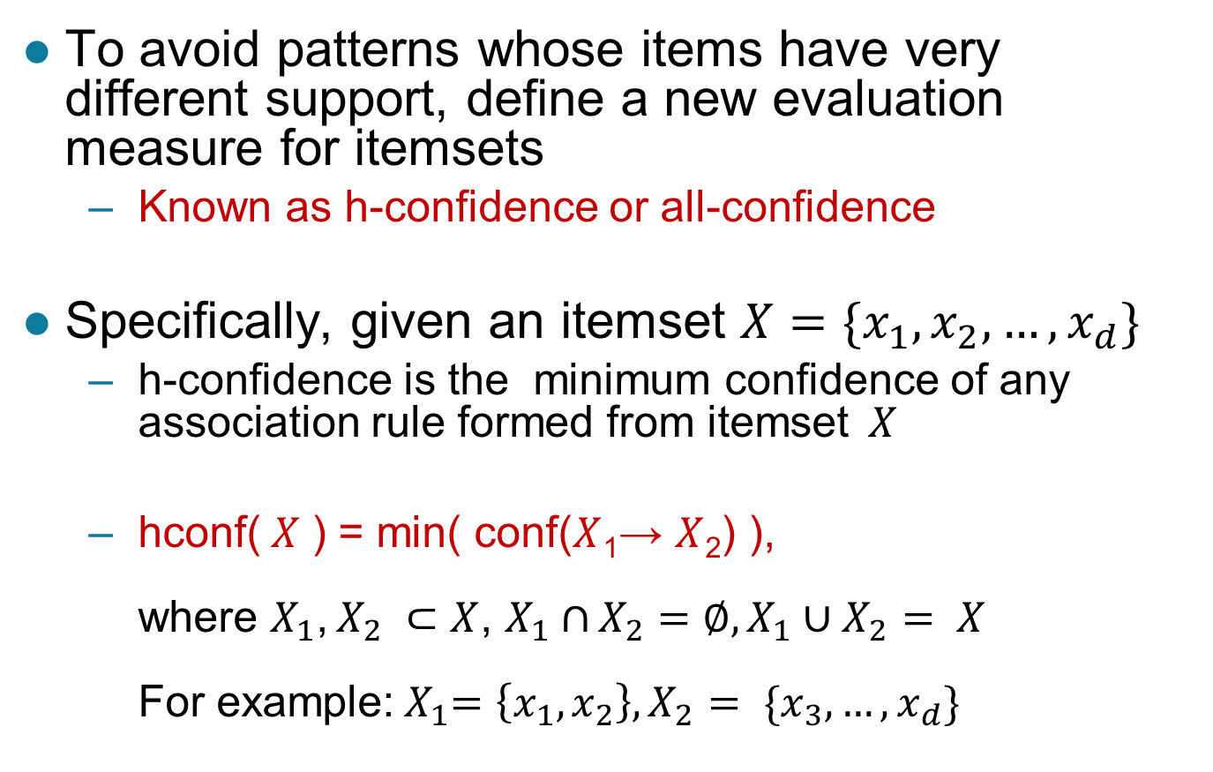
H-Confidence
To avoid patterns whose items have very different support, define a new evaluation measure for itemsets
  Known as h-confidence or all-confidence
Specifically, given an itemset $X=\{x_{1},x_{2},…,x_{d}\}$
  h-confidence is the minimum confidence of any association rule formed from itemset$X$
  hconf($X$ ) = min( conf($X$₁→ $X$₂) ),
  where $X_{1}$, $X_{2} ⊂$ $X$, $X_{1}∩$ $X_{2}=∅,X_{1}∪X_{2}$ $= X$
  For example:${ X}_{1}=\left\{x_{1},x_{2}\right\}, X_{2}$ $= \{x_{3},…,x_{d}\}$

Slide 105
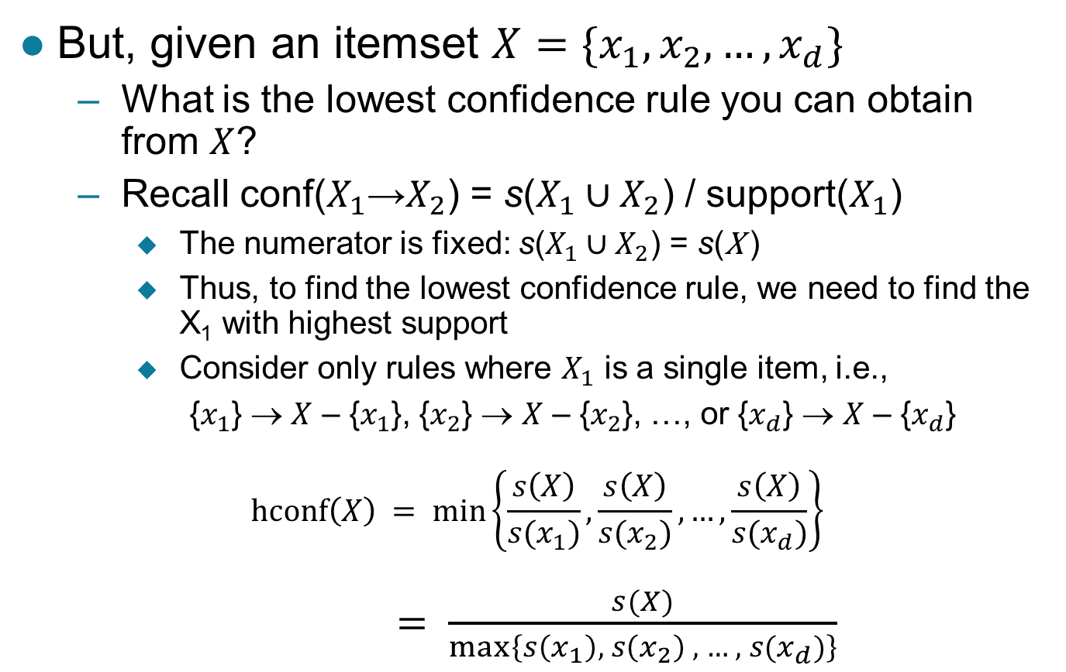
H-Confidence …
But, given an itemset $X=\{x_{1},x_{2},…,x_{d}\}$
  What is the lowest confidence rule you can obtain from $X$?
  Recall conf($X_{1}$→$X_{2}$) = s($X_{1}∪X_{2}$) / support($X_{1}$)
    The numerator is fixed: s($X_{1}∪X_{2}$) = s(X )
    Thus, to find the lowest confidence rule, we need to find the X₁ with highest support
    Consider only rules where $X_{1}$ is a single item, i.e.,
    {$x_{1}$} → $X$ – {$x_{1}$}, {$x_{2}$} → $X$ – {$x_{2}$}, …, or {$x_{d}$} → $X$ – {$x_{d}$}
    $$hconf\left(X\right) = min\left\{\frac{s\left(X\right)}{s(x_{1})},\frac{s\left(X\right)}{s(x_{2})},…,\frac{s\left(X\right)}{s(x_{d})}\right\}$$
    $= \frac{s(X)}{max⁡\left\{s\left(x_{1}\right), s\left(x_{2}\right) , …, s(x_{d})\right\}}$

Slide 106
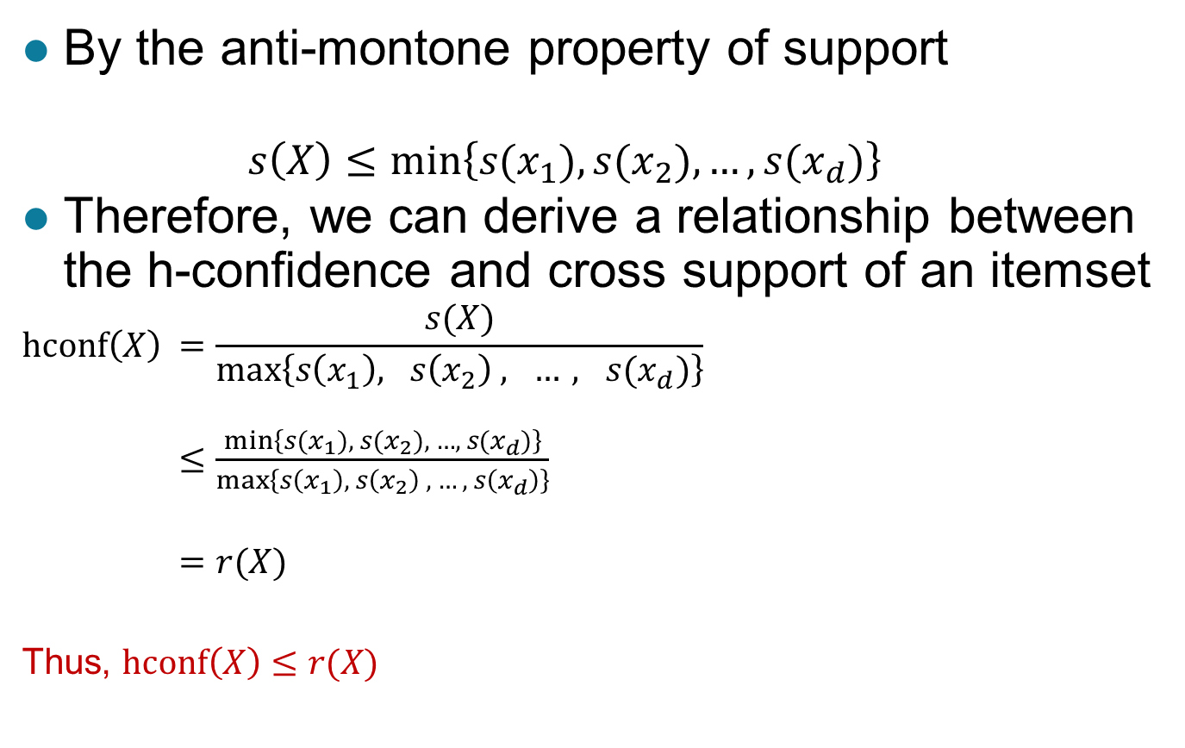
Cross Support and H-confidence
By the anti-montone property of support
  $$s\left(X\right)≤min\left\{s(x_{1}),{s(x}_{2}), …,{s(x}_{d})\right\}$$
Therefore, we can derive a relationship between the h-confidence and cross support of an itemset
$$hconf\left(X\right) =\frac{s(X)}{max⁡\left\{s\left(x_{1}\right), s\left(x_{2}\right) , …, s(x_{d})\right\}}$$
$≤\frac{min\left\{s(x_{1}),{ s(x}_{2}), …,{ s(x}_{d})\right\}}{\max\left\{s\left(x_{1}\right), s\left(x_{2}\right) , …, s\left(x_{d}\right)\right\}}$
$=r(X)$
Thus, $hconf\left(X\right)≤r(X)$

Slide 107
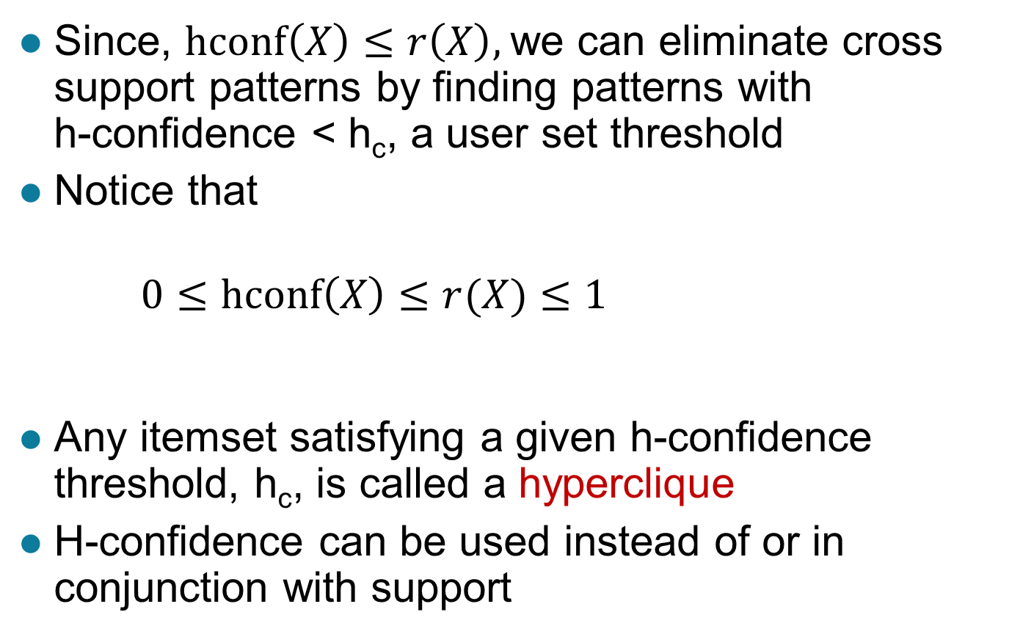
Cross Support and H-confidence …
Since, $hconf\left(X\right)≤r\left(X\right),$we can eliminate cross support patterns by finding patterns with
h-confidence < h_{c}, a user set threshold
Notice that
$0≤hconf\left(X\right)≤r(X)≤1$
Any itemset satisfying a given h-confidence threshold, h_{c}, is called a hyperclique
H-confidence can be used instead of or in conjunction with support

Slide 108
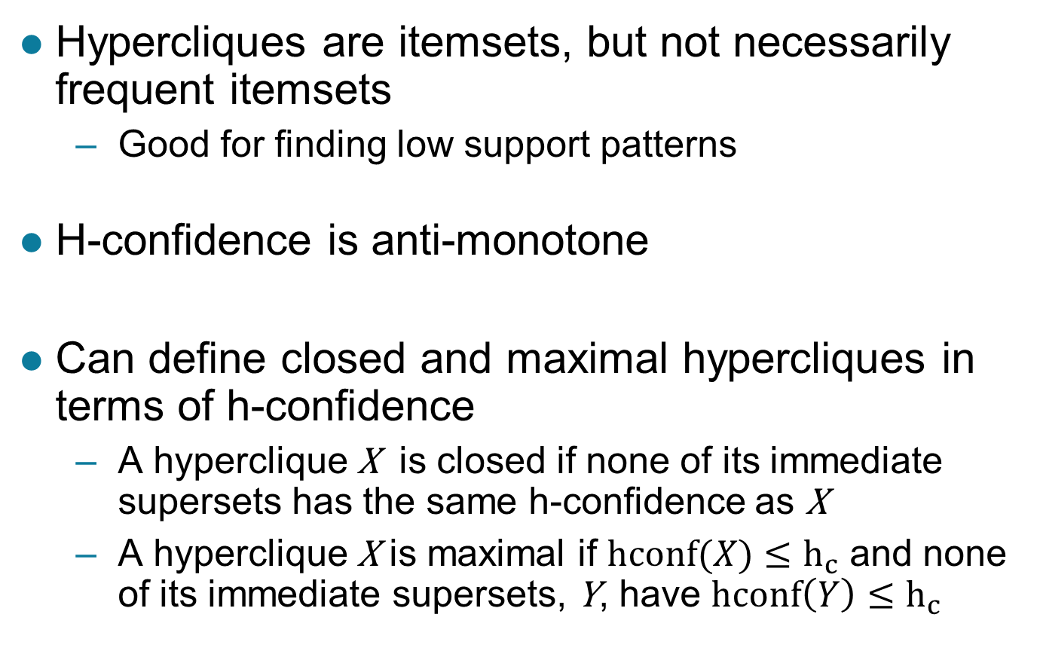
Properties of Hypercliques
Hypercliques are itemsets, but not necessarily frequent itemsets
  Good for finding low support patterns
H-confidence is anti-monotone
Can define closed and maximal hypercliques in terms of h-confidence
  A hyperclique X is closed if none of its immediate supersets has the same h-confidence as X
  A hyperclique X is maximal if $hconf(X)≤h_{c}$ and none of its immediate supersets, Y, have $hconf\left(Y\right)≤h_{c}$

Slide 109
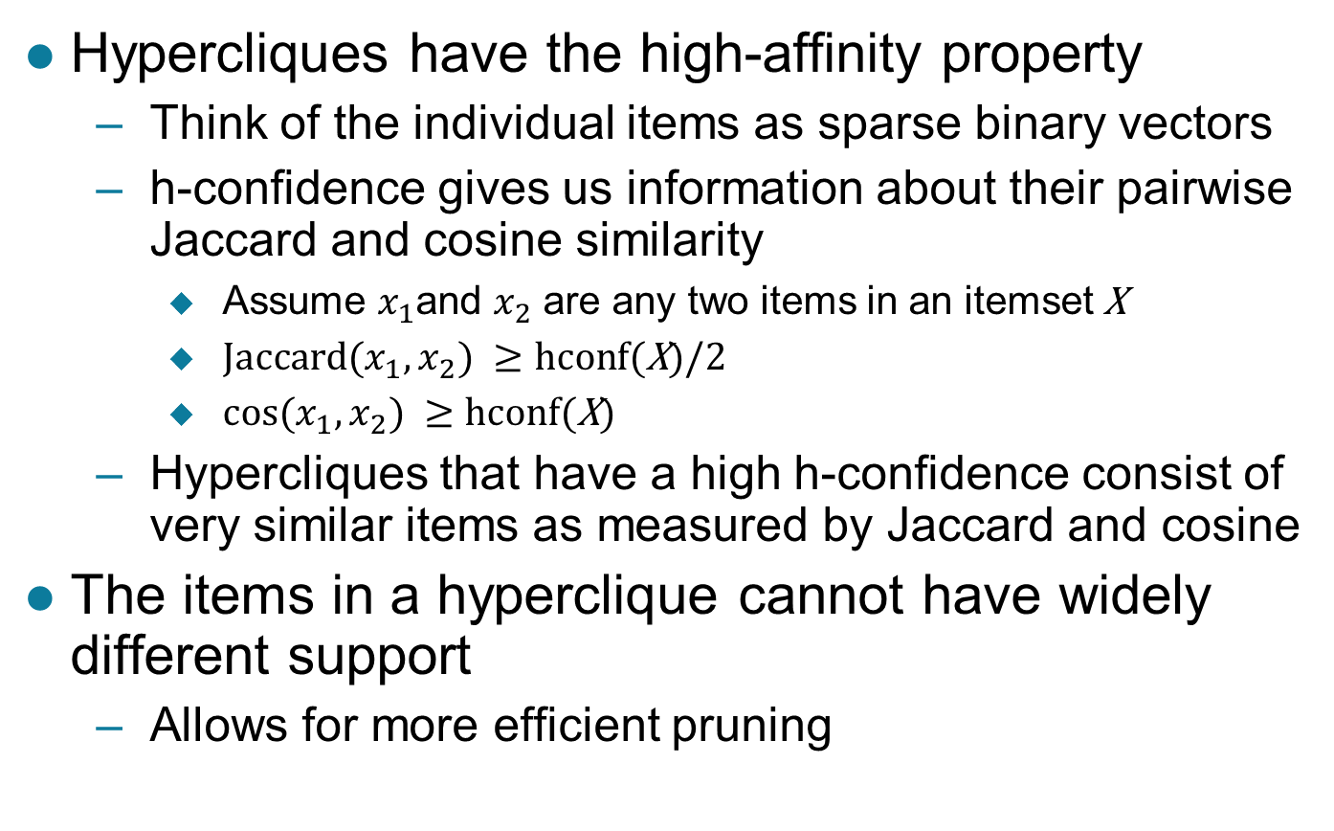
Properties of Hypercliques …
Hypercliques have the high-affinity property
  Think of the individual items as sparse binary vectors
  h-confidence gives us information about their pairwise Jaccard and cosine similarity
    Assume $x_{1}$and $x_{2}$ are any two items in an itemset X
    ${Jaccard⁡(x}_{1},x_{2}) ≥hcon$f(X)/2
    ${cos⁡(x}_{1},x_{2}) ≥hcon$f(X)
  Hypercliques that have a high h-confidence consist of very similar items as measured by Jaccard and cosine
The items in a hyperclique cannot have widely different support
  Allows for more efficient pruning

Slide 110
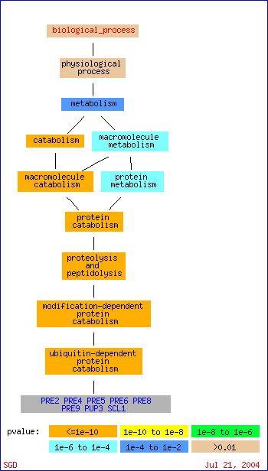
Example Applications of Hypercliques
Hypercliques are used to find strongly coherent groups of items
  Words that occur together in documents
  Proteins in a protein interaction network
In the figure at the right, a gene ontology hierarchy for biological process shows that the identified proteins in the hyperclique (PRE2, …, SCL1) perform the same function and are involved in the same biological process

Slide 111
Summary
Motivation
Frequent item generation
  Generate all itemsets whose support ≥ minsup; Apriori algorithm (F_{k-1} x F_{k,} F_{k-1} x F_{k-1})
  Support counting using Hash tree
Rule generation
Compact representation of frequent itemsets
  Maximal frequent itemsets
  Closed itemsets
Evaluation of association patterns
  Measures (properties: inversion, null addition and scaling)
  Simpson’s Paradox (contingency table)
  Skewed support distribution
Yuzhen Ye

