Slide 1
Data Mining
Evaluation and
Imbalanced Class Problem
Introduction to Data Mining, 2nd Edition
by
Tan, Steinbach, Karpatne, Kumar
Modified by Yuzhen Ye, Fall 2022

Slide 2
Accuracy
Most widely-used metric:
 | PREDICTED CLASS
ACTUAL CLASS |  | Class=Yes | Class=No
 | Class=Yes | a (TP) | b (FN)
 | Class=No | c (FP) | d (TN)

Slide 3
Confusion Matrix
Confusion Matrix:
 | PREDICTED CLASS
ACTUAL CLASS |  | Class=Yes | Class=No
 | Class=Yes | a | b
 | Class=No | c | d
a: TP (true positive)
b: FN (false negative)
c: FP (false positive)
d: TN (true negative)

Slide 4
Class Imbalance Problem
Lots of classification problems where the classes are skewed (more records from one class than another)
Credit card fraud
Intrusion detection
Defective products in manufacturing assembly line
COVID-19 test results on a random sample
Ye
Ref: https://www.kaggle.com/janiobachmann/credit-fraud-dealing-with-imbalanced-datasets

Slide 5
Challenges
Evaluation measures such as accuracy is not well-suited for imbalanced class
Detecting the rare class is like finding needle in a haystack

Slide 6
Problem with Accuracy
Consider a 2-class problem
Number of Class NO examples = 990
Number of Class YES examples = 10
If a model predicts everything to be class NO, accuracy is 990/1000 = 99 %
This is misleading because this trivial model does not detect any class YES example
Detecting the rare class is usually more interesting (e.g., frauds, intrusions, defects, etc)
 | PREDICTED CLASS
ACTUAL CLASS |  | Class=Yes | Class=No
 | Class=Yes | 0 | 10
 | Class=No | 0 | 990

Slide 7
Which model is better?
 | PREDICTED
ACTUAL |  | Class=Yes | Class=No
 | Class=Yes | 0 | 10
 | Class=No | 0 | 990
A
Accuracy: 99%
 | PREDICTED
ACTUAL |  | Class=Yes | Class=No
 | Class=Yes | 10 | 0
 | Class=No | 500 | 490
B
Accuracy: 50%

Slide 8
Which model is better?
 | PREDICTED
ACTUAL |  | Class=Yes | Class=No
 | Class=Yes | 5 | 5
 | Class=No | 0 | 990
A
B
 | PREDICTED
ACTUAL |  | Class=Yes | Class=No
 | Class=Yes | 10 | 0
 | Class=No | 500 | 490

Slide 9
Alternative Measures
 | PREDICTED CLASS
ACTUAL CLASS |  | Class=Yes | Class=No
 | Class=Yes | a | b
 | Class=No | c | d
F-measure (F1 score, F score): weighted harmonic mean of the precision and recall
Ye

Slide 10
Alternative Measures
 | PREDICTED CLASS
ACTUAL CLASS |  | Class=Yes | Class=No
 | Class=Yes | 10 | 0
 | Class=No | 10 | 980

Slide 11
Alternative Measures
 | PREDICTED CLASS
ACTUAL CLASS |  | Class=Yes | Class=No
 | Class=Yes | 10 | 0
 | Class=No | 10 | 980
 | PREDICTED CLASS
ACTUAL CLASS |  | Class=Yes | Class=No
 | Class=Yes | 1 | 9
 | Class=No | 0 | 990

Slide 12
Which of these classifiers is better?
 | PREDICTED CLASS
ACTUAL CLASS |  | Class=Yes | Class=No
 | Class=Yes | 40 | 10
 | Class=No | 10 | 40
A
B
 | PREDICTED CLASS
ACTUAL CLASS |  | Class=Yes | Class=No
 | Class=Yes | 40 | 10
 | Class=No | 1000 | 4000

Slide 13
Measures of Classification Performance
 | PREDICTED CLASS
ACTUAL CLASS |  | Yes | No
 | Yes | TP | FN
 | No | FP | TN
α is the probability that we reject the null hypothesis when it is true. This is a Type I error or a false positive (FP).
β is the probability that we accept the null hypothesis when it is false. This is a Type II error or a false negative (FN).

Slide 14
Alternative Measures
A | PREDICTED CLASS
ACTUAL CLASS |  | Class=Yes | Class=No
 | Class=Yes | 40 | 10
 | Class=No | 10 | 40
$$\text{Precision} (p) =0.8 \\ \text{TPR} = \text{Recall} (r)=0.8 \\ \text{FPR} =0.2 \\ \text{F}\text{−}\text{measure} (F)=0.8 \\ \text{Accuracy} =0.8$$
$$\frac{TPR}{FPR}=4$$
B | PREDICTED CLASS
ACTUAL CLASS |  | Class=Yes | Class=No
 | Class=Yes | 40 | 10
 | Class=No | 1000 | 4000
$$\text{Precision} (p) =0.038 \\ \text{TPR} = \text{Recall} (r)=0.8 \\ \text{FPR} =\text{ 0.2} \\ \text{F}\text{−}\text{measure} (F)=0.07 \\ \text{Accuracy} =0.8$$
$$\frac{TPR}{FPR}=4$$

Slide 15
Which of these classifiers is better?
A | PREDICTED CLASS
ACTUAL CLASS |  | Class=Yes | Class=No
 | Class=Yes | 10 | 40
 | Class=No | 10 | 40
B | PREDICTED CLASS
ACTUAL CLASS |  | Class=Yes | Class=No
 | Class=Yes | 25 | 25
 | Class=No | 25 | 25
C | PREDICTED CLASS
ACTUAL CLASS |  | Class=Yes | Class=No
 | Class=Yes | 40 | 10
 | Class=No | 40 | 10

Slide 16
ROC (Receiver Operating Characteristic)
A graphical approach for displaying trade-off between detection rate and false alarm rate
Developed in 1950s for signal detection theory to analyze noisy signals
ROC curve plots TPR against FPR
Performance of a model represented as a point in an ROC curve

Slide 17
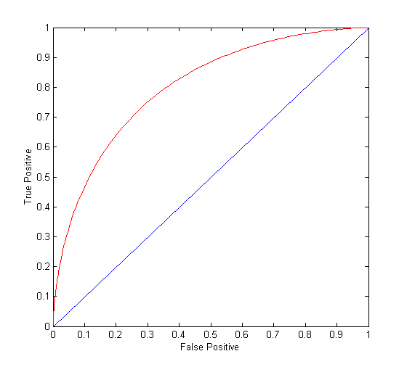
ROC Curve
(TPR,FPR):
(0,0): declare everything to be negative class
(1,1): declare everything to be positive class
(1,0): ideal
Diagonal line:
Random guessing
Below diagonal line:
prediction is opposite of the true class

Slide 18
ROC (Receiver Operating Characteristic)
To draw ROC curve, classifier must produce continuous-valued output
Outputs are used to rank test records, from the most likely positive class record to the least likely positive class record
By using different thresholds on this value, we can create different variations of the classifier with TPR/FPR tradeoffs
Many classifiers produce only discrete outputs (i.e., predicted class)
How to get continuous-valued outputs?
Decision trees, rule-based classifiers, neural networks, Bayesian classifiers, k-nearest neighbors, SVM

Slide 19
Example: Decision Trees
Decision Tree
Continuous-valued outputs

Slide 20
ROC Curve Example

Slide 21
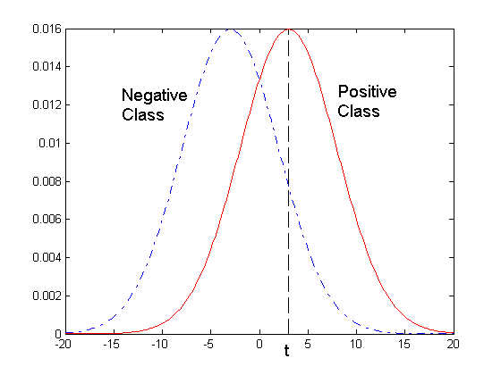
ROC Curve Example
- 1-dimensional data set containing 2 classes (positive and negative)
- Any points located at x > t is classified as positive
At threshold t:
TPR=0.5, FNR=0.5, FPR=0.12, TNR=0.88

Slide 22
How to Construct an ROC curve
Use a classifier that produces a continuous-valued score for each instance
The more likely it is for the instance to be in the + class, the higher the score
Sort the instances in decreasing order according to the score
Apply a threshold at each unique value of the score
Count the number of TP, FP, TN, FN at each threshold
TPR = TP/(TP+FN)
FPR = FP/(FP + TN)
Instance | Score | True Class
1 | 0.95 | +
2 | 0.93 | +
3 | 0.87 | -
4 | 0.85 | -
5 | 0.85 | -
6 | 0.85 | +
7 | 0.76 | -
8 | 0.53 | +
9 | 0.43 | -
10 | 0.25 | +

Slide 23
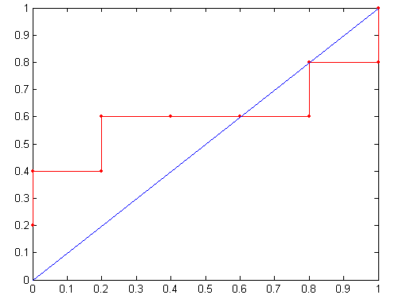
How to construct an ROC curve
Threshold >=
ROC Curve:

Slide 24
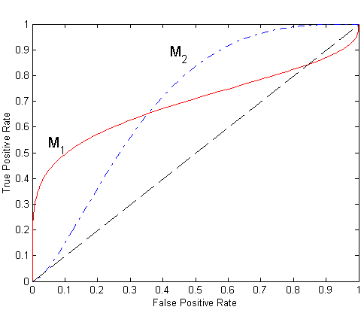
Using ROC for Model Comparison
No model consistently outperforms the other
M₁ is better for small FPR
M₂ is better for large FPR
Area Under the ROC curve (AUC)
Ideal:
Area = 1
Random guess:
Area = 0.5

Slide 25
Which measure to choose?
Many measures exists, but none of them may be ideal in all situations
Random classifiers can have high value for many of these measures
TPR/FPR provides important information but may not be sufficient by itself in many practical scenarios
Given two classifiers, sometimes you can tell that one of them is strictly better than the other
C1 is strictly better than C2 if C1 has strictly better TPR and FPR relative to C2 (or same TPR and better FPR, and vice versa)
Even if C1 is strictly better than C2, C1’s F-value can be worse than C2’s if they are evaluated on data sets with different imbalances
Classifier C1 can be better or worse than C2 depending on the scenario at hand (class imbalance, importance of TP vs FP, cost/time tradeoffs)
Ye

Slide 26
Which Classifier is better?
T1 | PREDICTED CLASS
ACTUAL CLASS |  | Class=Yes | Class=No
 | Class=Yes | 50 | 50
 | Class=No | 1 | 99
T2 | PREDICTED CLASS
ACTUAL CLASS |  | Class=Yes | Class=No
 | Class=Yes | 99 | 1
 | Class=No | 10 | 90
T3 | PREDICTED CLASS
ACTUAL CLASS |  | Class=Yes | Class=No
 | Class=Yes | 99 | 1
 | Class=No | 1 | 99
Ye

Slide 27
Which Classifier is better? Medium Skew case
T1 | PREDICTED CLASS
ACTUAL CLASS |  | Class=Yes | Class=No
 | Class=Yes | 50 | 50
 | Class=No | 10 | 990
T2 | PREDICTED CLASS
ACTUAL CLASS |  | Class=Yes | Class=No
 | Class=Yes | 99 | 1
 | Class=No | 100 | 900
T3 | PREDICTED CLASS
ACTUAL CLASS |  | Class=Yes | Class=No
 | Class=Yes | 99 | 1
 | Class=No | 10 | 990
Ye

Slide 28
Which Classifier is better? High Skew case
T1 | PREDICTED CLASS
ACTUAL CLASS |  | Class=Yes | Class=No
 | Class=Yes | 50 | 50
 | Class=No | 100 | 9900
T2 | PREDICTED CLASS
ACTUAL CLASS |  | Class=Yes | Class=No
 | Class=Yes | 99 | 1
 | Class=No | 1000 | 9000
T3 | PREDICTED CLASS
ACTUAL CLASS |  | Class=Yes | Class=No
 | Class=Yes | 99 | 1
 | Class=No | 100 | 9900
Ye

Slide 29
Handling Class Imbalanced Problem
Sampling-based approaches
Undersample the majority class
Oversample the rare class
Cost-sensitive classification
Cost-sensitive classification treats the different misclassifications differently
Misclassifying rare class as majority class is more expensive than misclassifying majority as rare class

Slide 30
Sampling-based Approaches
Modify the distribution of training data so that rare class is well-represented in training set
Undersample the majority class
Oversample the rare class
Advantages and disadvantages
Easy to realize
Disadvantage: prone to overfitting (over-sampling); loss of useful information (under-sampling)

Slide 31
Cost-sensitive Classification: Cost Matrix
 | PREDICTED CLASS
ACTUAL CLASS |  | Class=Yes | Class=No
 | Class=Yes | f(Yes, Yes) | f(Yes,No)
 | Class=No | f(No, Yes) | f(No, No)
C(i,j): Cost of misclassifying class i example as class j
Cost Matrix | PREDICTED CLASS
ACTUAL CLASS | C(i, j) | Class=Yes | Class=No
 | Class=Yes | C(Yes, Yes) | C(Yes, No)
 | Class=No | C(No, Yes) | C(No, No)

Slide 32
Computing Cost of Classification
Cost Matrix | PREDICTED CLASS
ACTUAL CLASS | C(i,j) | + | -
 | + | -1 | 100
 | - | 1 | 0
Model M₁ | PREDICTED CLASS
ACTUAL CLASS |  | + | -
 | + | 150 | 40
 | - | 60 | 250
Model M₂ | PREDICTED CLASS
ACTUAL CLASS |  | + | -
 | + | 250 | 45
 | - | 5 | 200
Accuracy = 80%
Cost = 3910
Accuracy = 90%
Cost = 4255

Slide 33
Cost Sensitive Classification
Cost insensitive (cost-blind) classification
Given a test record x:
Compute p(i|x) for each class i
Decision rule: classify node as class k if
For 2-class, classify x as + if p(+|x) > p(-|x)
This decision rule implicitly assumes that C(+|+) = C(-|-) = 0 and C(+|-) = C(-|+)
Ye

Slide 34
Cost Sensitive Classification
General decision rule:
Classify test record x as class k if
2-class:
Cost(+) = p(+|x) C(+,+) + p(-|x) C(-,+)
Cost(-) = p(+|x) C(+,-) + p(-|x) C(-,-)
Decision rule: classify x as + if Cost(+) < Cost(-)
if C(+,+) = C(-,-) = 0:

Slide 35
Cost Sensitive Classification
The values of the cost matrix must be carefully defined. The choice of costs will determine the quality the model.
For the credit card fraud classification, the costs for a false positive might be the monetary cost of follow-up with the customer to the company and the cost of a false negative might be the cost of the fraudulent transaction to the company.
For disease diagnosis, the costs of a false positive might be related to the monetary cost of extra tests; but how about the costs of a false negative?
Ye

Slide 36
Summary
Imbalanced class problems are common
Examine the class distributions first (EDA)
Accuracy isn’t good metric for classification problem with imbalanced classes; consider alternative metrics
Consider approaches that can deal with imbalanced classes.

