Slide 1
Curse of dimensionality & dimensionality reduction
Yuzhen Ye
Luddy School of Informatics, Computing and Computing
Indiana University, Bloomington
Fall 2021

Slide 2
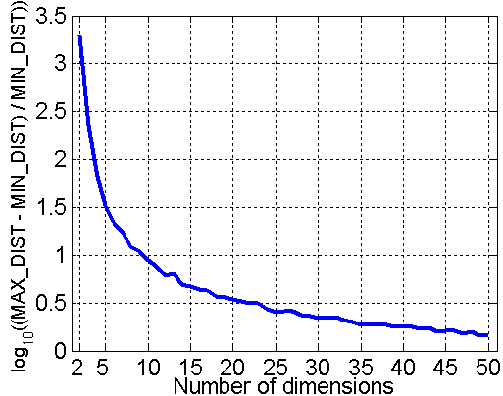
Curse of Dimensionality
When dimensionality increases, data becomes increasingly sparse in the space that it occupies
Definitions of density and distance between points, which are critical for clustering and outlier detection, become less meaningful
Randomly generate 500 points
Compute difference between max and min distance between any pair of points

Slide 3
PCA (Principle Component Analysis)
The goal of PCA is to find a new set of dimensions (attributes) that better captures the variability of the data. More specifically, the first dimension is chosen to capture as much of the variability as possible. The second dimension is orthogonal to the first, and, subject to that constraint, captures as much of the remaining variability as possible, and so on.
In other words, PCA is to find a transformation of the data that satisfies the following properties:
  1. Each pair of new attributes has 0 covariance (for distinct attributes).
  2. The attributes are ordered with respect to how much of the variance of the data each attribute captures.
  3. The first attribute captures as much of the variance of the data as possible.
  4. Subject to the orthogonality requirement, each successive attribute captures as much of the remaining variance as possible.

Slide 4
Solve the characteristic equation
Four points in 2-D space
Eigenvalues:
Derive eigenvectors
Eigenvectors:
Axes rotated 45 degrees counterclockwise
Matrix of eigenvectors
Project the data onto a 1D space
(dimensionality reduction)
Project the data onto the new space
The points in the new coordinate system
Given a matrix M, PCA finds eigenpairs of M^{T}M

Slide 5
Querying using concepts.
For example, a new user Quincy has only seen one movie, The Matrix, and he rated it 4. Quincy can be represented as q=[4,0,0,0,0], and be mapped onto the “concept space” by multiplying q by the matrix V of the decomposition: qV=[2.32,0], meaning that Quincy has high interest in science-fiction, but not romance.
To find his actual interest in movies, just need to map his representation in the concept space back into movie space by multiplying [2.31,0] by V^{T}. The product is [1.33,1.33,1.33,0,0].
SVD
SVD defines a small number of hidden “concepts” that connect the row and column. In this case, the concepts can be science-fiction and romance. U connects people to concepts, V connects concepts to movies, and the middle diagonal gives the strength of each of the concepts.

Slide 6
SVD algorithms
Problem: Given input matrix M (of m by n, and assume m ≥ n), output k (k ≤n) singular values and corresponding singular vectors
The idea is to find square roots of eigenvalues of M^{T}M without actually computing M^{T}M.
Two categories
  Algorithms that first reduce the matrix to bidiagonal form (e.g., Householder reduction, QR algorithm), and then compute k singular values as well as the corresponding singular vectors of the bidiagonal matrix.
  Algorithms that iterate directly on the input matrix : Jacobi method for symmetric matrices and other methods analogous to Jacobi method for nonsymmetric matrices
References
  Computation of the singular value decomposition http://www.cs.utexas.edu/users/inderjit/public_papers/HLA_SVD.pdf
  Jacobi eigenvalue algorithm (an iterative method) for symmetric matrices http://fourier.eng.hmc.edu/e176/lectures/ch1/node1.html

