Slide 1
Convolutional Neural Networks
Yuzhen Ye
Luddy School of Informatics, Computing, and Engineering
Indiana University, Bloomington

Slide 2
Contents
CNN basics
CNN for visual recognition (to explain the concept of convolution)
CNN for bioinformatics

Slide 3
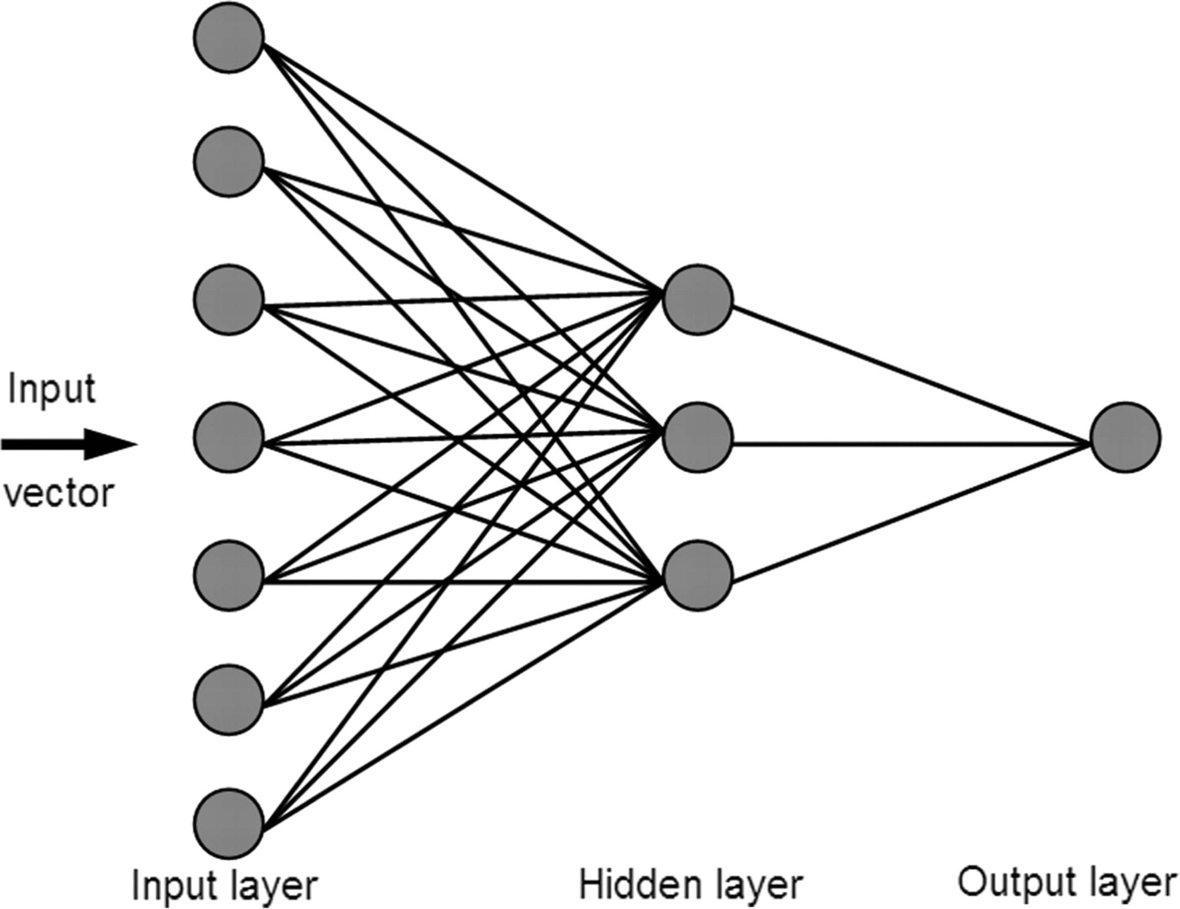
A Beginner's Guide To Understanding CNN
Neural Networks with Convolution layers
Ref 1: http://cs231n.stanford.edu
Ref 2: https://adeshpande3.github.io/adeshpande3.github.io/A-Beginner%27s-Guide-To-Understanding-Convolutional-Neural-Networks/

Slide 5
Moving Average In 2D
0 | 0 | 0 | 0 | 0 | 0 | 0 | 0 | 0 | 0
0 | 0 | 0 | 0 | 0 | 0 | 0 | 0 | 0 | 0
0 | 0 | 0 | 90 | 90 | 90 | 90 | 90 | 0 | 0
0 | 0 | 0 | 90 | 90 | 90 | 90 | 90 | 0 | 0
0 | 0 | 0 | 90 | 90 | 90 | 90 | 90 | 0 | 0
0 | 0 | 0 | 90 | 0 | 90 | 90 | 90 | 0 | 0
0 | 0 | 0 | 90 | 90 | 90 | 90 | 90 | 0 | 0
0 | 0 | 0 | 0 | 0 | 0 | 0 | 0 | 0 | 0
0 | 0 | 90 | 0 | 0 | 0 | 0 | 0 | 0 | 0
0 | 0 | 0 | 0 | 0 | 0 | 0 | 0 | 0 | 0
 | 0 | 10 | 20 | 30 | 30 | 30 | 20 | 10
 | 0 | 20 | 40 | 60 | 60 | 60 | 40 | 20
 | 0 | 30 | 60 | 90 | 90 | 90 | 60 | 30
 | 0 | 30 | 50 | 80 | 80 | 90 | 60 | 30
 | 0 | 30 | 50 | 80 | 80 | 90 | 60 | 30
 | 0 | 20 | 30 | 50 | 50 | 60 | 40 | 20
 | 10 | 20 | 30 | 30 | 30 | 30 | 20 | 10
 | 10 | 10 | 10 | 0 | 0 | 0 | 0 | 0
Slide credit: Steve Seitz

Slide 6
Correlation filtering
Say the averaging window size is 2k+1 x 2k+1:
Attribute uniform weight to each pixel
Loop over all pixels in neighborhood around image pixel f[i,j]
Now generalize to allow different weights depending on neighboring pixel’s relative position:
Non-uniform weights
Slide adapted from Kristen Grauman

Slide 7
Correlation filtering
This is called cross-correlation, denoted
Filtering an image: replace each pixel with a linear combination of its neighbors.
The filter “kernel” or “mask” h[u,v] is the prescription for the weights in the linear combination.
Slide credit: Michael S. Ryoo
Notes:
Linear filtering: weighted combination of pixels in a small neighborhood

Slide 8
Averaging filter
What values belong in the kernel h for the moving average example?
0 | 0 | 0 | 0 | 0 | 0 | 0 | 0 | 0 | 0
0 | 0 | 0 | 0 | 0 | 0 | 0 | 0 | 0 | 0
0 | 0 | 0 | 90 | 90 | 90 | 90 | 90 | 0 | 0
0 | 0 | 0 | 90 | 90 | 90 | 90 | 90 | 0 | 0
0 | 0 | 0 | 90 | 90 | 90 | 90 | 90 | 0 | 0
0 | 0 | 0 | 90 | 0 | 90 | 90 | 90 | 0 | 0
0 | 0 | 0 | 90 | 90 | 90 | 90 | 90 | 0 | 0
0 | 0 | 0 | 0 | 0 | 0 | 0 | 0 | 0 | 0
0 | 0 | 90 | 0 | 0 | 0 | 0 | 0 | 0 | 0
0 | 0 | 0 | 0 | 0 | 0 | 0 | 0 | 0 | 0
 | 0 | 10 | 20 | 30 | 30
1
1
1
1
?
1
1
1
1
1
“box filter”
Slide credit: Michael S. Ryoo

Slide 9
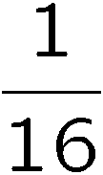
Gaussian filter
What if we want nearest neighboring pixels to have the most influence on the output?
Removes high-frequency components from the image (“low-pass filter”).
This kernel is an approximation of a 2d Gaussian function:
0 | 0 | 0 | 0 | 0 | 0 | 0 | 0 | 0 | 0
0 | 0 | 0 | 0 | 0 | 0 | 0 | 0 | 0 | 0
0 | 0 | 0 | 90 | 90 | 90 | 90 | 90 | 0 | 0
0 | 0 | 0 | 90 | 90 | 90 | 90 | 90 | 0 | 0
0 | 0 | 0 | 90 | 90 | 90 | 90 | 90 | 0 | 0
0 | 0 | 0 | 90 | 0 | 90 | 90 | 90 | 0 | 0
0 | 0 | 0 | 90 | 90 | 90 | 90 | 90 | 0 | 0
0 | 0 | 0 | 0 | 0 | 0 | 0 | 0 | 0 | 0
0 | 0 | 90 | 0 | 0 | 0 | 0 | 0 | 0 | 0
0 | 0 | 0 | 0 | 0 | 0 | 0 | 0 | 0 | 0
1 | 2 | 1
2 | 4 | 2
1 | 2 | 1
Slide credit: Steve Seitz

Slide 10
Convolution
Convolution is a simple mathematical operation which is fundamental to many common image processing operators.
Convolution is performed by sliding the kernel over the image, generally starting at the top left corner, so as to move the kernel through all the positions where the kernel fits entirely within the boundaries of the image.
Convolution:
Flip the filter in both dimensions (bottom to top, right to left)
Then apply cross-correlation
h
f
Notation for convolution operator
Slide credit: Michael S. Ryoo

Slide 11
Convolution vs. correlation
Convolution
Cross-correlation
Slide adapted from Kristen Grauman

Slide 12
Convolution or correlation
“The Convolutional operation widely used in CNN is a misnomer. The operation that is used is strictly speaking a correlation instead of convolution.”
Ref: https://towardsdatascience.com/convolution-vs-correlation-af868b6b4fb5

Slide 13
Derivatives and edges
An edge is a place of rapid change in the image intensity function.
intensity function (along horizontal scanline)
image
first derivative
edges correspond to extrema of derivative
Slide credit: Svetlana Lazebnik

Slide 14
Derivatives with convolution
For 2D function, f(x,y), the partial derivative is:
For discrete data, we can approximate using finite differences:
To implement above as convolution, what would be the associated filter?
Slide credit: Kristen Grauman

Slide 15
Partial derivatives of an image
?
-1 1
1 -1
-1 1
or
Which shows changes with respect to x?
Slide credit: Kristen Grauman
(showing filters for correlation)

Slide 16
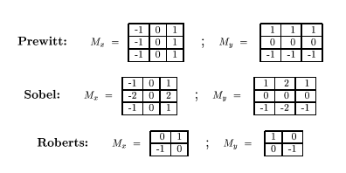
Filters as feature (edge) detectors
sobel filter
Slide credit: Kristen Grauman
http://homepages.inf.ed.ac.uk/rbf/HIPR2/index.htm

Slide 17
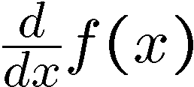
Effects of noise
Consider a single row or column of the image
Plotting intensity as a function of position gives a signal
Where is the edge?
Slide credit: Steve Seitz

Slide 18
Effects of noise
Difference filters respond strongly to noise
Image noise results in pixels that look very different from their neighbors
Generally, the larger the noise the stronger the response
What can we do about it?
Slide credit: Michael S. Ryoo

Slide 19
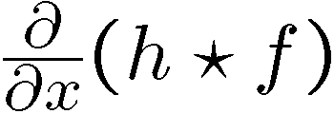
Solution: smooth first
Where is the edge?
Look for peaks in
Slide credit: Kristen Grauman

Slide 20
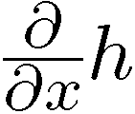
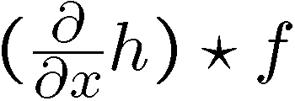
Derivative theorem of convolution
Differentiation property of convolution.
Slide credit: Steve Seitz

Slide 21
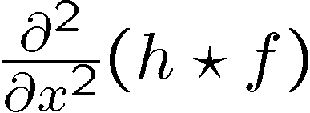
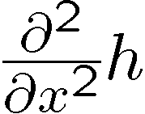
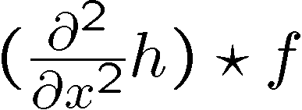
Laplacian of Gaussian
Consider
Laplacian of Gaussian
operator
Where is the edge?
Zero-crossings of bottom graph
Slide credit: Steve Seitz
Notes:
Second order derivative

Slide 22
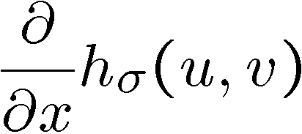
2D edge detection filters
Laplacian of Gaussian
Gaussian
derivative of Gaussian
is the Laplacian operator:
Two commonly used discrete approximations to the Laplacian filter
Slide credit: Steve Seitz
Notes:
22
Second derivative can be more sensitive to noise

Slide 26
CNN for biological image analysis
http://onlinelibrary.wiley.com/doi/10.15252/msb.20156651/full#msb156651-fig-0002

Slide 27
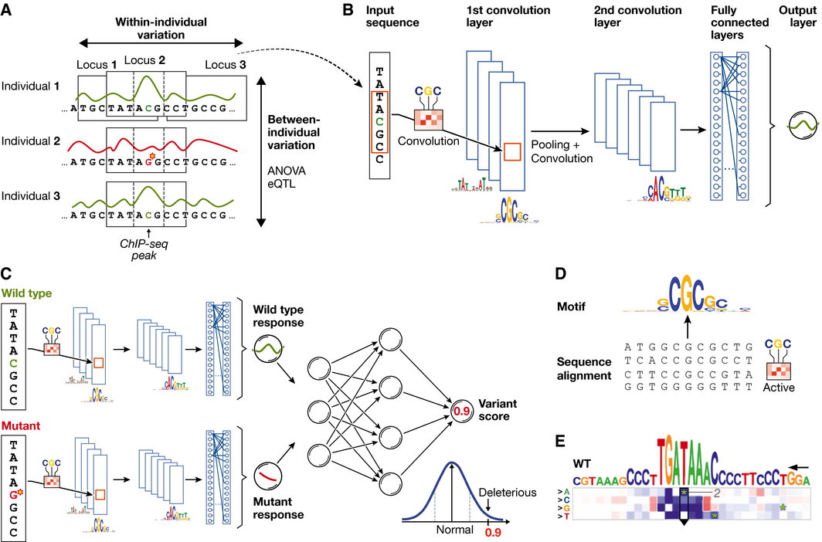
CNN for predicting molecular traits
Input data: one-dimensional genomic sequences with one channel per nucleotide
[Visual recognition:
2D-image with three color channels]
Molecular Systems Biology Volume 12, Issue 7, 29 JUL 2016 DOI: 10.15252/msb.20156651 http://onlinelibrary.wiley.com/doi/10.15252/msb.20156651/full#msb156651-fig-0002
Notes:
(A) DNA sequence and the molecular response variable along the genome for three individuals. Conventional approaches in regulatory genomics consider variations between individuals, whereas deep learning allows exploiting intra‐individual variations by tiling the genome into sequence DNA windows centred on individual traits, resulting in large training data sets from a single sample. (B) One‐dimensional convolutional neural network for predicting a molecular trait from the raw DNA sequence in a window. Filters of the first convolutional layer (example shown on the edge) scan for motifs in the input sequence. Subsequent pooling reduces the input dimension, and additional convolutional layers can model interactions between motifs in the previous layer. (C) Response variable predicted by the neural network shown in (B) for a wild‐type and mutant sequence is used as input to an additional neural network that predicts a variant score and allows to discriminate normal from deleterious variants. (D) Visualization of a convolutional filter by aligning genetic sequences that maximally activate the filter and creating a sequence motif. (E) Mutation map of a sequence window. Rows correspond to the four possible base pair substitutions, columns to sequence positions. The predicted impact of any sequence change is colour‐coded. Letters on top denote the wild‐type sequence with the height of each nucleotide denoting the maximum effect across mutations (figure panel adapted from Alipanahi et al, ).
IF THIS IMAGE HAS BEEN PROVIDED BY OR IS OWNED BY A THIRD PARTY, AS INDICATED IN THE CAPTION LINE, THEN FURTHER PERMISSION MAY BE NEEDED BEFORE ANY FURTHER USE. PLEASE CONTACT WILEY'S PERMISSIONS DEPARTMENT ON PERMISSIONS@WILEY.COM OR USE THE RIGHTSLINK SERVICE BY CLICKING ON THE 'REQUEST PERMISSIONS' LINK ACCOMPANYING THIS ARTICLE. WILEY OR AUTHOR OWNED IMAGES MAY BE USED FOR NON-COMMERCIAL PURPOSES, SUBJECT TO PROPER CITATION OF THE ARTICLE, AUTHOR, AND PUBLISHER.

