Slide 1
Neural Networks (Some Practical Issues)
Yuzhen Ye
Luddy School of Informatics, Computing, and Engineering
Indiana University, Bloomington

Slide 2
ANN: Regularization
In ANNs the risk of low generalization is mainly attributed to over-training of the model, leading to over-fitting and subsequently poor predictive performance during independent validation.
Regularization is to add a regularization term to the cost/error function to prevent the coefficients to fit training data so perfectly
Approaches
Weight decay
Resampling and early stopping
Bayesian regularization
Cross validation
Dropout

Slide 3
L1 and L2 regularization
L2 is the sum of the square of the weights
L1 is just the sum of the weights
Add L2
Machine Learning: Tom Mitchell

Slide 4
Dropout: A Simple Way to Prevent Neural Networks from Overfitting
Ref: https://www.cs.toronto.edu/~rsalakhu/papers/srivastava14a.pdf

Slide 5
Convergence and local minima
Common heuristics to alleviate the problem of local minima
Add a momentum term to the weight-update rule
Use stochastic gradient descent rather than true gradient descent: the different error surfaces typically will have different local minima, making it less likely that the process gets stuck in any one of them.
Gradient descent: computes weight updates after summing over all the training examples
Stochastic gradient descent: computes weight updates for each individual example.
Initialize each network with different random weights. Select the one with the best performance over a separate validate data set; or retain all networks and treat them as a “committee” of networks, whose output is the average of the individual network outputs.

Slide 6
Tracing the performance of ANN
Quantities to monitor during training of a neural network: loss, accuracy
Epoch measures how many times every example has been seen during training in expectation (e.g. one epoch means that every example has been seen once)
Ref: http://cs231n.github.io/neural-networks-3/

Slide 7
Use ANN in Keras: Fashion MNIST
model = keras.Sequential([ keras.layers.Flatten(input_shape=(28, 28)), keras.layers.Dense(128, activation='relu'), keras.layers.Dense(10) ])
First layer, transform 2D-array (28x28) into 1D
Second layer with 128 neurons, fully connected, using ReLU
Output layer with 10 neurons, each containing a logit score that indicates the current image belongs to one of the 10 classes.
model.compile(optimizer='adam', loss=tf.keras.losses.SparseCategoricalCrossentropy(from_logits=True), metrics=['accuracy'])
model.fit(train_images, train_labels, epochs=10)
Source: https://www.tensorflow.org/tutorials/keras/classification

Slide 8
Loss functions
A loss function quantifies the loss of a model (in other words, it maps the set of parameter values for the network onto a scalar value that indicates how well those parameter accomplish the task the network is intended to do. The loss of the model can then be used to update the weights of the network to reduce the loss on the next evaluation.
mean_squared_error
the mean of squared differences between actual(target) and predicted values
keras.losses.mean_squared_error(y_true, y_pred)
Used when the output is a number (e.g., house price predicted based on house data)
mean_absolute_error
mean_absolute_percentage_error
mean_squared_logarithmic_error
categorical_crossentropy
used in multi-class classification
there must be the same number of output nodes as the classes.
the final layer output passed through a softmax activation
See more existing loss functions (https://keras.io/losses/)
It is also possible to customize loss functions
actual: one-hot encoded value
predicted: predicted probabilities for each class.
Add a small number to avoid log(0)
Ref

Slide 9
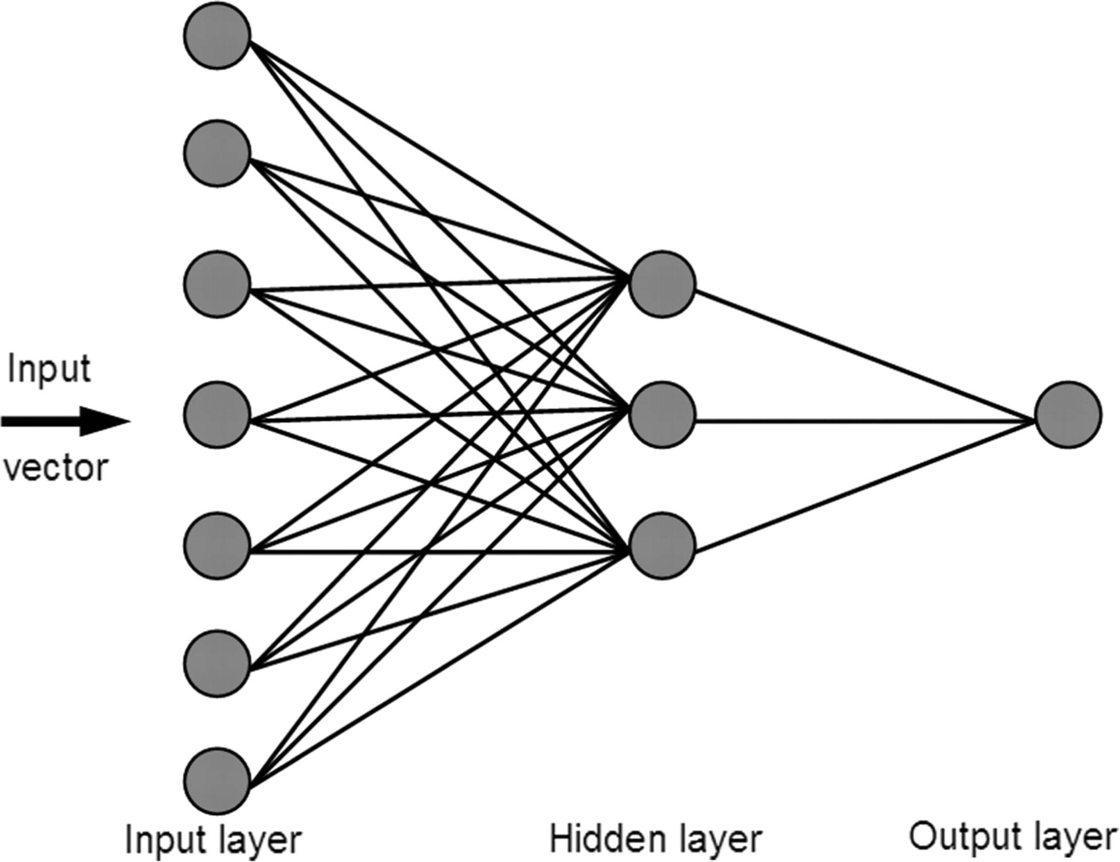
From ANN to DNN, CNN etc
DNN: ANN with multiple layers between the input and output layers
CNN: Neural Networks with Convolution layers
RNN: recurrent neural network
LSTM: a special kind of RNN, capable of learning long-term dependencies
Ref 1: http://cs231n.stanford.edu
Ref 2: https://adeshpande3.github.io/adeshpande3.github.io/A-Beginner%27s-Guide-To-Understanding-Convolutional-Neural-Networks/

